Slide 1
Perimeter Exploration:
Dark Matter
Notes:
The main idea of this presentation is subversive physics. Many of these topics include connections to modern physics using classical activities.

Slide 2
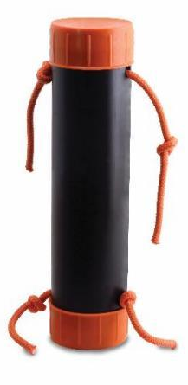
Black Box
Building and Revising Scientific Models
Notes:
(About 10-15 min) Using the Black Box:
-Demonstrate the box by pulling several strings
-Ask the participants to draw what they think is happening using their whiteboards
-Ask 3-4 people with different ideas to come up at the same time. Test their models, if they work, give their boards a checkmark (within a degree of error, they ALL should work)
-Explain how nature can be described using models. We observe the universe, and build models to explain and predict behaviour.
-We test these model/theories until they are proven wrong. At that point, they need to be thrown out or revised.
- Eureka moment for students: Several, different models are capable of describing the same thing.
-Shake the Black Box. Show how some of the drawn models fail, while others survive.
-It is important to build vocabulary such as “predict, observe, model, etc.”

Slide 3
Uniform Circular Motion
Predict
Observe
Explain
How are mass and speed connected in circular motion?
speed
mass
Notes:
Uniform Circular Motion (5-7 min)
-Begin by asking the participants to use their white boards to predict what happens to velocity as mass changes (PEOE). Ask them to explain their reasoning using diagrams, metaphors, etc.
-After the PEOE, get the students to complete the lab portion (18-20 min) of the activity. Make sure the participants get to the point where they must predict the weight of the unknown mass.
-Use some time at the end to explain the effectiveness of group work, and the ability to collaborate, communicate, and strategize.

Slide 4
Uniform Circular Motion
Objective:
Determine the mass of an unknown item.
Collect data and plot a graph of speed² vs mass (on your white boards).
Using your plot, determine the mass of the unknown object.
**Please note any discussions, assumptions, or decisions your group made when attempting to construct the plot or measure the unknown mass, on your white board.

Slide 5
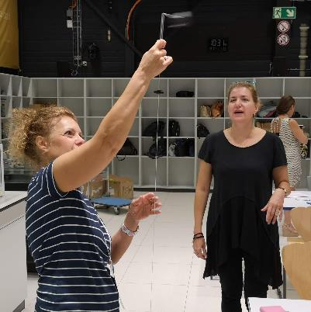
Circular Motion Lab
Collaborative version:
Set radius = 60 cm
Use assigned mass
Record the period for 10 orbits
Compare results
Report results

Slide 6
Circular Motion Lab Results
# of washers | 10 Orbits (s)
8 | 7.29
10 | 7.02
12 | 6.43
14 | 6.02
16 | 5.42
How is the orbital speed related to the mass of the washers?

Slide 7
Circular Motion Lab Results

Slide 8
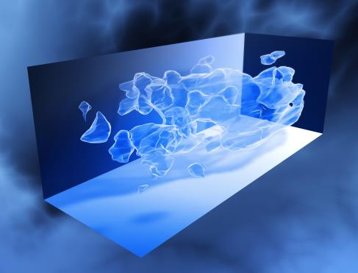
Uniform Circular Motion
Theory vs Observation → Connection to Dark Matter

Slide 9
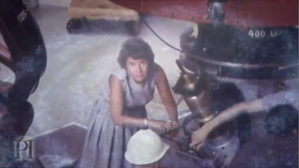
Uniform Circular Motion
Vera Rubin’s
Discovery
“Science progresses best when observations force us to alter our preconceptions.”
Notes:
The remainder of this section are video clips to use. Choose the ones that will complement your presentation. Ensure that the connections are made between circular motion, and dark matter.

Slide 10
Uniform Circular Motion
Download the video at: https://resources.perimeterinstitute.ca
Notes:
We’ll show you a clip from the video that highlights just what Rubin observed. She looked at Andromeda and saw stars mov

Slide 11
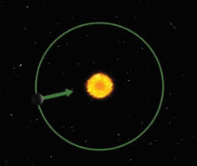
Uniform Circular Motion
Orbital speed depends on the mass of the central object.
Notes:
We can scale up what we found with the circular motion apparatus to a galaxy. The principles are the same.

Slide 12
Extend this to galaxies

Slide 13
Uniform Circular Motion
Download the video at: https://resources.perimeterinstitute.ca
Notes:
Video

Slide 14
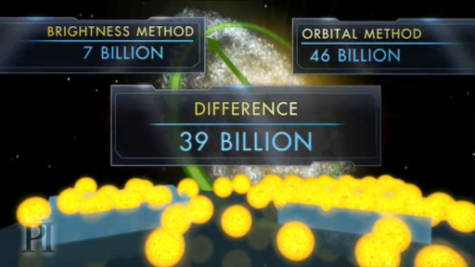
Triangulum is More Massive Than it Looks

Slide 15
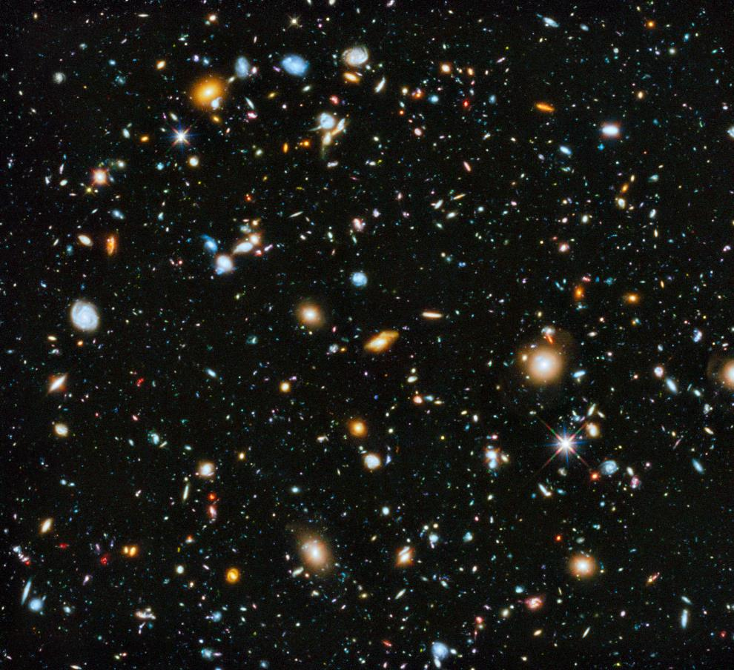
The same discrepancy happens in most galaxies
Notes:
What’s going on? You know the answer is dark matter. But what would your students make of this?

Slide 16
What’s happening?
Notes:
What’s going on? You know the answer is dark matter. But what would your students make of this?

Slide 17
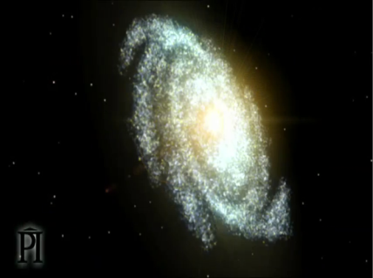
Old View

Slide 18
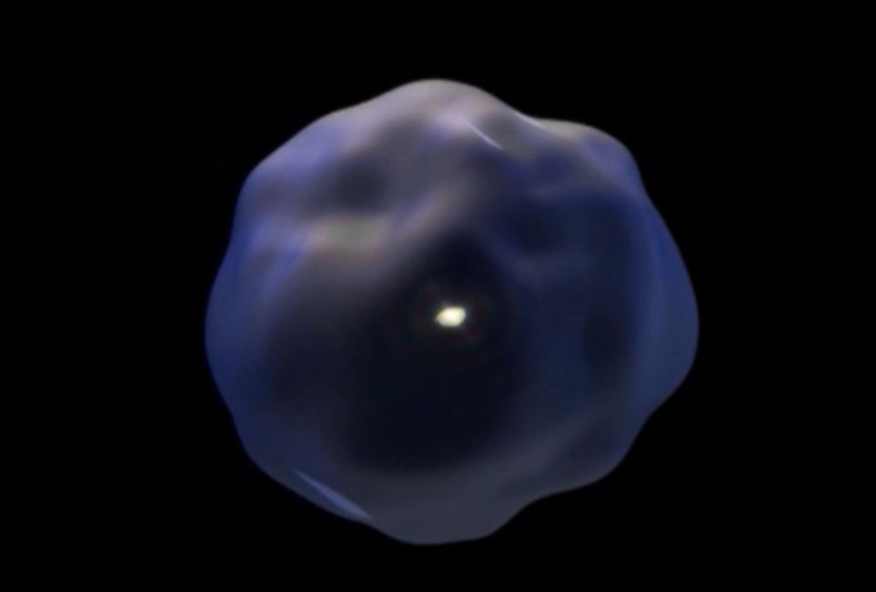
New View
Notes:
We now know that surrounding the stars in the centre of the galaxy is a blob of dark matter that extends ten times farther our & has 10 times more mass.
The stars are just the tip of the iceberg.
This is a radical change. On a par with realizing the Earth orbits around the Sun. Arguably, the greatest advance in our understanding of the universe in the last half a century.

Slide 19
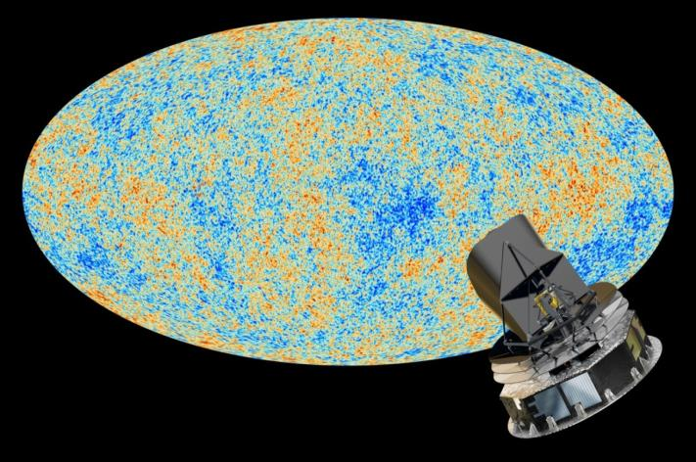
Dark Matter
26.8%
Normal Matter
4.9%
Dark Energy
68.3%
Notes:
Planck results from observations of the CMB (4-year survey fro 2009-2013)
Adds confidence to L-CDM model, from WMAP
Dark Energy Survey, started in 2012 and ending in 2018
Year 1, August 2017 results:
DES in the Chilean Andes to reduce precipitation, light pollution, and tau (optical density of the atmosphere)

Slide 20
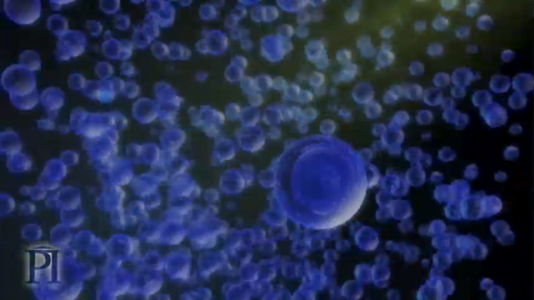
What is Dark Matter?
Notes:
Competing Theories For Dark Matter (5-10 min)
-The slides in this section contain video clips about the latest research in the field. You may choose some of them to compliment your presentation.

Slide 21
What is Dark Matter?
Direct Search Experiments

Slide 22
Competing Theories For Dark Matter
What’s The Latest?

Slide 23
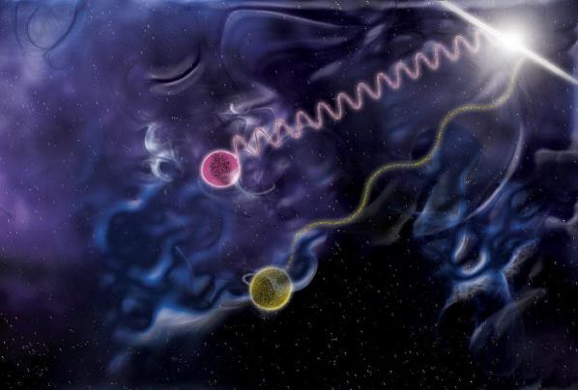
LIGO prefers a dark matter particle
Notes:
The Neutron Star merger places very strong constraints on theoretical models because it demonstrated that gravitational waves travel at speed of light.

Slide 24
How to detect dark matter?
Wait-Until-Something-Hits-Me Principle

Slide 25
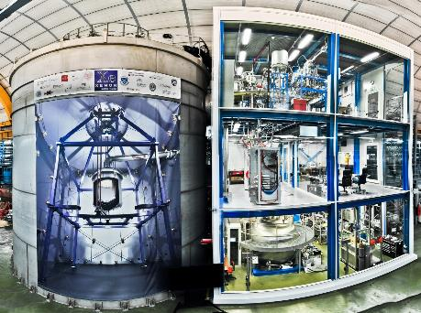
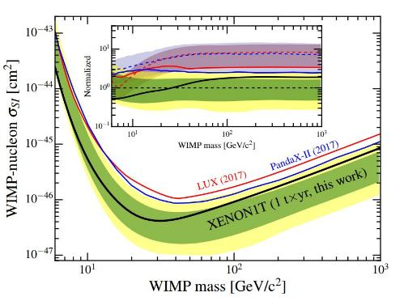
XENON1T The most sensitive measurement yet
Notes:
http://www.xenon1t.org/
XENON1T just released data further constraining WIMP window. No significant events were recorded over 300 days using an active target of 1300 kg of xenon.

Slide 26
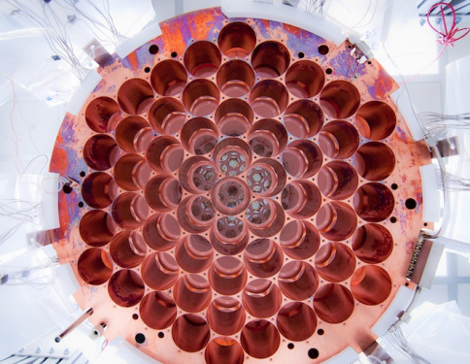
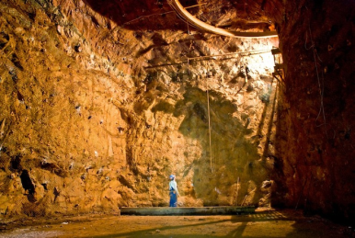
Lux- Large Underground Xenon Detector
Homestake Mine, South Dakota
Notes:
Homestake Mine in Lead South Dakota – first neutrinos from sun detected here
LUX, like most direct dark matter searching experiments, uses the wait-until-something-hits-me principle. The detector is composed of an extremely large number of atoms sitting around, increasing the probability that dark matter slams into them. In the case of LUX, these atoms are xenon, a very stable element that doesn’t undergo any pesky chemical reactions that could screw with results.
The idea is that a dark matter particle might whoosh by a xenon atom, knocking off an electron, which LUX would detect as an increase in charge. Alternatively, a dark matter particle could slam right into a xenon atom, kicking up one of its electrons to a higher orbit. When that electron returned to ground state, it would release a photon, creating a tiny flash of light that one of LUX’s 122 photomultiplier detectors could spot.
The LUX experiment was designed to look for weakly interacting massive particles, or WIMPs, the leading theoretical candidate for a dark matter particle. If the WIMP idea is correct, billions of these particles pass through your hand every second, and also through the Earth and everything on it. But LUX did not detect anything which rules out many theories of dm

Slide 27
How to detect dark matter?
Look where there is a lot … the Galactic Center

Slide 28
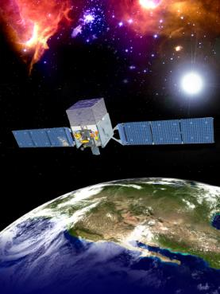
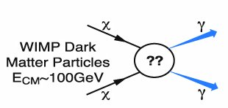
FERMI
Detects ɣ-rays
DM particle annihilation
Notes:
Dark matter candidates such as weakly interacting massive particles are predicted to annihilate or decay into Standard Model particles, leaving behind distinctive signatures in gamma rays, neutrinos, positrons, antiprotons, or even antinuclei. Indirect dark matter searches, and in particular those based on gamma-ray observations and cosmic-ray measurements, could detect such signatures.

Slide 29
How to detect dark matter?
Make it yourself!

Slide 30
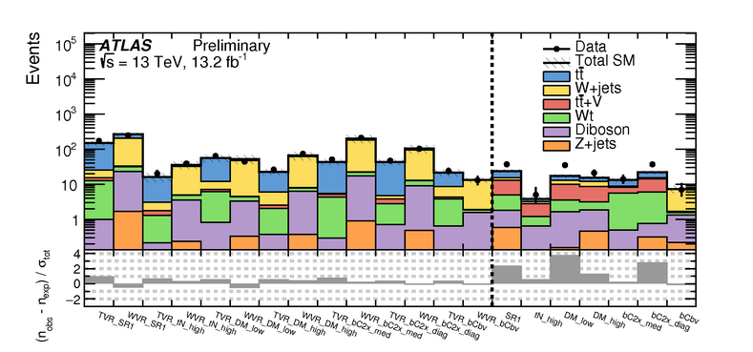
LHC
Notes:
ATLAS data (black points) are compared to the contribution expected from known particles (the filled histograms) in a number of control selections where no signal is expected (left of the dashed line) as well as in a number of selections where a supersymmetric signal, if it exists, would be enhanced (right of the dashed line). The statistical compatibility is reported on the lower panel, where a value above 5 in the signal selections would indicate a discovery.

Slide 31
Empty-Handed?

Slide 32
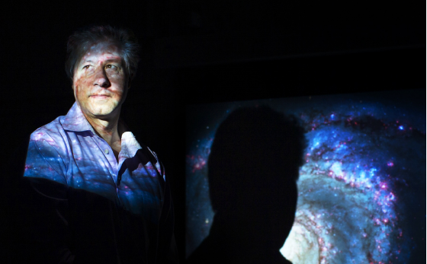
Modified Gravity Theories
Notes:
Could modified gravity be back on the table
Discuss verlinde and stacey mcgaugh work

Slide 33
New paper by Turok, et al…
Notes:
Dark Matter has been in the model all along…neutrinos!

Slide 34
Current Status of Dark Matter
Download the video at: https://resources.perimeterinstitute.ca
Notes:
Video

Slide 35
Evidence for Dark Matter on Multiple Scales
Speeds of stars in galaxies
Speeds of galaxies in clusters
Gravitational lensing of clusters of galaxies
Web-like structure of large-scale universe
Cosmic Microwave Background

Slide 36
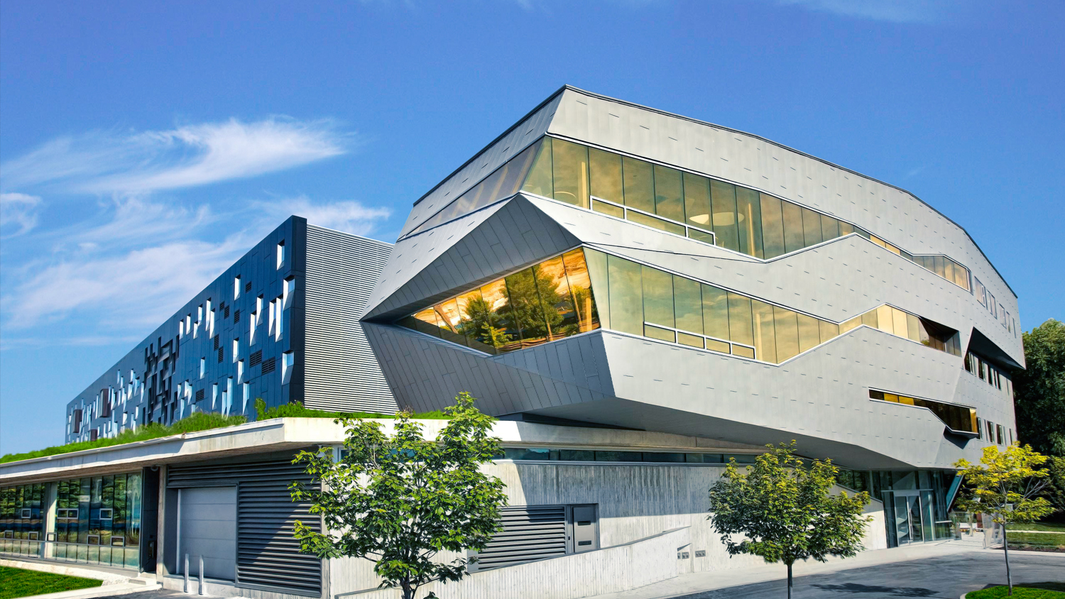
Perimeter Institute for Theoretical Physics
Notes:
PI is now the largest theoretical physics institute in the world.

Slide 37
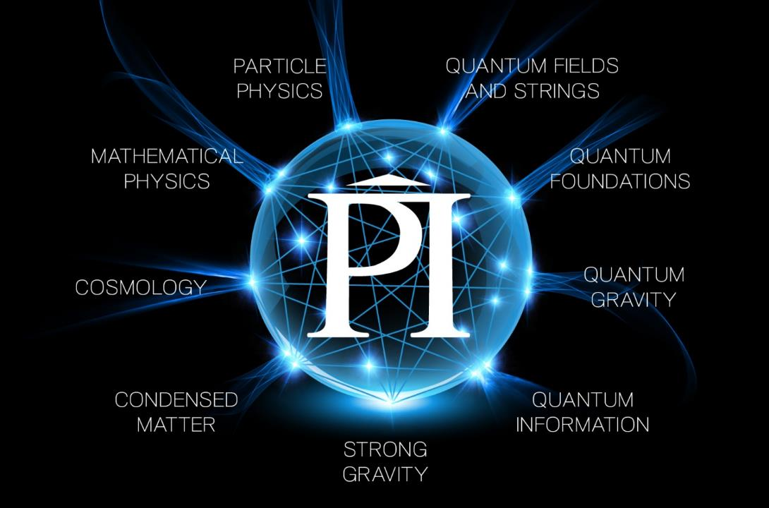

Slide 38
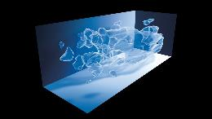
PI Resource Centre
The Mystery of Dark Matter
https://resources.perimeterinstitute.ca/
Notes:
Visit the website and show the teachers how to download the resources

Slide 39
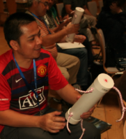
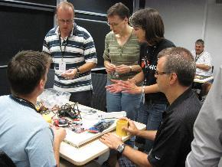
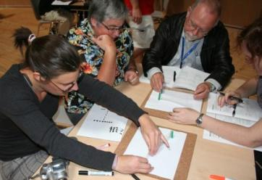
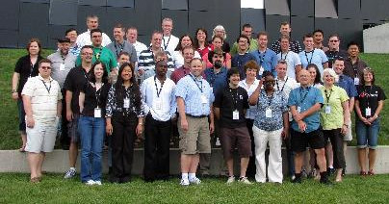
EinsteinPlus
Week-long modern physics summer camp for teachers!
“…one of the most valuable
workshops I have ever attended”
Patrick Kossman, Regina
Notes:
Eplus is the modern physics teachers’ camp in Canada, and provides PI Outreach with a great deal of credibility and rapport in the educational community in Canada and beyond.
40 educators from across Canada and beyond
Pedagogical experts share effective strategies
Focus on student learning
National resource to educators
Focus is three-fold:
Provide rich modern physics content (PI researcher informed; PI in-class resources and presentations)
Ensure effective teaching strategies are role modeled (via Canada’s best physics teachers)
Facilitate communication among motivated educators

Slide 40
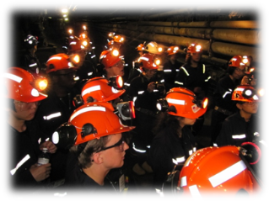
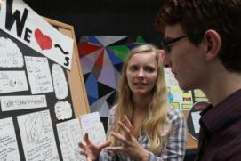
ISSYP
Modern Physics course
Keynote talks
Mentor groups
Visits to cutting-edge experiments
Social Interaction
“I can safely say it was the best two weeks of my life… Because of ISSYP, I’m now absolutely sure that I want to take up a career in physics”
Anna O’Grady, ISSYP 2011
Notes:
ISSYP: International Summer School for Young Physicists
20 Canadian, 20 International students
20 male, 20 female
Geographically diverse across Canada
2 week program
http://www.youtube.com/watch?v=u0w42R8ApKs&feature=player_embedded
Anecdotally, the top high school physics camp in the world; includes a trip 2km below ground to SNOLAB
Presentations by Perimeter Institute researchers on cutting edge theoretical physics: hot topics such as superstring theory, quantum computing and dark matter.
Opportunities to work with leading international theoretical physicists in small group mentoring sessions.
Mini-courses on modern physics designed to deepen their insights into Einstein's ideas and the quantum nature of our universe.
Hands-on labs, tours of neighbouring research facilities, and other exciting activities with like-minded students from around the globe.
Awareness of their own potential as potential future researchers in theoretical physics.
SNOLAB is an underground science laboratory specializing in neutrino and dark matter physics. Situated two km below the surface in the Vale Creighton Mine located near Sudbury Ontario Canada, SNOLAB is an expansion of the existing facilities constructed for the Sudbury Neutrino Observatory (SNO) solar neutrino experiment.

Slide 41
Thank You! – Ευχαριστώ!!
Dave Fish
PI Teacher-in-Residence Emeritus
dfish@perimeterinstitute.ca
Olga Michalopoulos
PI Teacher Network Lead for Greece
omichalopoulos@gmail.com

