Slide 1

What’s New in Physics?
EHT, LIGO and Exoplanets
Notes:
DONE

Slide 2
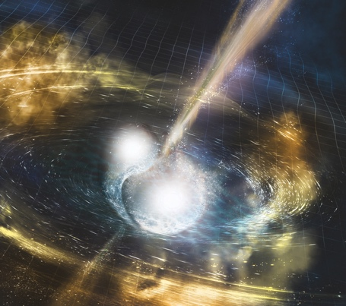

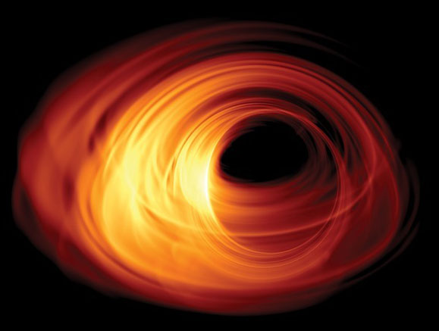
Most exciting time in physics
Notes:
We’re on the verge of breaking existing theories which is very exciting because we hope to replace them with better models
More data than ever before, LHC, and more creative theoretical models that hope to explain more of the universe.

Slide 3
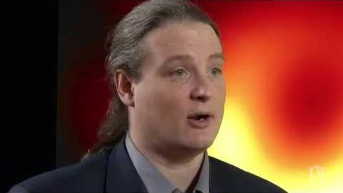
What Is A Black Hole?
Notes:
https://www.youtube.com/watch?v=lRI9ZUs0BXY&feature=emb_logo

Slide 4
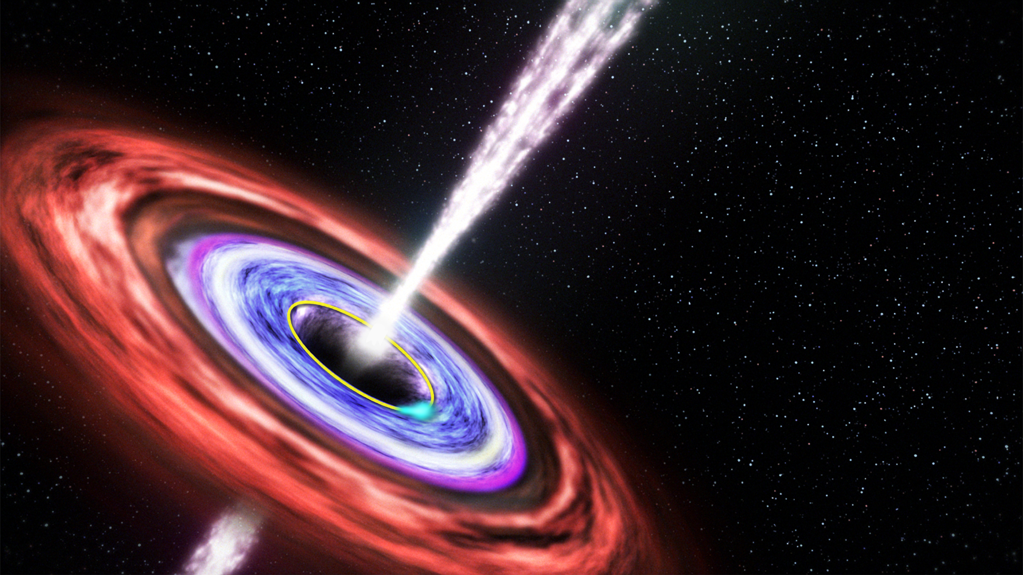
Black Hole Anatomy: Event Horizon
Relativistic Jet
Innermost Stable Orbit
Shadow
Event Horizon
Accretion Disk
Notes:
Now to look at an actual black hole would be pretty boring as it’s black. But around many black holes are orbiting particles including photons.
And you can potentially see their rings. In the immediate surroundings of the black hole itself. And this is what the Eevent Horizon Telescope hopes to do.

Slide 5
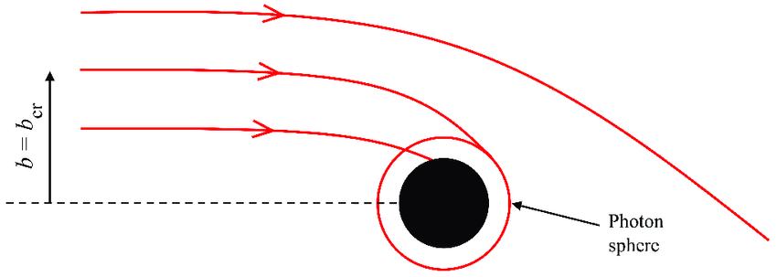

What happens to light near a black hole?
Bisnovatyi-Kogan & Tsupko
Notes:
Do the ray tracing activity.

Slide 6
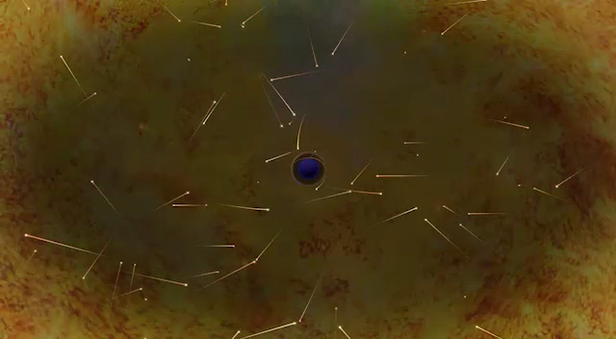
CREDIT: Nicolle R. fuller/NSF
Notes:
https://www.eso.org/public/videos/eso1907n/

Slide 7
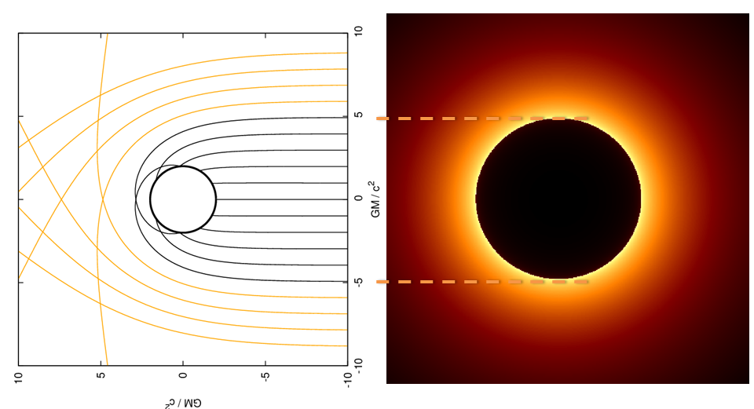
The shadow is formed by the rays of light that are NOT escaping

Slide 8
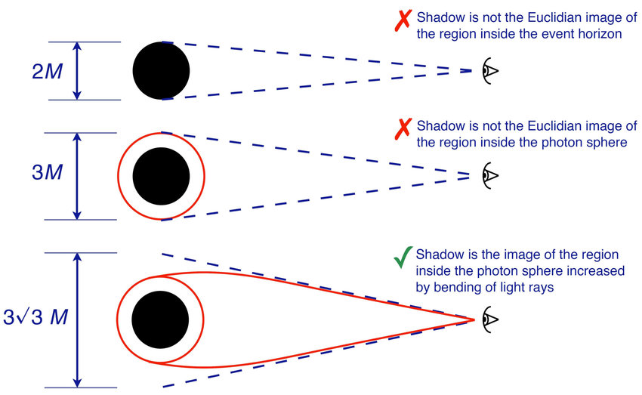
The shadow is NOT the event horizon
Bisnovatyi-Kogan & Tsupko
Notes:
https://www.researchgate.net/publication/318497993_Gravitational_Lensing_in_Presence_of_Plasma_Strong_Lens_Systems_Black_Hole_Lensing_and_Shadow

Slide 9
Notes:
This is the first ever image of a black hole.
This is M87*. It is 55 million light years away. The shadow is 42 µas across which translates to 6.5 billion solar masses. It is circular which agrees with GR. It is brighter at the bottom due to the rotation of the black hole.

Slide 10
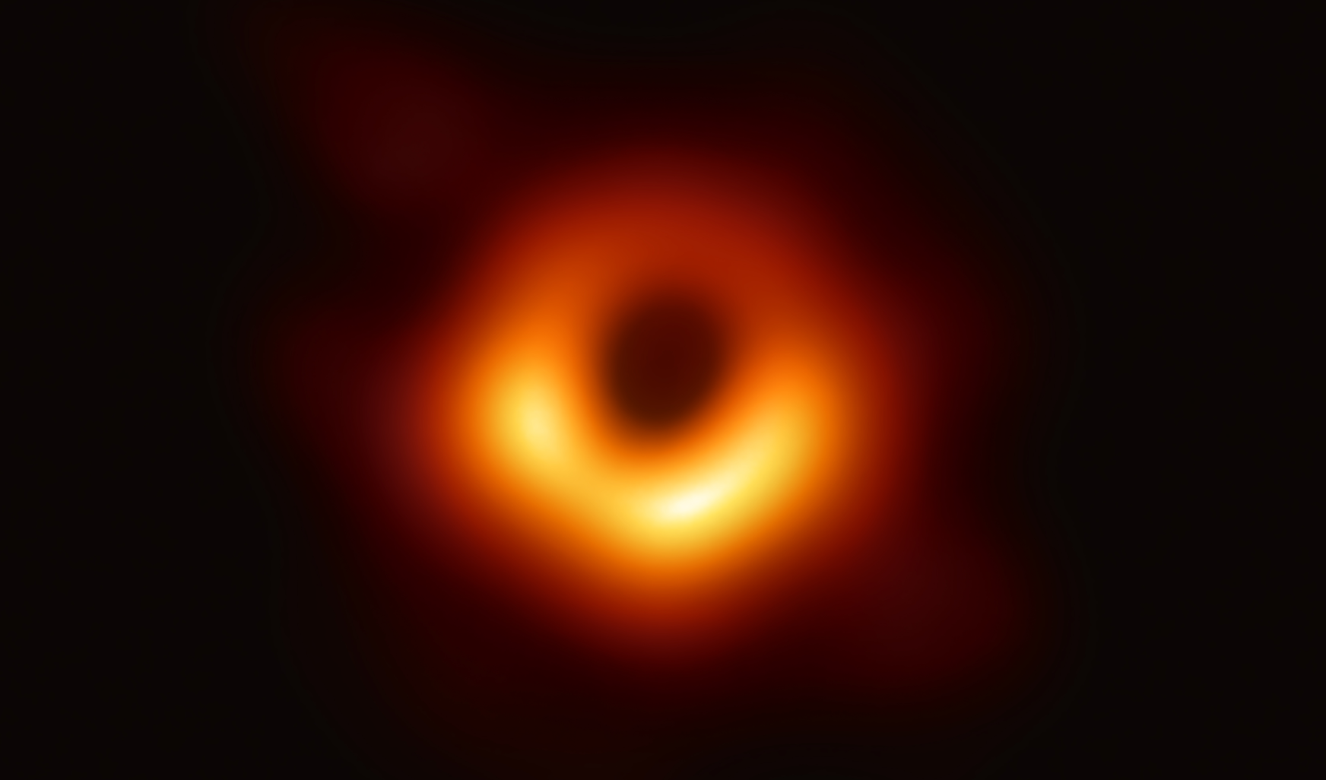
The angular diameter of the shadow is 42 µas.
CREDIT: EHT Collaboration
Notes:
This is the first ever image of a black hole.
This is M87*. It is 55 million light years away. The shadow is 42 µas across which translates to 6.5 billion solar masses. It is circular which agrees with GR. It is brighter at the bottom due to the rotation of the black hole.

Slide 11




Slide 12
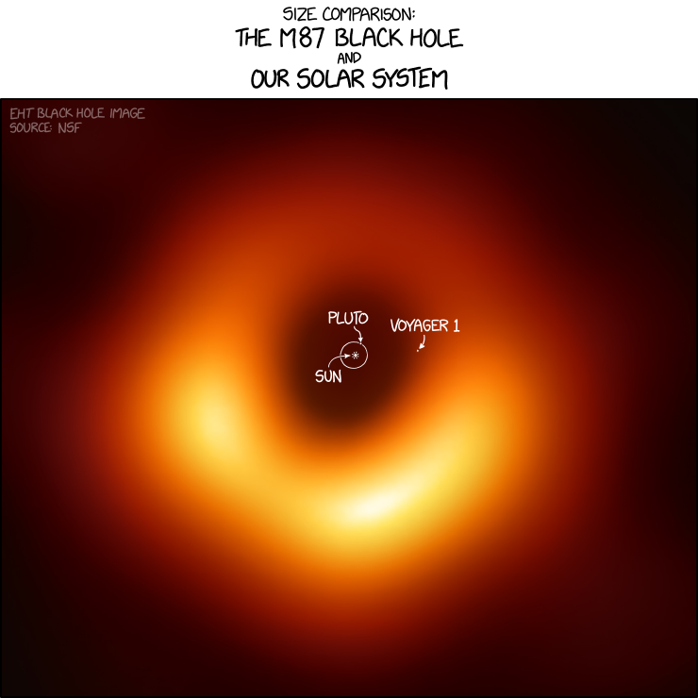
https://xkcd.com/2135/

Slide 13
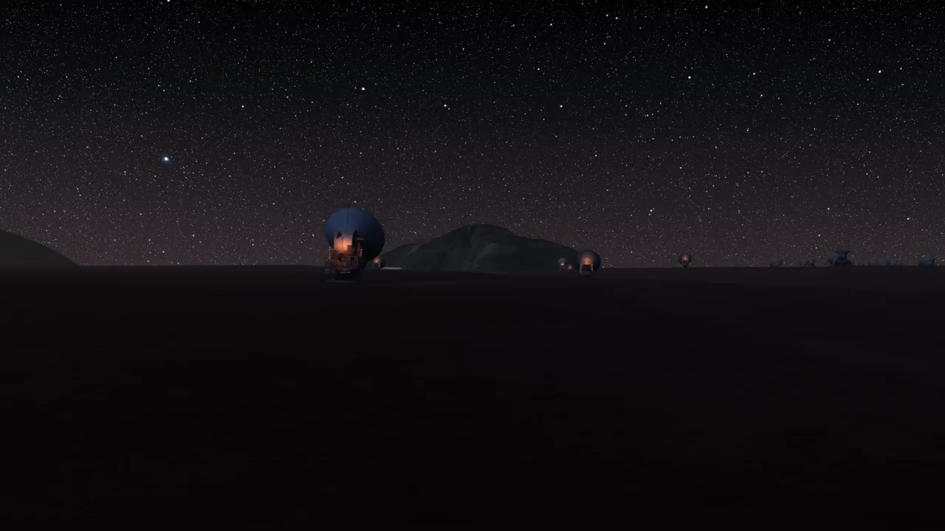
Zooming in on M87*
Notes:
This zoom video starts with a view of ALMA and zooms in on the heart of M87, showing successively more detailed observations and culminating in the first direct visual evidence of a supermassive black hole’s shadow. Credit: ESO/L. Calçada, Digitized Sky Survey 2, ESA/Hubble, RadioAstron, De Gasperin et al., Kim et al., EHT Collaboration. Music: Niklas Falcke

Slide 14
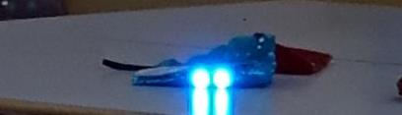




How do you improve resolving power?
Use two pencils to create a narrow wedge.
View two lights through the different widths.

Slide 15
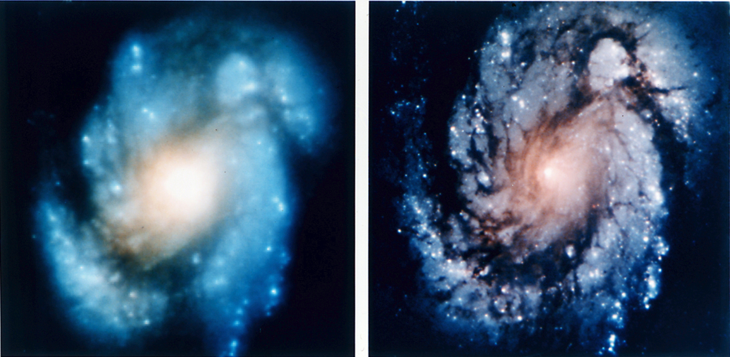

$$Resolving Power∝\frac{1}{Diameter}$$
Notes:
How does it work? All telescopes have resolution that is dependent on the diameter. Conventional telescopes are limited by diffraction in their apertures.
Let’s see this. Pencil demo.
This limits resolution to 10^-6 degrees. Sgr A* is 10^-8 degrees. We need to do better.
What about telescopes without lenses and just mirrors? I think you will still get diffraction when light goes through initial aperature of telescope

Slide 16
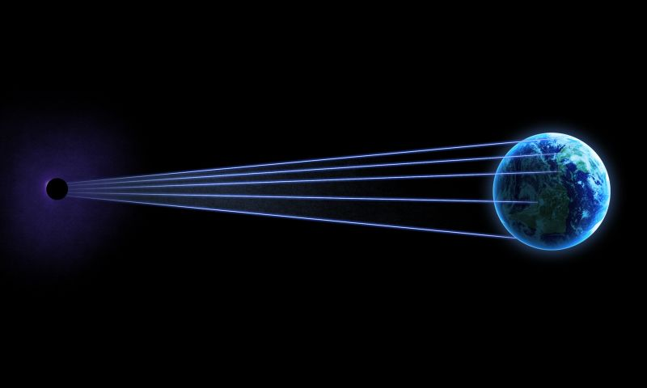

Slide 17
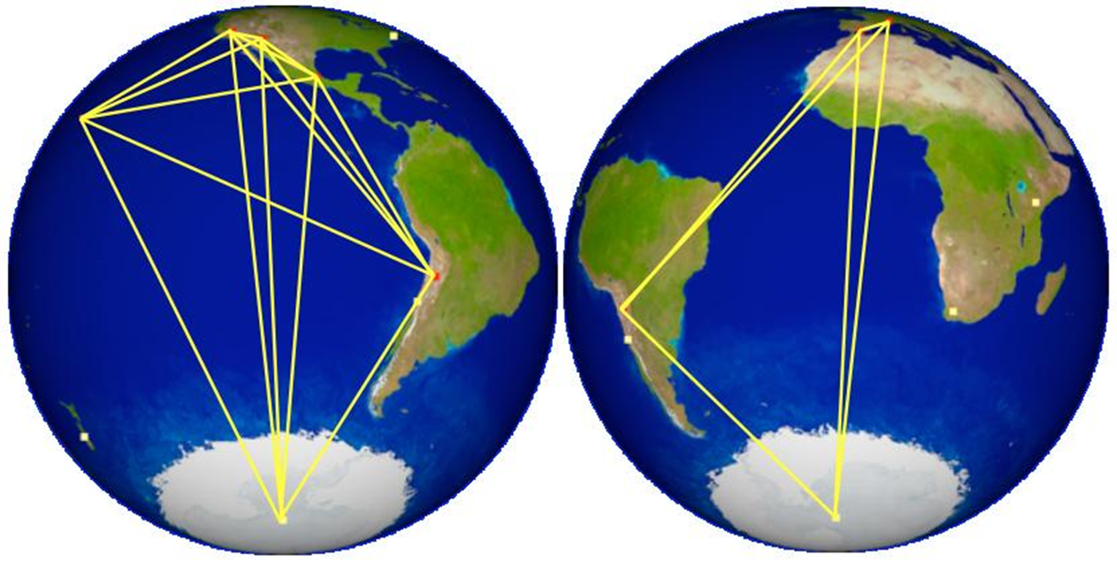
Event Horizon Telescope
Notes:
Global network of 15 radio telescopes.
Most powerful telescope in human history
Will have a resolution that can read the year written on the back of a 1 euro coin (~2 mm high) on a euro in Athens from Lagos, Nigeria (where Giannis Antetokounmpo’s parents are from).

Slide 18


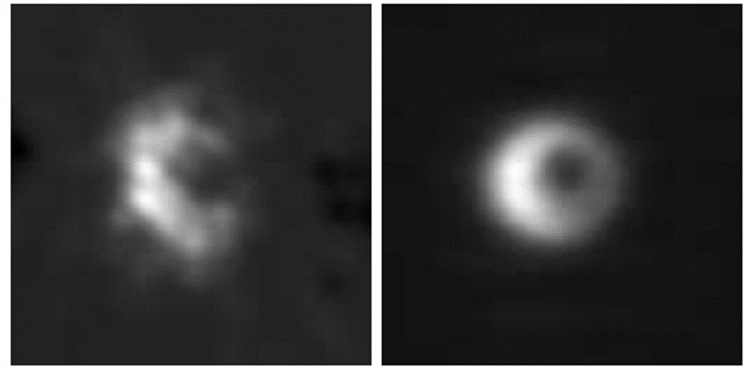
More telescopes gives more resolution…
Notes:
Broderick Model of what we might see – left – ideal
Middle – 7 scopes
Right – 15 scopes
Initial data has been taken. Have been able to resolve the centre to about 4X the Schwarzschild radius. It works!
Will we see an event horizon? General relativity predicts multiple solutions to a black hole, with an event horizon or as a ‘naked singularity’ where no event horizon exists. EHT will test the predictions made by Einstein’s GR.

Slide 19
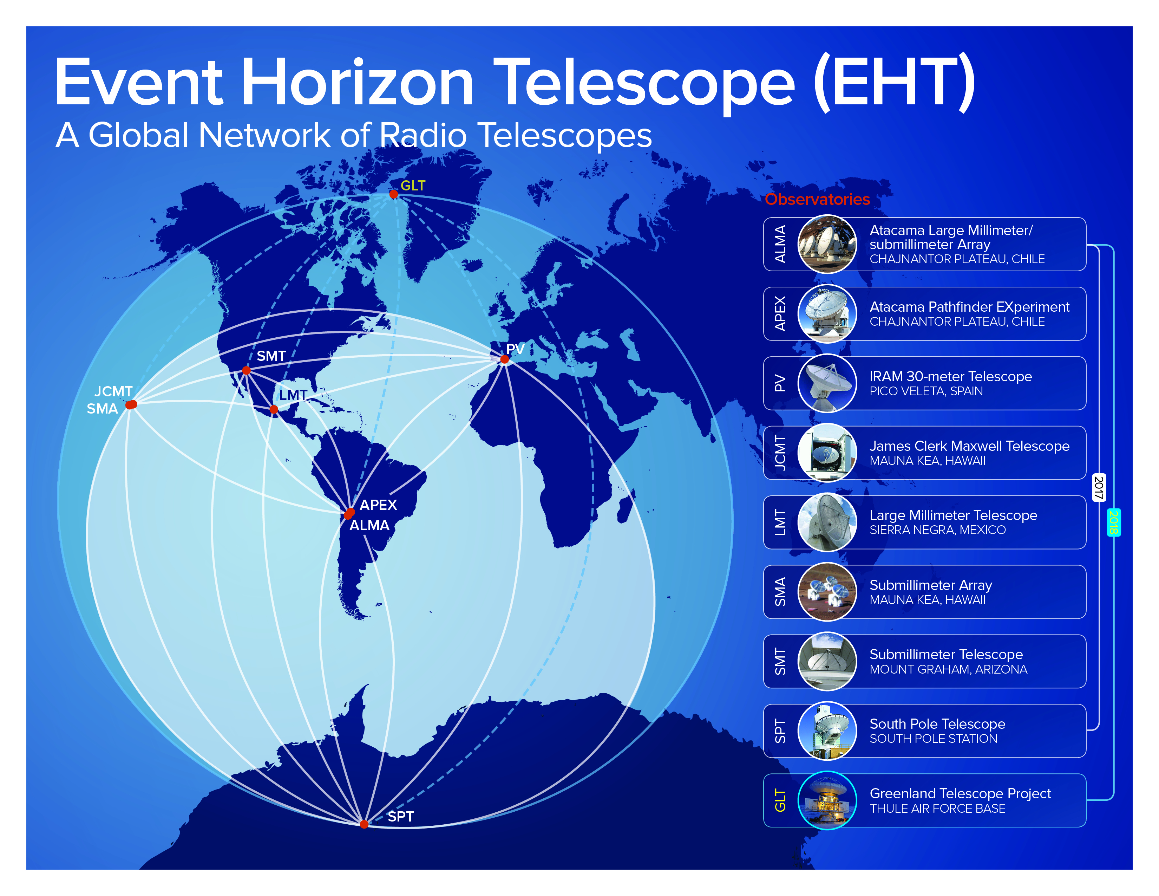
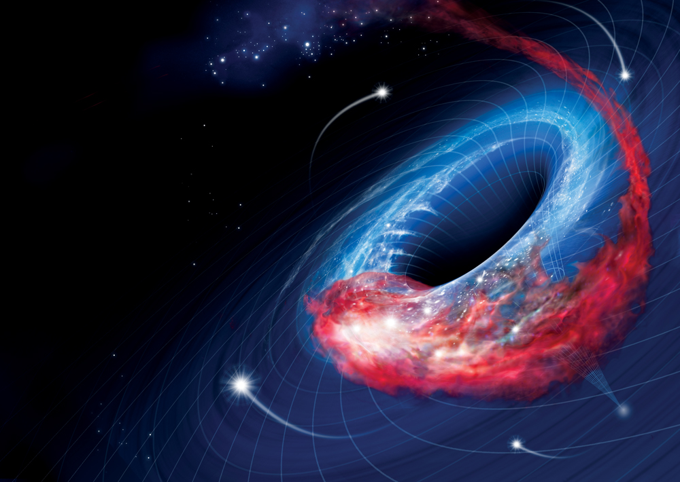
Event Horizon Telescope
Notes:
One of the most amazing experiments on the planet today
Hopes to take the first ever image of a black hole and its immediate surroundings., just outside of the event horizon.
What is schr. Radius for Sgr a*? 10 million km

Slide 20
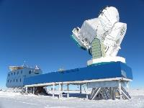
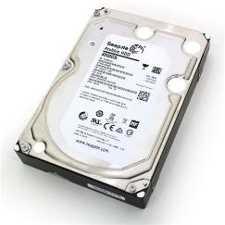

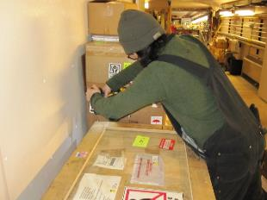
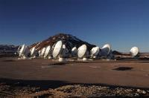
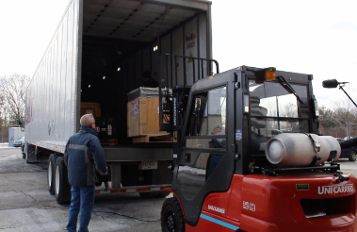



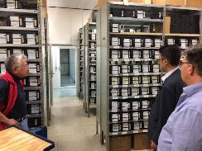
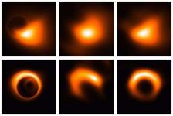


Data Collection to Final Image
64 x 8 TB helium-filled hard drives
8 EHT telescopes
Boxing hard drives
Secondary Processing
(Model matching)
Initial processing
(4 independent groups)
Half a ton of hard drives
5 petabytes of data
~600 hard drives
Notes:
Compare secondary processing to a POE “on steroids”. Lots of predictions made.

Slide 21
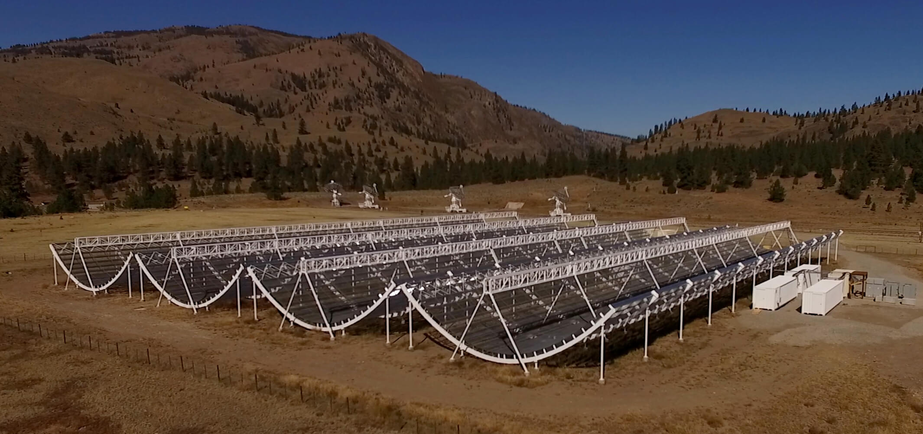
Earlier this year…
Canadian
Hydrogen
Intensity
Mapping
Experiment

Slide 22
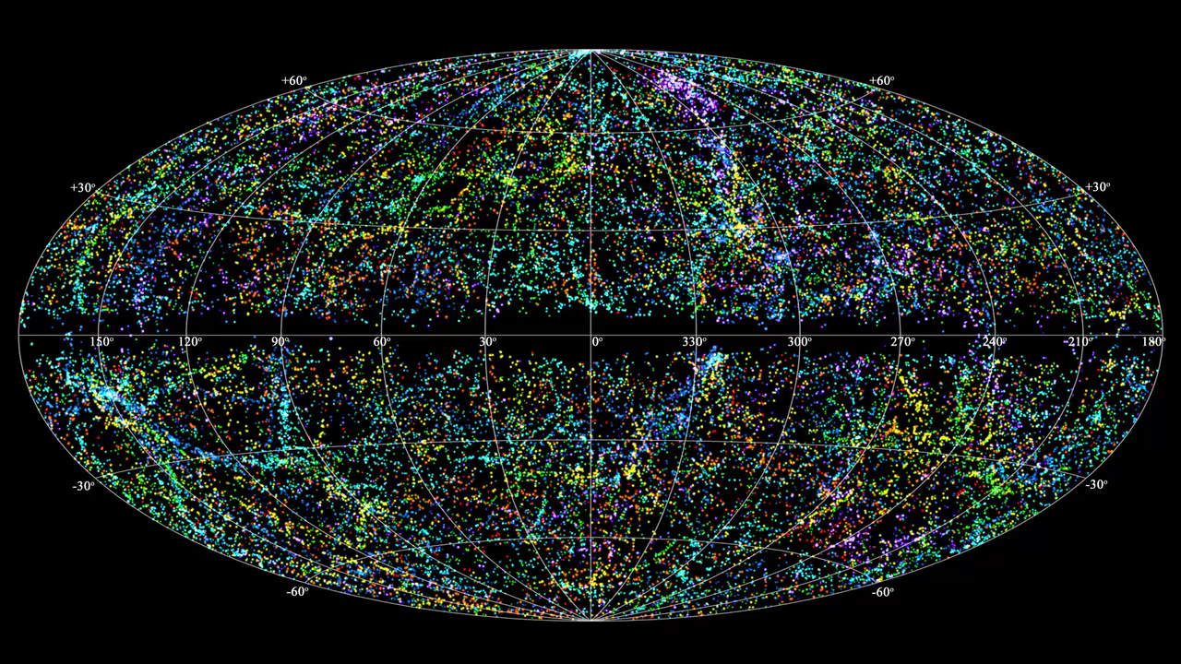

Slide 23
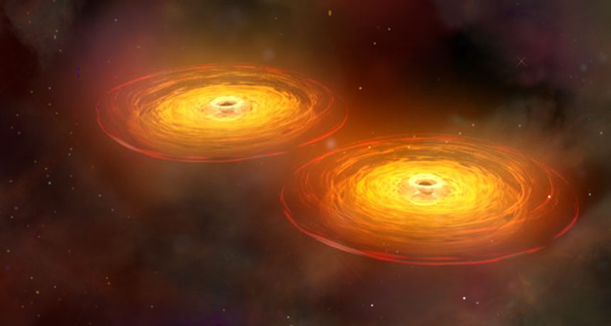
Gravitational Waves

Slide 24
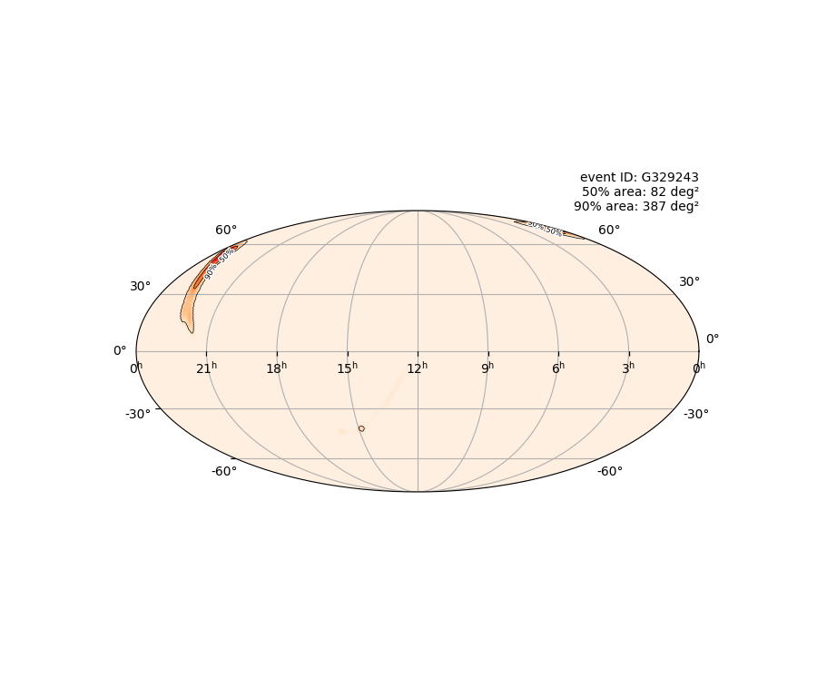
LIGO O3 started April 1st
Event recorded April 8th

Slide 25
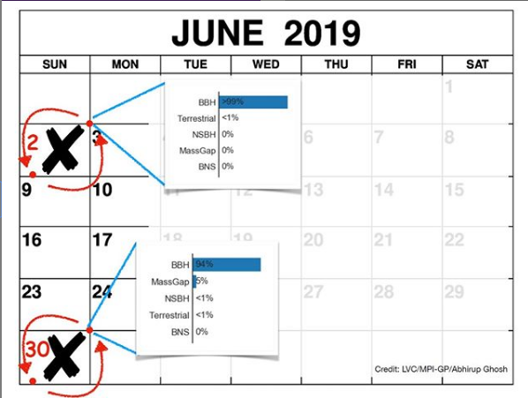
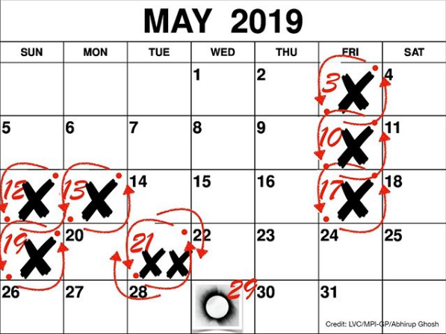
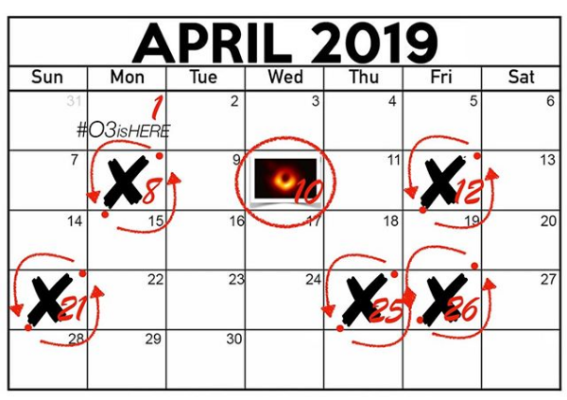

LIGO O3 started April 1st
Notes:
Notice the two observations on one day! LIGO had to rethink their naming convention after that because it was based on the date.
20 detections since O3 began

Slide 26
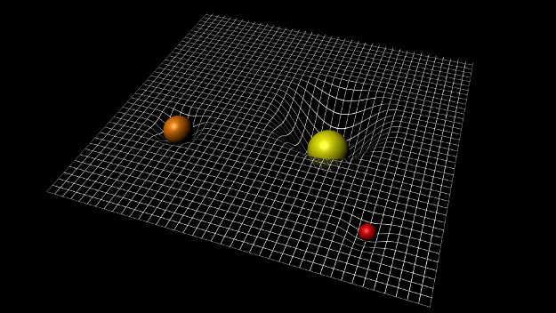
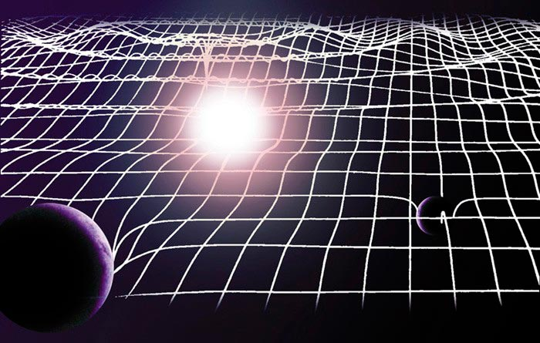
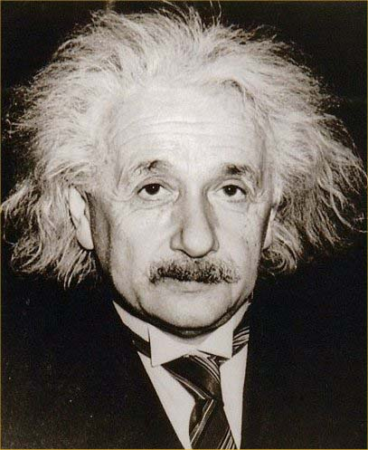
Space according to Einstein
Notes:
Why is everyone in that video so excited? For one thing, the results support Einstein’s theory of general relativity, which says space is like a stretchy fabric that warps with mass. It’s an elastic medium. Gravitational waves were a byproduct of his theory.

Slide 27
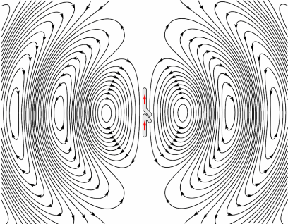
Accelerating Charges Produce EM Waves
Notes:
Imagine a sitting by a lake a throwing a pebble into it. You will create ripples on the surface of the water. Gravitational waves are like this but with space itself rippling. They’re created by the acceleration of mass, such as two black holes colliding with each other.

Slide 28
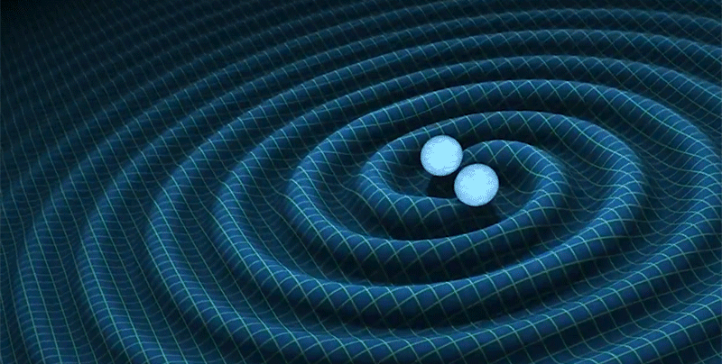
Accelerating Masses Produce Gravitational Waves
Notes:
Imagine a sitting by a lake a throwing a pebble into it. You will create ripples on the surface of the water. Gravitational waves are like this but with space itself rippling. They’re created by the acceleration of mass, such as two black holes colliding with each other.

Slide 29
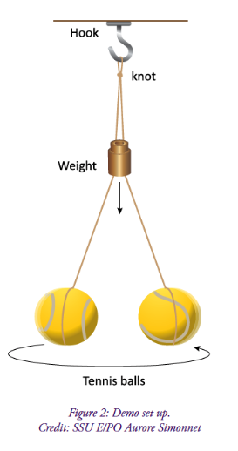
Classroom Model of Inspiral Motion

Slide 30
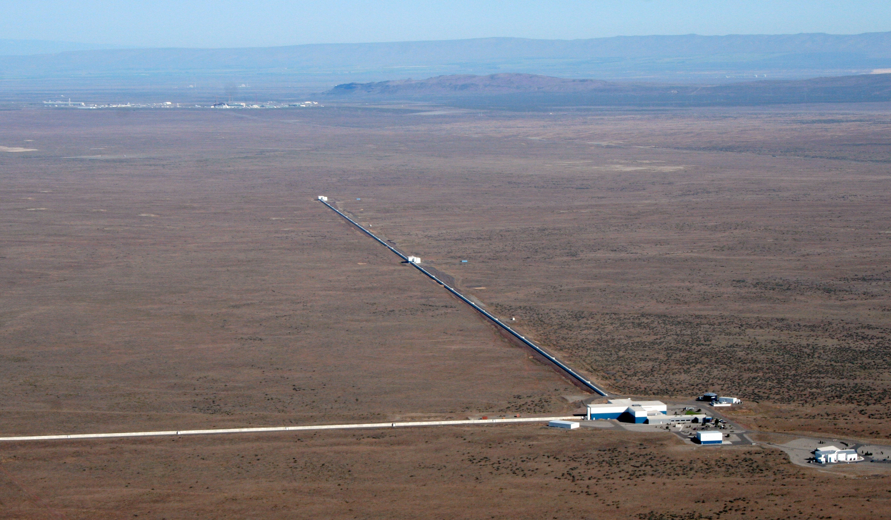
How did scientists detect gravitational waves?
Notes:
Hanford, Washington State, east of Seattle. In the desert. Arms are 4 km long. An interferometer.

Slide 31
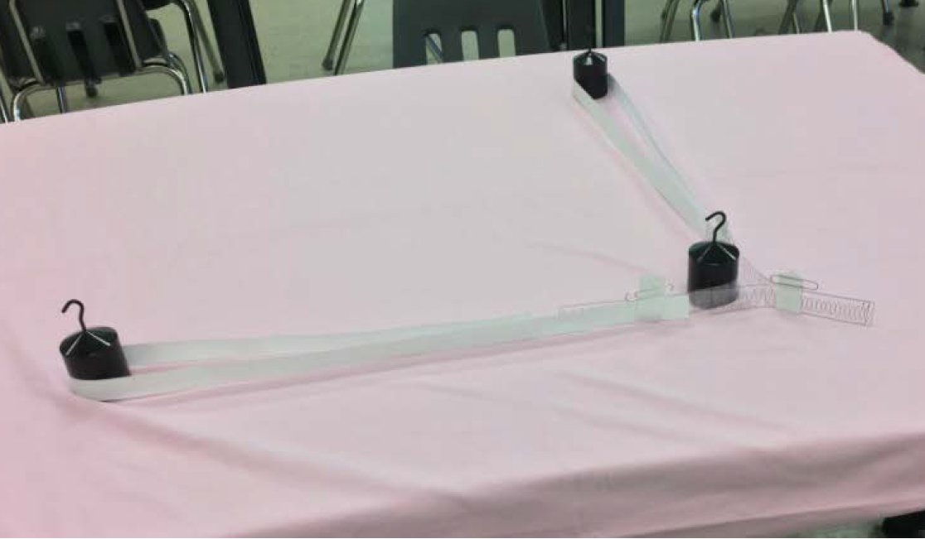
Hands-on LIGO Model

Slide 32
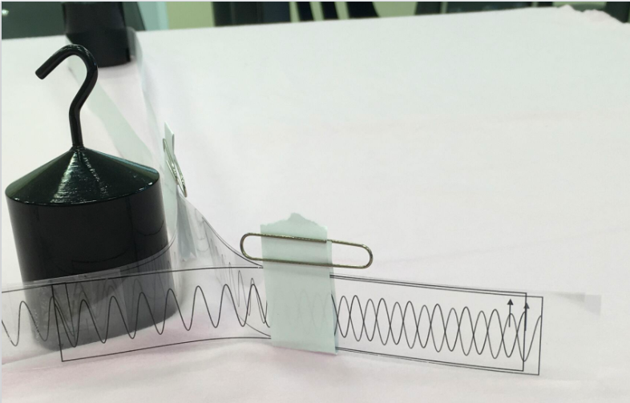
Tuned arms:
Fine tune the length of one of arms of your model so that the overlapped waves produce destructive interference.
Notes:
Why would they want the interference to be destructive instead of constructive? Want no light (setting a trap)

Slide 33
Detecting Gravitational Waves

Slide 34
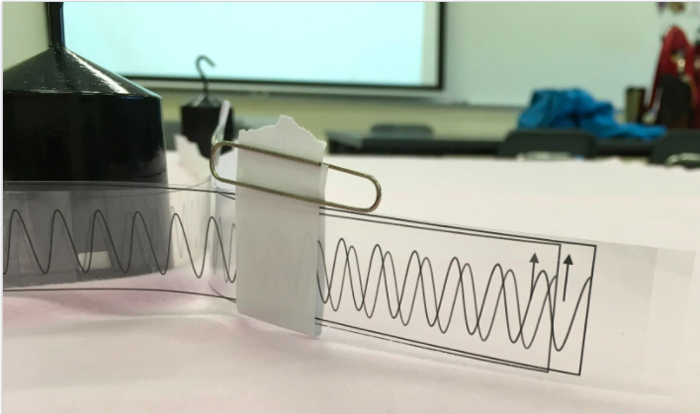
Tuned arms before:
Tuned arms after a “Gravitational Wave”:

Slide 35
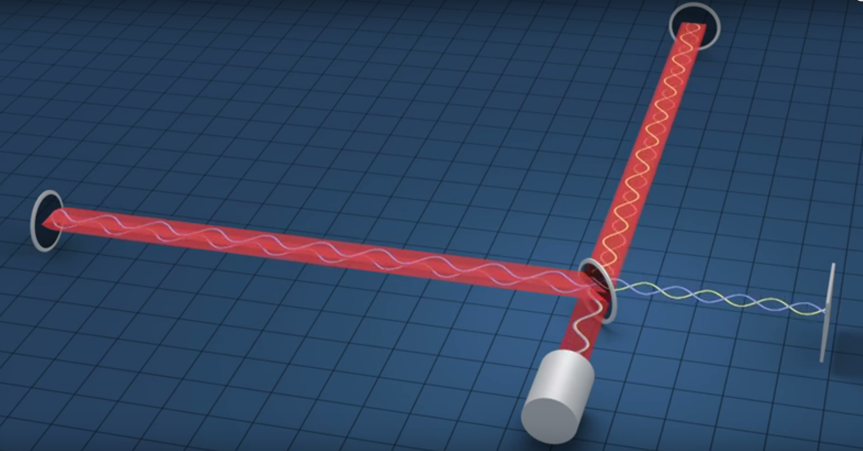
Notes:
Laser passes through a beam splitter and is reflected off mirrors at either end. If the ends are the same length, the wavelengths cancel when they’re recombined.

Slide 36

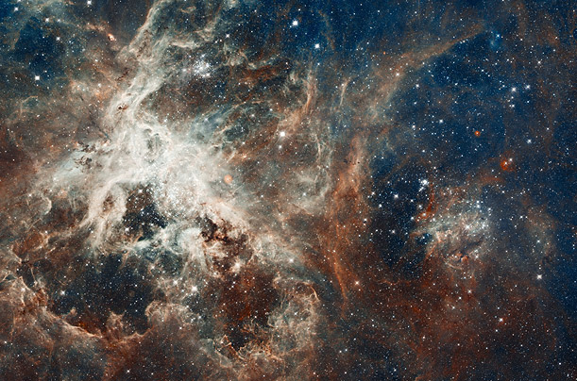
Entirely New Window into the Universe
Notes:
We can use gravitational waves to observe the collisions between compact objects like black holes and neutron stars. We can also use them to study spinning massive objects. Any bumps or imperfections will generate gravitational waves as the object spins.
Another type of gravitational wave we could detect is a burst signal, which could be caused by energetic events such as supernovae.

Slide 37
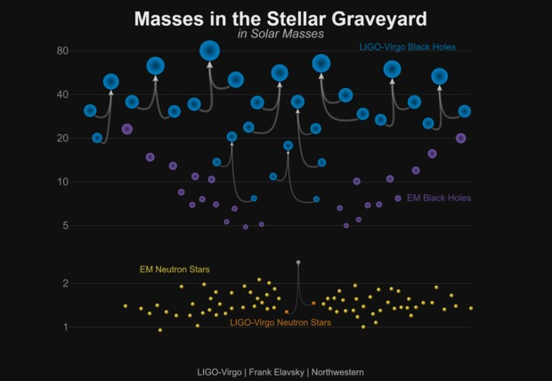
Notes:
10 black hole mergers and one neutron star merger

Slide 38

Binary Neutron Star Collision
Observed August 2017
Between 1.1 and 1.6 solar masses
130 million light years from Earth
~100 seconds

Slide 39
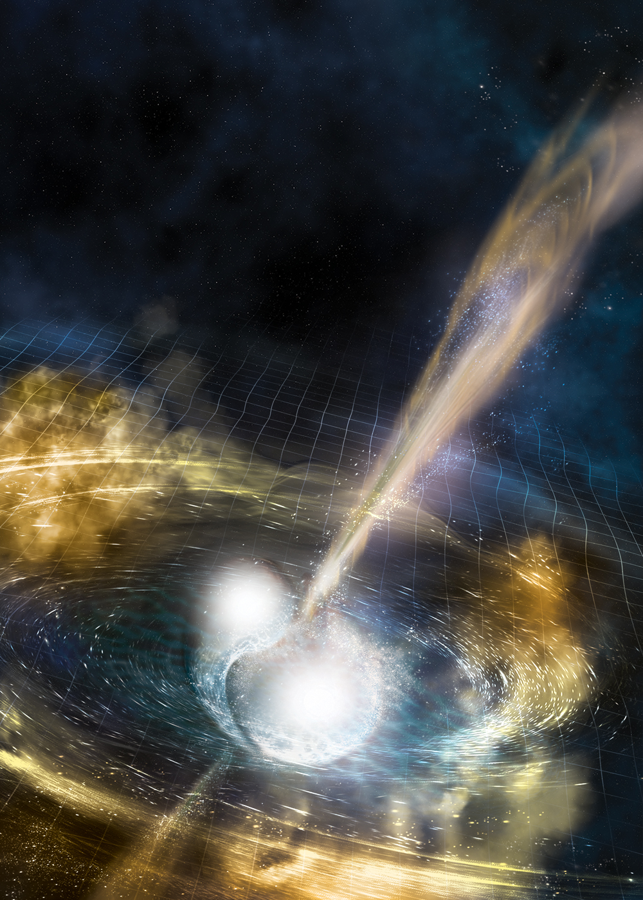
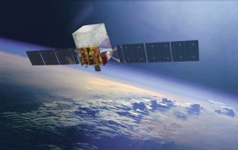
Gamma ray burst simultaneously observed by Fermi Space Telescope

Slide 40
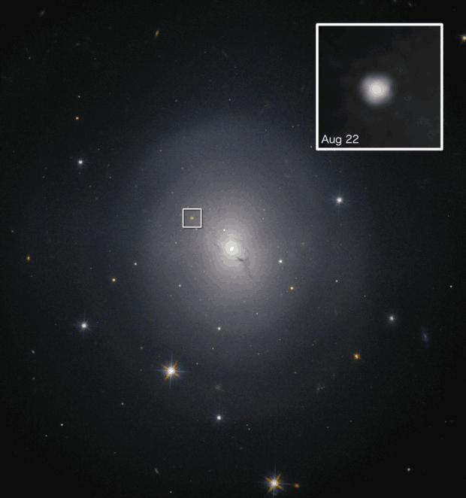

~70 optical telescopes quickly observed light from collision

Slide 41
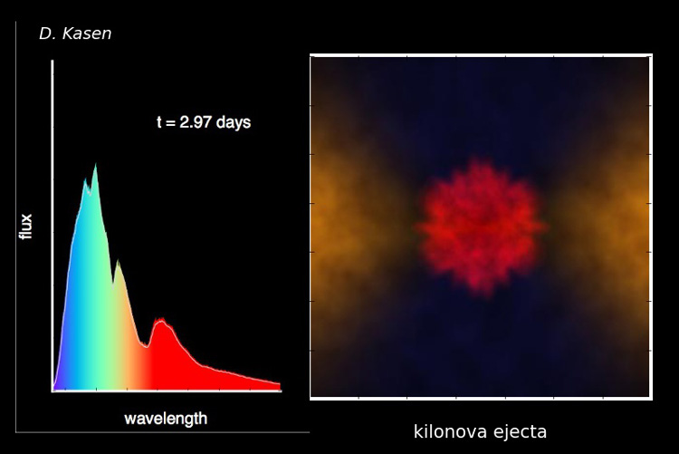
Huge amount of Au and Pt formed!

Slide 42
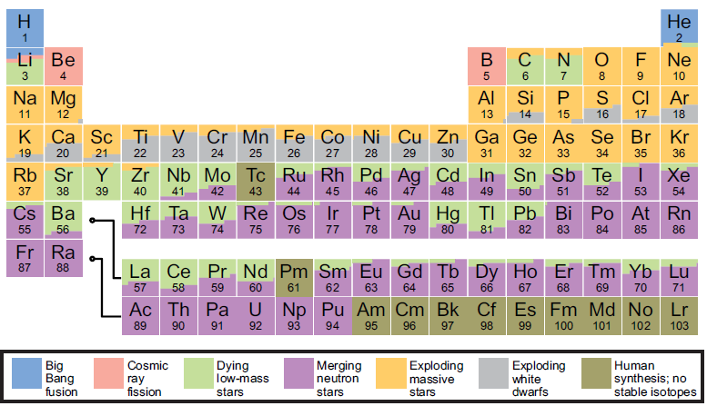

Slide 43

The merger probably created the smallest black hole
Notes:
http://chandra.si.edu/photo/2018/gw170817/
Chandra observed GW170817 multiple times. An observation two to three days after the event failed to detect a source, but subsequent observations 9, 15 and 16 days after the event, resulted in detections (bottom left). The source went behind the Sun soon after, but further brightening was seen in Chandra observations about 110 days after the event (bottom right), followed by comparable X-ray intensity after about 160 days.
If the neutron stars merged and formed a heavier neutron star, then astronomers would expect it to spin rapidly and generate a very strong magnetic field. This, in turn, would have created an expanding bubble of high-energy particles that would result in bright X-ray emission. Instead, the Chandra data show levels of X-rays that are a factor of a few to several hundred times lower than expected for a rapidly spinning, merged neutron star and the associated bubble of high-energy particles, implying a black hole likely formed instead.

Slide 44





Download one these apps
OR
OR
Physics Toolbox
Phyphox
Science Journal

Slide 45

What’s the latest on Exoplanets?
Image credit: Danielle Futselaar - SETI Institute
Notes:
Artist concept of the planetary system Kepler 62. Image credit: Danielle Futselaar - SETI Institute

Slide 46

with one half to
James Peebles
Princeton University, USA
“for theoretical discoveries in physical cosmology”
and the other half jointly to
Michel Mayor
University of Geneva, Switzerland
and Didier Queloz
University of Geneva, Switzerland
University of Cambridge, UK
“for the discovery of an exoplanet orbiting a solar-type star”
Notes:
The Royal Swedish Academy of Sciences has decided to award the Nobel Prize in Physics 2019
“for contributions to our understanding of the evolution of the universe and Earth’s place in the cosmos”

Slide 47

Credits: Carnegie Institution for Science
Notes:
First evidence of exoplanets was this spectrum taken of van Maanen’s star in 1917. The fuzzy lines point to Calcium in the outer layer of the star which could only get there by infalling dust from orbiting matter.

Slide 48

Exoplanet movie
Notes:
https://twitter.com/i/status/1193227699956748288

Slide 49

How do we detect exoplanets?
Credit: NASA Ames

Slide 50


Use a flashlight, sphere and a Smart phone
Notes:
Hold Styrofoam ball about 10 cm in front of flashlight.
Hold Smartphone about 50 cm in front of the flashlight.
Just be consistent.

Slide 51
Predict:
How does a planet’s size affect the light curve?
Notes:
Play around with the smartphone app to familiarize yourself with the graphical output.
Predict what light curve you would expect for a large and small exoplanet at the same orbital distance.
Make your observations and discuss any discrepancies.

Slide 52
Predict:
How does a planet’s speed affect the light curve?
Notes:
Predict what light curve you would expect for a slow and fast moving exoplanet at the same orbital distance.
Make your observations and discuss any discrepancies.
Are there other variables that need to be accounted for?

Slide 53
Real Data
Notes:
HIP 41378 planetary system reveals five planets: two inner planets (b,c) and three outer planets.

Slide 54

Kepler is dead
Notes:
TRAPPIST-1 is a planetary system located 39 lya. There are seven Earth-sized planets orbiting a red dwarf star

Slide 55


Slide 56


Image taken from www.universetoday.com
Notes:
A Neptune-sized moon orbiting around a Jupiter-sized exoplanet
HD 26965 is a super-Earth orbiting around 40 Eridani A (the star identified by Gene Roddenberry as the host star of Vulcan)

Slide 57


Exomoon
Notes:
Found by Hubble after exoplanet found by Kepler
8000 ly away. Jupiter sized exoplanet with a Neptune-sized moon.

Slide 58

What’s next?
Transiting
Exoplanet
Survey
Satellite
MIT KAVLI Institute for Astrophysics and Space Research
Notes:
Transiting Exoplanet Survey Satellite
NASA and SpaceX are targeting launch of TESS no earlier than April 16, 2018, pending range approval. SpaceX requested additional time for hardware readiness and to meet NASA launch service mission requirements. The TESS spacecraft arrived at NASA’s Kennedy Space Center in Florida Feb. 12 for payload processing. TESS will launch on a Falcon 9 rocket from Cape Canaveral
Will be studying potential planets in habitable zone.
Area of sky 400 times greater than Kepler. Expected to discover 3000 exoplanets.

Slide 59

Credit: NASA/MIT/TESS
Notes:
This test image from one of the four cameras aboard the Transiting Exoplanet Survey Satellite (TESS) captures a swath of the southern sky along the plane of our galaxy. TESS is expected to cover more than 400 times the amount of sky shown in this image when using all four of its cameras during science operations. Credit: NASA/MIT/TESS

Slide 60


What to Watch for!
JWST – Exoplanet Atmospheres
Launching 2021

Slide 61


What to Watch for!
CHEOPS– Exoplanets
November 2019
Notes:
Launching November 2019
Uses transit method for detection
Will measure planet size and with previous mass measurements allow for density calculations
5 year mission
Characterising Exoplanets Satellite

Slide 62

eROSITA X-Ray Telescope
First Images Revealed Oct 22, 2019 at Max Planck Institute
(Image credit: T. Reiprich (University of Bonn), M. Ramos-Ceja (MPE), F. Pacaud (University of Bonn), D. Eckert (University of Geneva), J. Sanders (MPE), N. Ota (University of Bonn), E. Bulbul (MPE), V. Ghirardini (MPE), MPE/IKI)
Notes:
This image from eROSITA, the dark matter telescope, shows A3391/3395, two interacting galaxy clusters that are 800 million light-years from Earth.
This image was created with exposures from all seven of the telescope's mirror modules; the images were taken between Oct. 17 TKTK

Slide 63

quantumtocosmos.ca

Slide 64

PI Resource Centre
https://resources.perimeterinstitute.ca/

Slide 65
Thank You! – Ευχαριστώ!!
Dave Fish
PI Teacher-in-Residence Emeritus
dfish@perimeterinstitute.ca
@DaveFishPI
Olga Michalopoulos
PI Teacher Network Lead for Greece
omichalopoulos@gmail.com

