Slide 1
How Do Scientists Think?
The Process of Science
Notes:
This slide show is meant to accompany the Perimeter Resource, Inspirations 02: The Process of Science

Slide 2
How Do Scientists Think?
Scientists Are …
Creative
Curious
Collaborative
Notes:
5 mins
Scientists inquire and they are creative.
Are we providing students with these opportunities? Are we building this capacity for students?

Slide 3
How Do Scientists Think?
Scientists Are Creative

Slide 4
Observation vs Inference
Observation:
We use our 5 senses to gather information about the world around us.
Παρατήρηση:
Mαθαίνοντας για το περιβάλλον σας διαμέσου των αισθήσεών σας.
Inference:
A logical interpretation of an event based on observations and prior knowledge.
Συμπέρασμα:
Bγάζοντας αποτελέσματα βασιζόμενοι σε παρατηρήσεις και πληροφορίες.
Observation:
Based on the five senses:
sight, smell, touch, taste, hearing.
inference:
Based on prior knowledge or opinion.
vs

Slide 5
What happened?
Notes:
Challenge the participants to describe what is happening. How do you know? Which story is right? Can we find additional evidence?

Slide 6
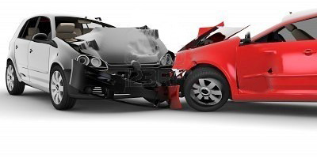
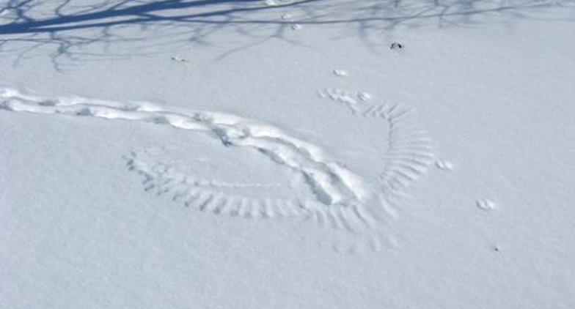
Other versions?
Notes:
All you need is a good photo that students can use to make OBSERVATIONS and draw INFERENCES
ASK FOR IDEAS!!
From nature:
tracks or scat or carcass…
From people:
car accidents, crime scenes, messy house…

Slide 7
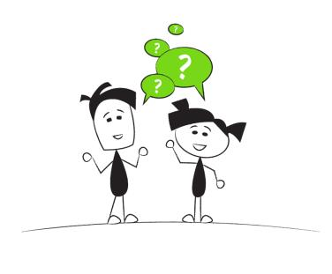
How Do Scientists Think?
Scientists are Curious

Slide 8
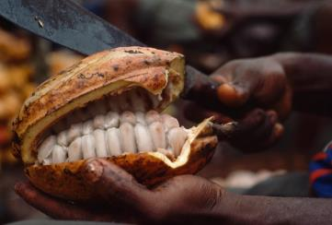
Why is it Like That?
Notes:
The next three slides are samples of an upcoming activity. Using the “Why is it like that” pictures from the resource, stations can be setup where groups look at a picture and attempt to add to a Freyer graphic organizer. After a defined amount of time, the groups can change stations. It should be pointed out that the questions and observations become more detailed and descriptive over time.

Slide 9
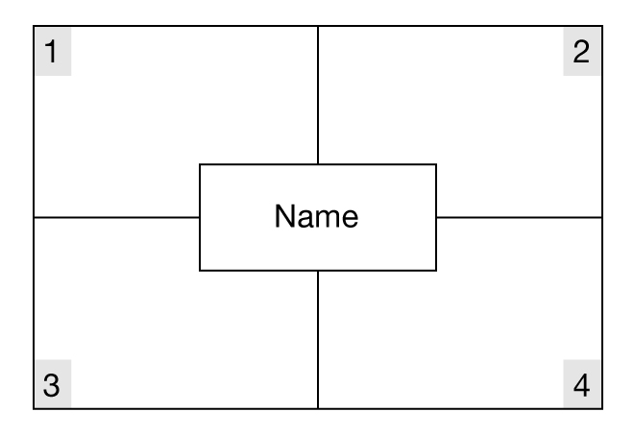
Frayer Model
Describing words
Ideas
Questions
Connections

Slide 10
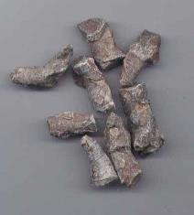
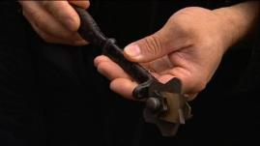
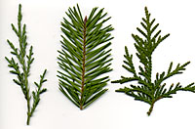
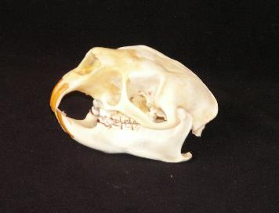
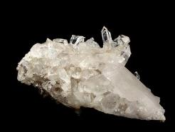
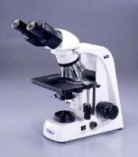
What else can you look at?

Slide 11
How Do Scientists Think?
Scientists Collaborate
Notes:
ASHLEY
[The next section describes the Science in the News activities from the resource. ]
Scientists do work individually, but they also work collaboratively to push theories forward.
It is just the same for students in the classroom. It’s important for students to work together as co-learners and co-teachers.
This is another important skill that kids need to learn that will be vital to their success in all aspects of their life.

Slide 12
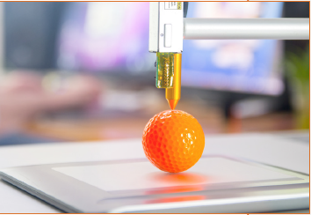
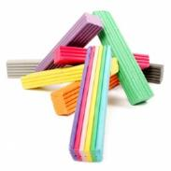
3-D Printing
With a partner, make a 3-D drawing of something to build with modelling clay.
Draw and build your design to scale with labelled measurements.
How can you measure the actual volume of modelling clay used?
Notes:
15 mins
21st Century Skills for this activity:
Creativity (Arts)
Collaboration (working with a partner)
Critical Thinking (how to measure ACTUAL volume of modelling clay used for sculpture.)
Provide time for teachers to make with clay?
Some other Critical Thinking action includes discussion around, “How might 3D printers positively impact our lives? How might they impact the environment?

Slide 13
3D Concrete Printer
Notes:
https://www.youtube.com/watch?v=GUdnrtnjT5Q

Slide 14
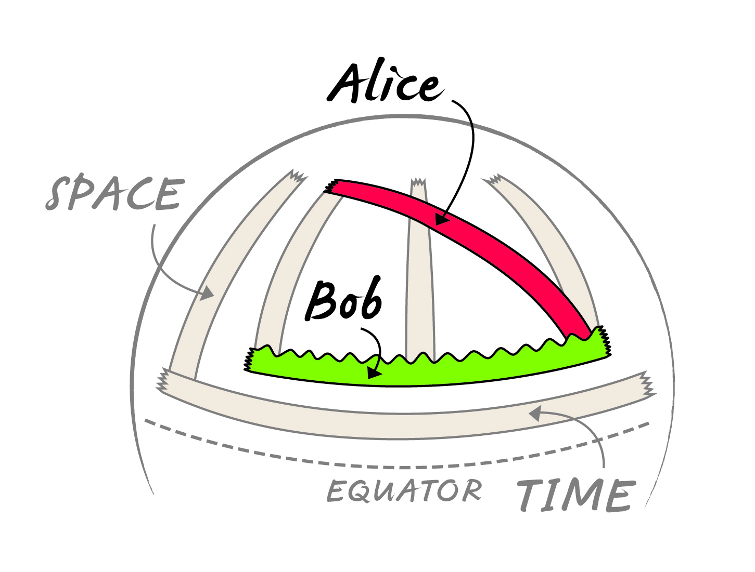
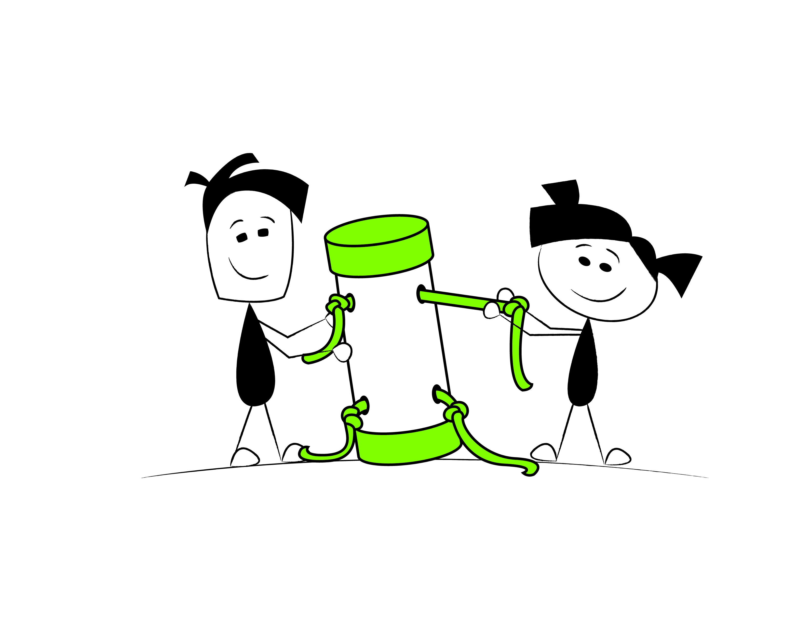
Science is a powerful way of thinking...
Curiosity
Creativity
Collaboration
Notes:
In summary.

Slide 15
PI Resource Centre
https://resources.perimeterinstitute.ca/
Notes:
Visit the website and show the teachers how to download the resources

Slide 16
Thank You! – Ευχαριστώ!!
Dave Fish
PI Teacher-in-Residence Emeritus
dfish@perimeterinstitute.ca
@DaveFishPI
Olga Michalopoulos
PI Teacher Network Lead for Greece
omichalopoulos@gmail.com

