Slide 1

How Do Scientists Think?
The Process of Science
Notes:
This slide show is meant to accompany the Perimeter Resource, Inspirations 02: The Process of Science

Slide 2
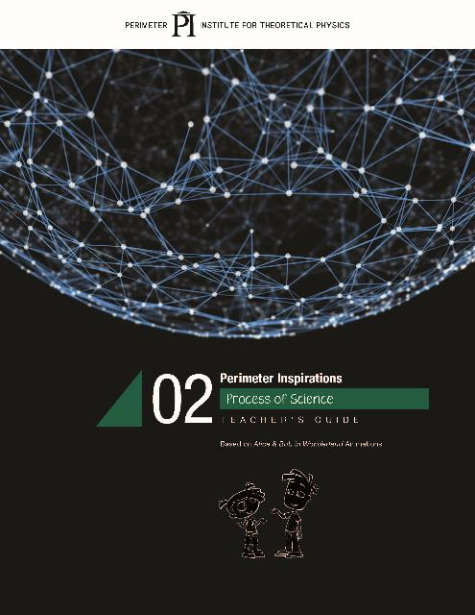

Slide 3
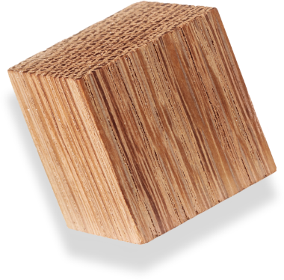

How Do Scientists Think?
Scientists Build and Revise Models
Notes:
(About 10-15 min) Using the Black Box:
-Demonstrate the box by pulling several strings
-Ask the participants to draw what they think is happening using their whiteboards
-Ask 3-4 people with different ideas to come up at the same time. Test their models, if they work, give their boards a checkmark
-Explain how nature can be described using models. We test these model/theories until they are proven wrong. At that point, they need to be thrown out or revised. Several, different models are capable of describing the same thing.
-Shake the Black Box. Show how some of the drawn models fail, while others survive.
-It is important to build vocabulary such as “predict, observe, model, etc.”

Slide 4
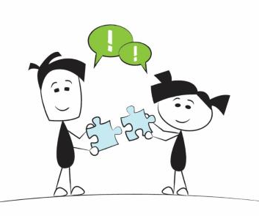
How Do Scientists Think?
Scientists Look for Patterns
Notes:
ASHLEY
[The next section describes the Science in the News activities from the resource. ]
Scientists do work individually, but they also work collaboratively to push theories forward.
It is just the same for students in the classroom. It’s important for students to work together as co-learners and co-teachers.
This is another important skill that kids need to learn that will be vital to their success in all aspects of their life.

Slide 5
Looking for patterns
spin
electric charge (Q)
strangeness (S)
mass
date

Slide 6
Finding patterns

Slide 7
Finding patterns
Column:
Same Charge
Increasing Mass
Row:
Same Strangeness

Slide 8
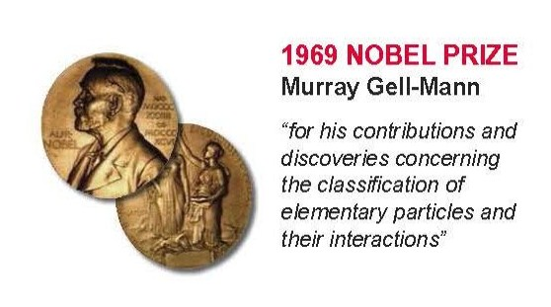
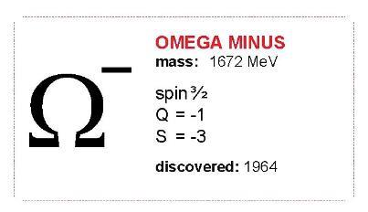
Predicting particles
spin 3/2
charge = -1
strangeness = -3
mass ≈ 1680 MeV

Slide 9
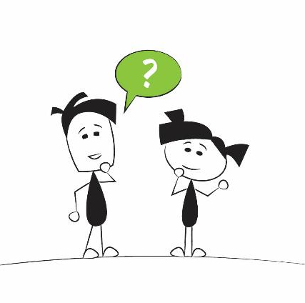
How Do Scientists Think?
Scientists Ask Questions
Notes:
The natural response to curiosity is questions.
Scientists are just big toddlers that are good at asking questions.

Slide 10

What do you see?
Download the video at: https://resources.perimeterinstitute.ca
Notes:
*Click “next” or arrow key and the video begins.
INFERENCE from the video?
Presenters asking: Scientists make observations and inferences. What is the inference that Alice makes? Why or how can she make these inferences (what observations did she have to make first)?
Inferring isn’t just a Language/Reading skill. Inferring and justifying your answer could lead to more questions.
Group Discussion: Challenge the participants to describe what is happening. How do you know? Which story is right? Can we find additional evidence? Or How should we find additional evidence?
These prints could have been made at different times/days/weeks.

Slide 11
How Do Scientists Think?
Scientists Collaborate
Notes:
ASHLEY
[The next section describes the Science in the News activities from the resource. ]
Scientists do work individually, but they also work collaboratively to push theories forward.
It is just the same for students in the classroom. It’s important for students to work together as co-learners and co-teachers.
This is another important skill that kids need to learn that will be vital to their success in all aspects of their life.

Slide 12
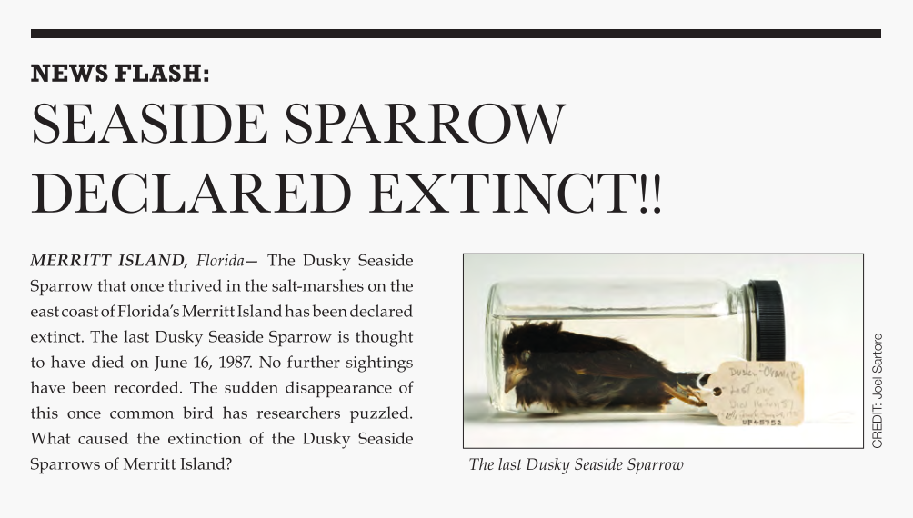
What caused the extinction?

Slide 13
DDT was used extensively in the 1940s to reduce the number of mosquitoes on Merrit Island.
Merrit Island is home to the Kennedy Space Center.
One salt marsh was drained to build a highway to connect the Space Center with Disney World.
Salt marshes on Merrit Island were protected in 1973 by the Endangered Species Act.
The Dusky Seaside Sparrow was not hunted for sport or food.
The introduction of a new predator can have a negative effect on populations.
In 1963 one marsh on the island was flooded in an attempt to reduce the mosquito population.
In the early 1970s Merritt Island experienced an increase in real estate development.
The sparrows could only nest in the cordgrass that grows in the salt marshes.
The sparrows were ground foragers that ate insects and invertebrates on dry ground.

Slide 14
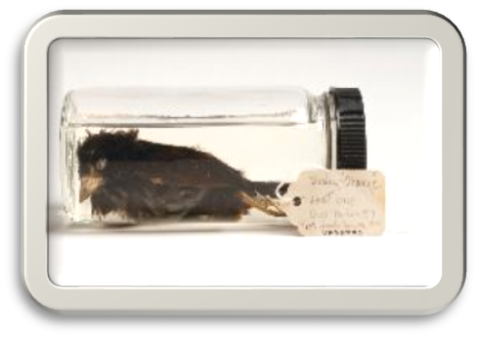
Science in the News
Seaside Sparrow Declared Extinct!
The demise of the Dusky Seaside Sparrow began with DDT spraying in the 1940s. DDT reduced the population from 2000 to 600 breeding pairs.
The sparrows were ground foragers so when the marshes were flooded in 1963, they declined further.
The final blow to the population came when the last remaining marsh was drained for development in the early 1970s.
The Endangered Species Act of 1973 came too late to save them: the damage had already been done and the population could not recover.

Slide 15
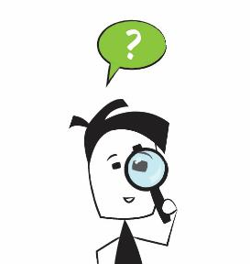
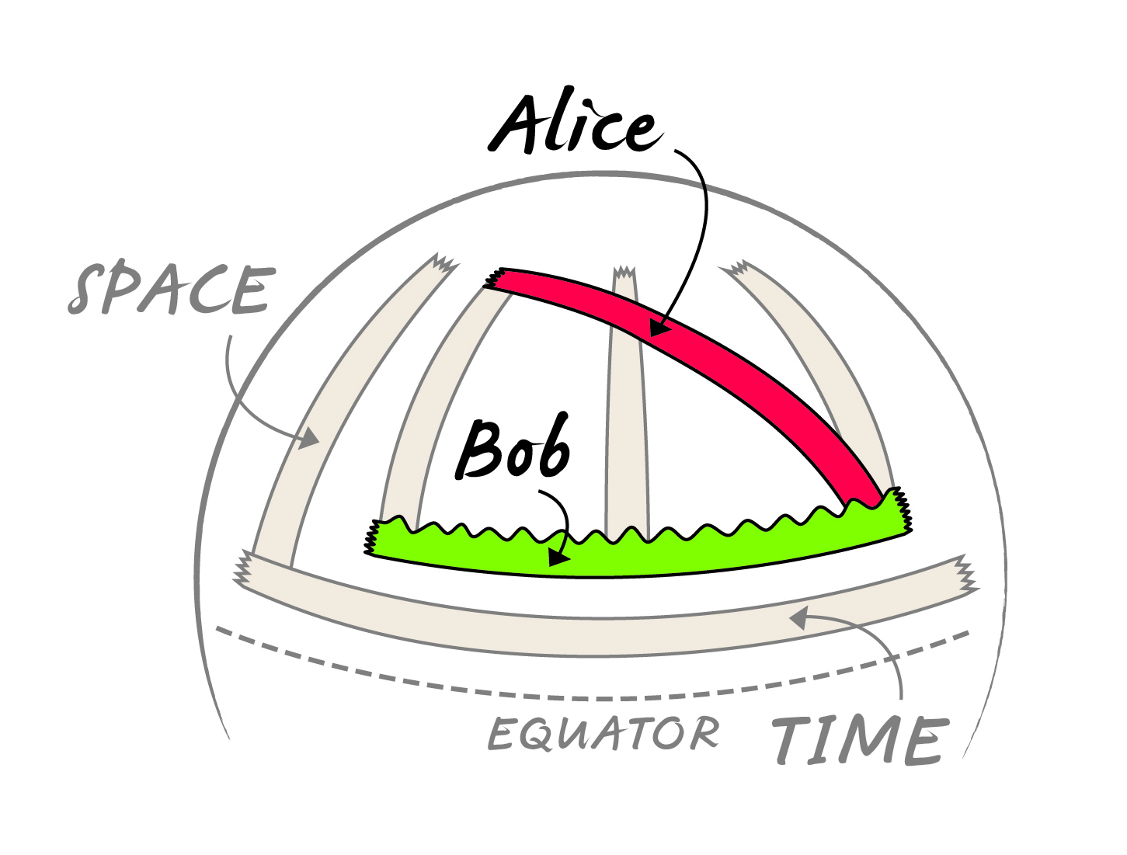
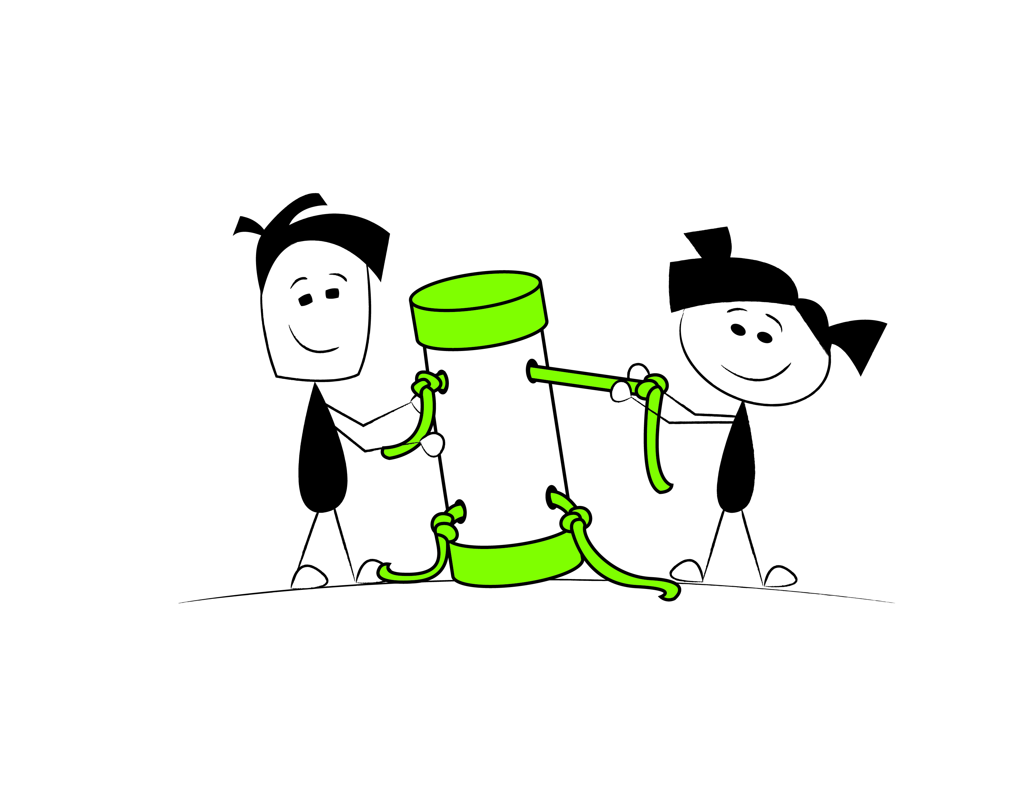
Science is a powerful way of thinking...
Curiosity
Creativity
Collaboration
Notes:
In summary.

Slide 16

PI Resource Centre
https://resources.perimeterinstitute.ca/

Slide 17
Thank You! – Ευχαριστώ!!
Dave Fish
PI Teacher-in-Residence Emeritus
dfish@perimeterinstitute.ca
@DaveFishPI
Olga Michalopoulos
PI Teacher Network Lead for Greece
omichalopoulos@gmail.com

