Slide 1
Evidence for Climate Change

Slide 2
Questions
What questions about climate change do you hear the most?
What is the question that you are most worried about being asked?
What is the question you have always wanted to ask?

Slide 3
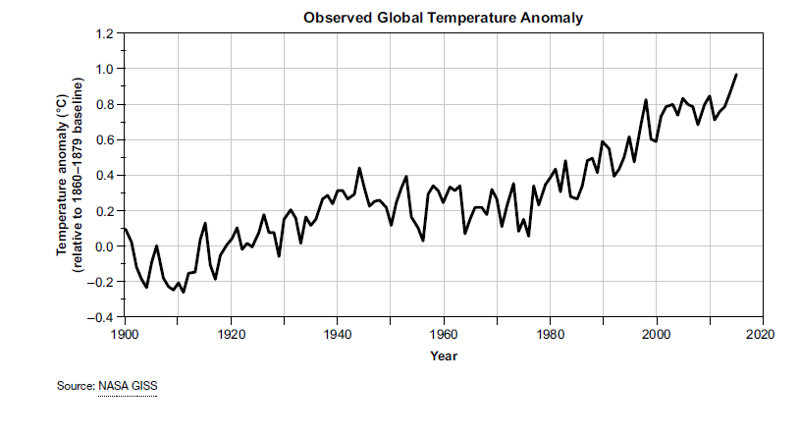
Earth is getting warmer
Notes:
I believe this is land temperature, right? Averaged over many different sites.

Slide 4
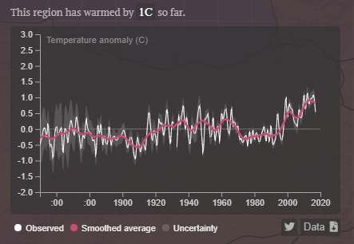
Athens is getting warmer
Notes:
Data taken from Carbon Brief (https://www.carbonbrief.org/mapped-how-every-part-of-the-world-has-warmed-and-could-continue-to-warm) Interactive Map
Based on Berkeley Earth degree by degree avg temperature
Discuss with your neighbours. What are the reasons that you have heard for rising temperatures?

Slide 5
A few degrees may not seem like much…
37ºC = healthy
39ºC = sick
Notes:
Students might think that 2 degrees isn’t much but…

Slide 6
Global warming 1880 to 2017
Notes:
https://climate.nasa.gov/climate_resources/139/

Slide 7
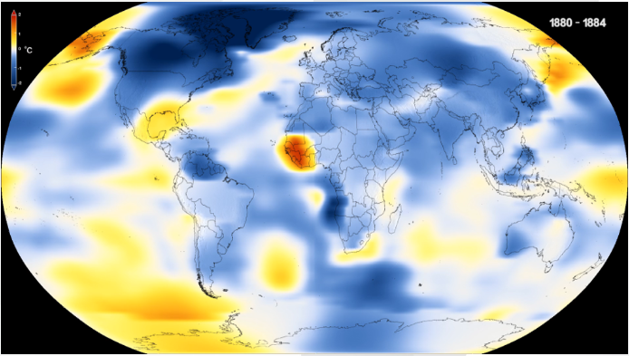
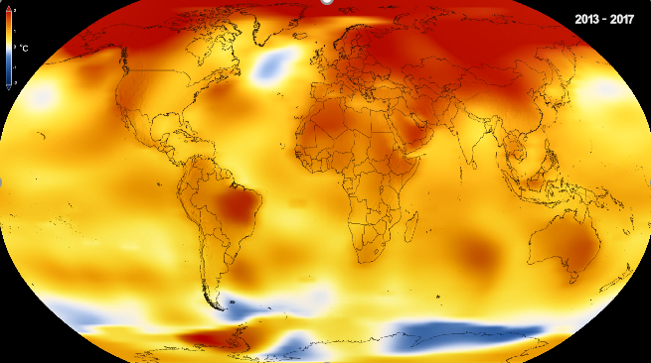
1880 2017
Notes:
https://climate.nasa.gov/climate_resources/139/

Slide 8
Notes:
Annual average temperatures for Greece from 1901-2018 using data from Berkeley Earth.
https://showyourstripes.info/
For most countries, the data comes from the Berkeley Earth temperature dataset, updated to the end of 2018. For some countries (USA, UK, Switzerland & Germany) the data comes from the relevant national meteorological agency. For each country, the average temperature in 1971-2000 is set as the boundary between blue and red colours, and the colour scale varies from +/- 2.6 standard deviations of the annual average temperatures between 1901-2000.

Slide 9
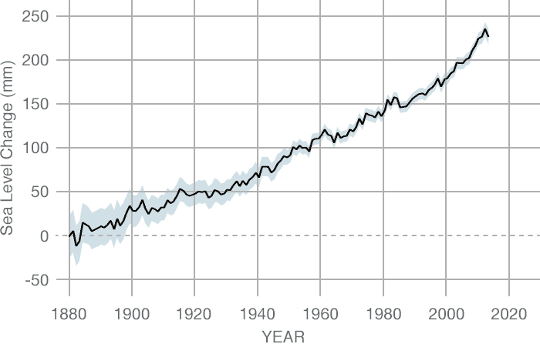
Sea Levels are rising
CREDIT: CSIRO
Notes:
Data source: Coastal tide gauge records. Credit: CSIRO
https://climate.nasa.gov/vital-signs/sea-level/

Slide 10
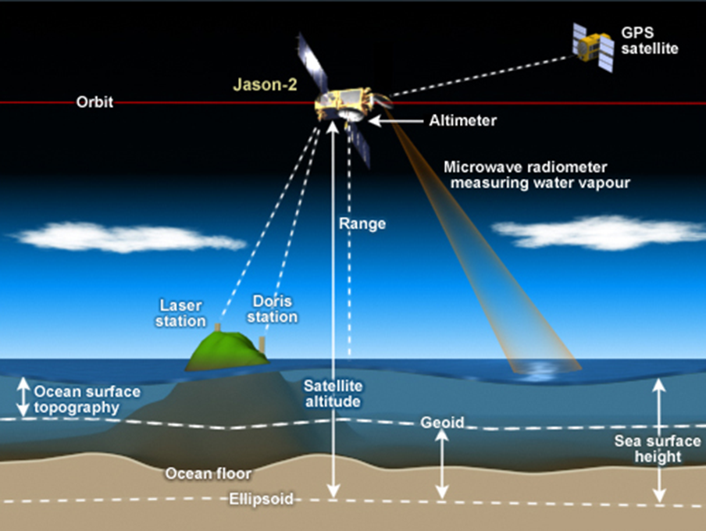
Satellite Altimetry: Measuring Sea Level
Notes:
Distribute the Satellite Altimetry card. Quick explanation for one way to measure sea levels is to bounce radar signals between satellites and sea surface

Slide 11
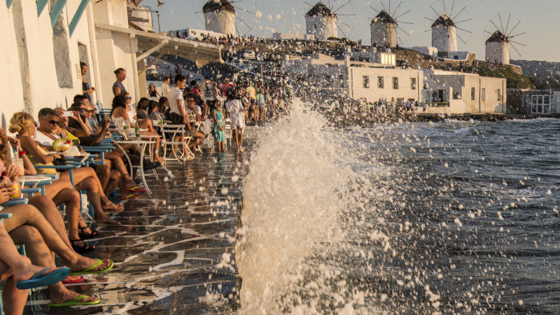
A few centimetres may not seem like much…
www.david baxendale.com/Flickr
The coastline of Mykonos could move 150m inland as the sea level rises.
Notes:
Mean sea level in the Mediterranean is expected to rise at the rate of 5 cm/decade. In particular sea level will rise about 50 cm by the year 2100 (with an uncertainty range of 20-86 cm). Delta Nile, Venice and Thessalonica appear to be the more sensitive areas in the Mediterranean (1).

Slide 12
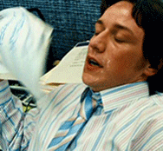
Heat
Predict
Observe
Explain
Apply
Notes:
Heat
Predict
Observe
Explain
Apply

Slide 13
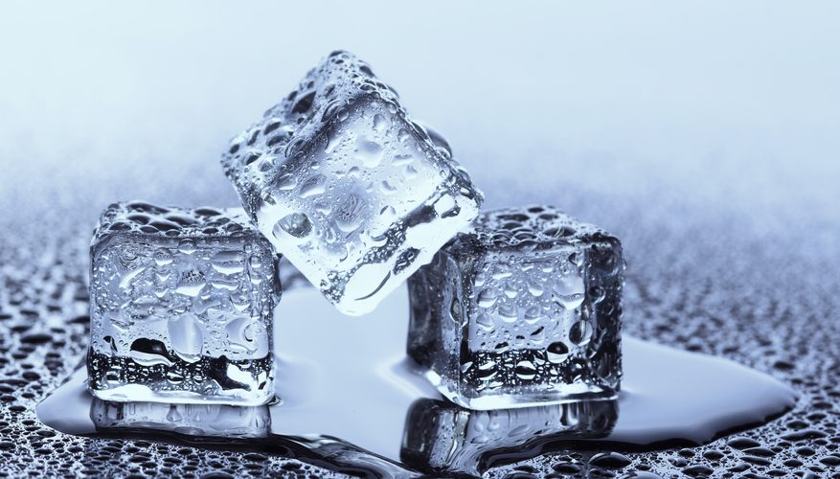
Predict and Explain: What happens when ice heats up?
Notes:
What happens when ice heats up?
How does this relate to Earth?

Slide 14
Predict and Explain: What happens when water heats up?
Notes:
What happens when water heats up?
How does this relate to the Earth?

Slide 15
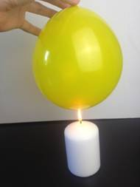
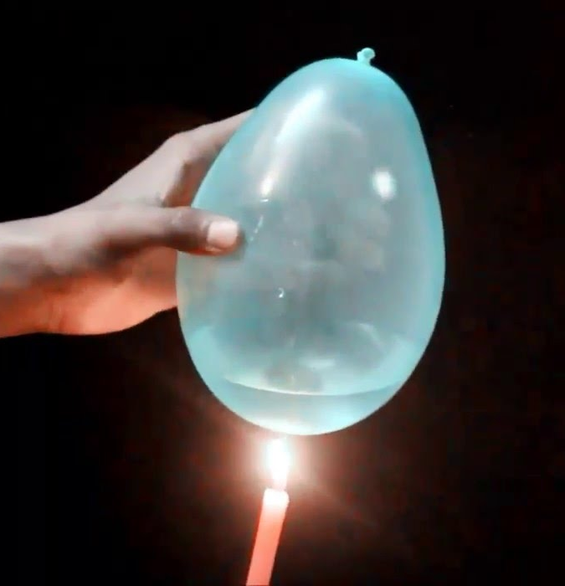
Predict and Explain: What happens to the balloons?
air
water
Notes:
What happens to the balloons?
How does this relate to the Earth?

Slide 16
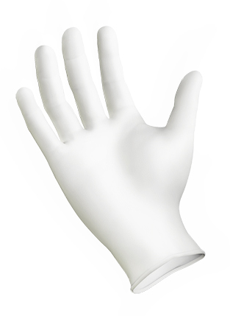
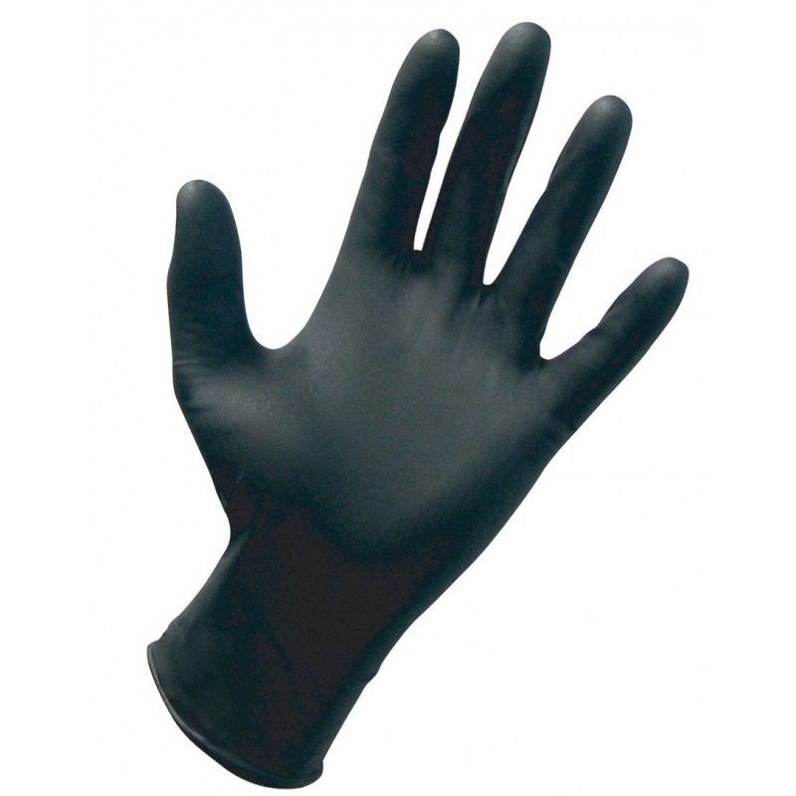
Predict and Explain: How will this feel?
Notes:
How will this feel?
How does this relate to the Earth?

Slide 17
A Climate Change demo
Download the video at: https://resources.perimeterinstitute.ca

Slide 18
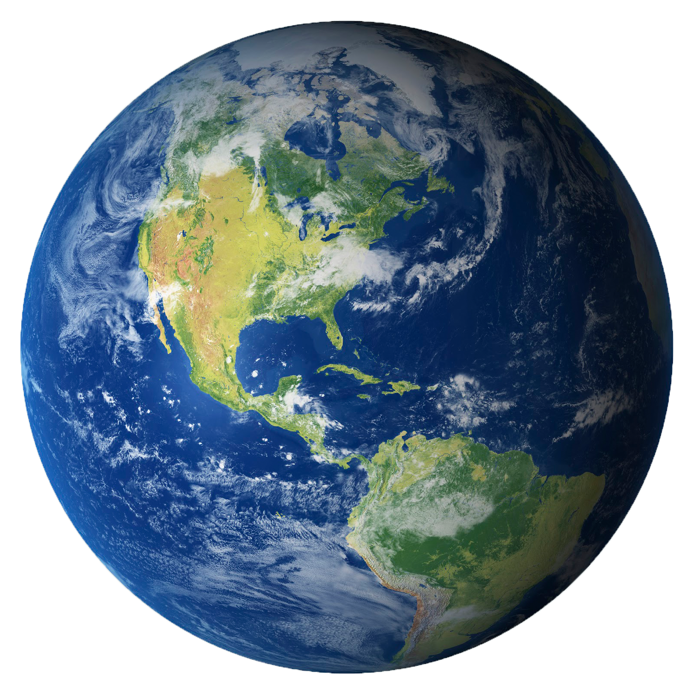
How do these observations relate to the Earth?
Notes:
The implications
How does this relate to the Earth?

Slide 19
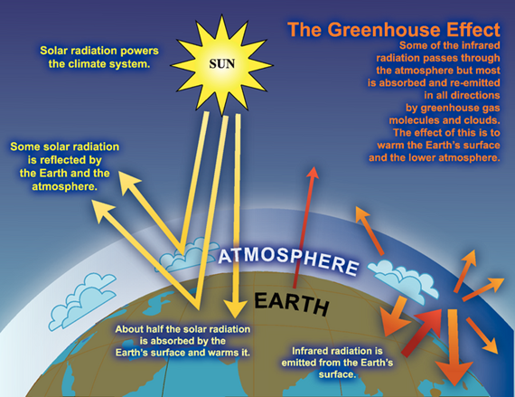
Earth’s atmosphere traps heat
Notes:
Earth’s atmosphere traps heat; analogy isn’t strong… don’t push it!
Image source
International Panel on Climate Change 2007b: The image is described as an “idealized model of the natural greenhouse effect”
https://wg1.ipcc.ch/publications/wg1-ar4/faq/wg1_faq-1.3.html

Slide 20
Keeling Curve
Measurement of the concentration of CO₂ in the atmosphere
Continuous record at Mauna Loa since 1958
Notes:
Faster then in Dec

Slide 21
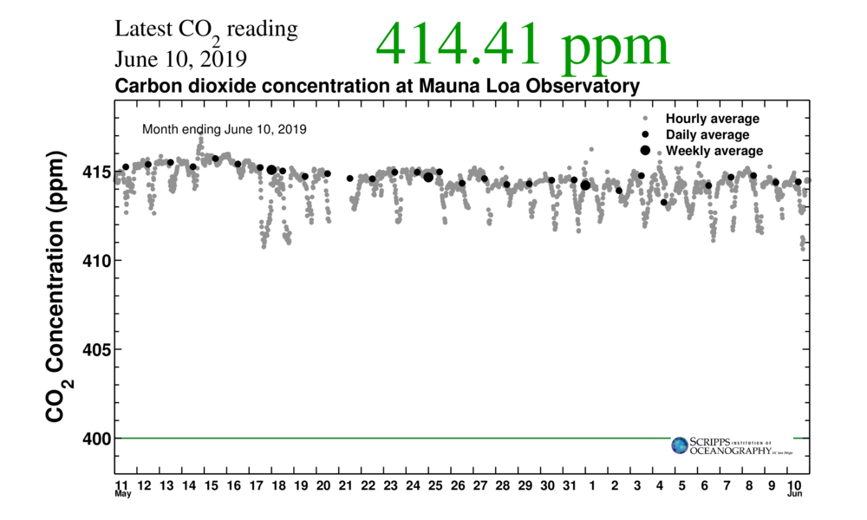
One month
Notes:
https://scripps.ucsd.edu/programs/keelingcurve/wp-content/plugins/sio-bluemoon/graphs/mlo_one_month.png
What do you notice?

Slide 22
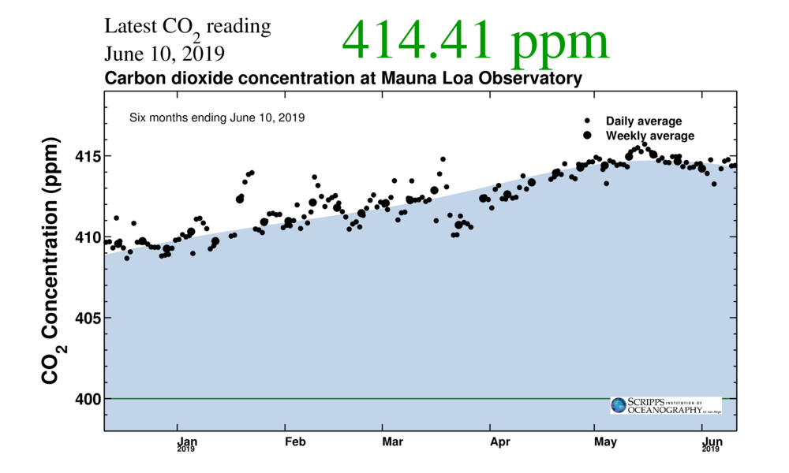
Six months
Notes:
https://scripps.ucsd.edu/programs/keelingcurve/wp-content/plugins/sio-bluemoon/graphs/mlo_six_months.png
What do you notice?

Slide 23
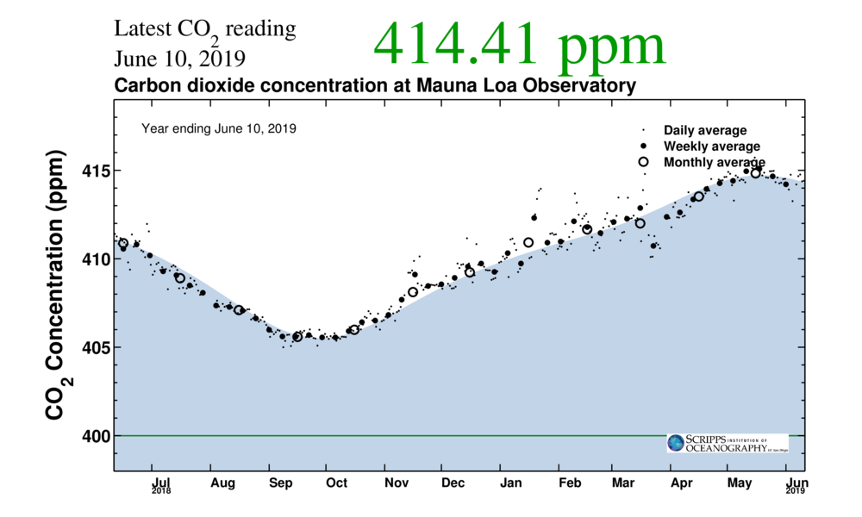
1 year
Notes:
https://scripps.ucsd.edu/programs/keelingcurve/wp-content/plugins/sio-bluemoon/graphs/mlo_one_year.png
What do you notice?

Slide 24
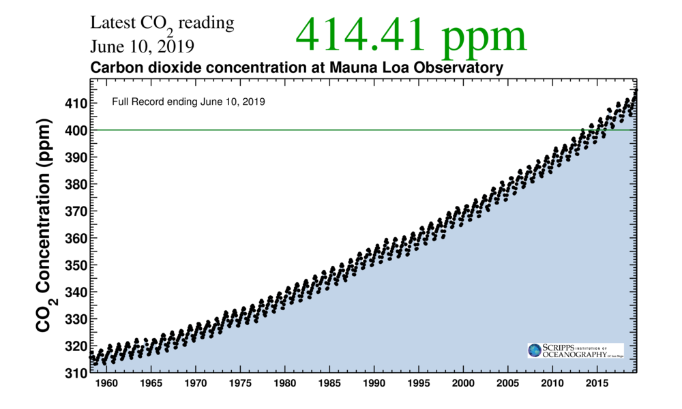
Full record
Notes:
https://scripps.ucsd.edu/programs/keelingcurve/wp-content/plugins/sio-bluemoon/graphs/mlo_full_record.png
What do you notice?
Consider what you saw in the video about how carbon dioxide interacts with IR light. What does this imply about the energy in the atmosphere.

Slide 25
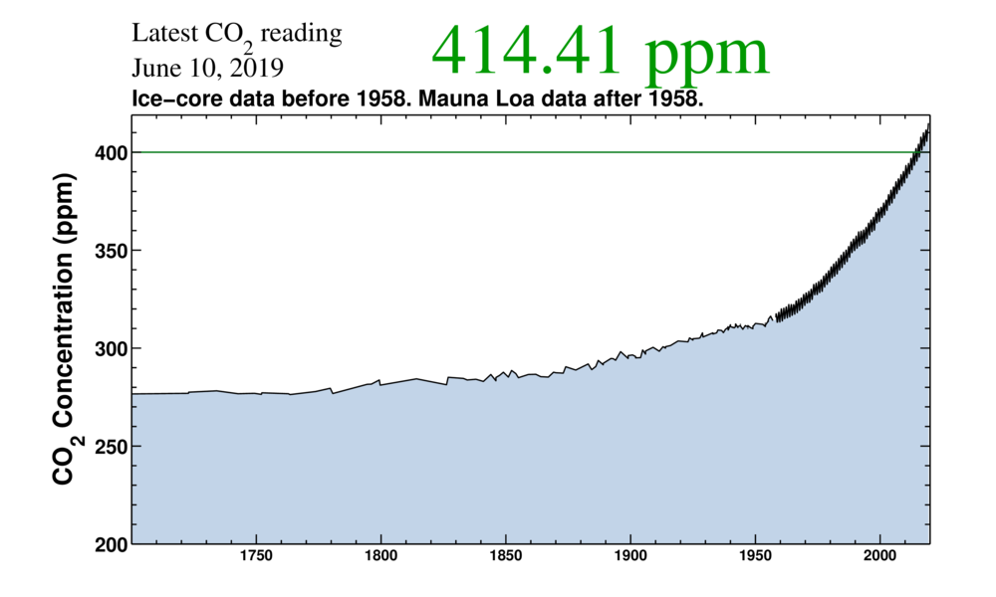
1700 - present
Notes:
https://scripps.ucsd.edu/programs/keelingcurve/wp-content/plugins/sio-bluemoon/graphs/co2_800k_zoom.png
This graph combines Mauna Loa data with ice core measurements. What do you notice? What historical events coincide with the change in CO2 levels?
Law Dome ice cores from the late 1990s provided continuity of measurement by confirming CO2 levels in bubbles up to the mid 1970s.

Slide 26
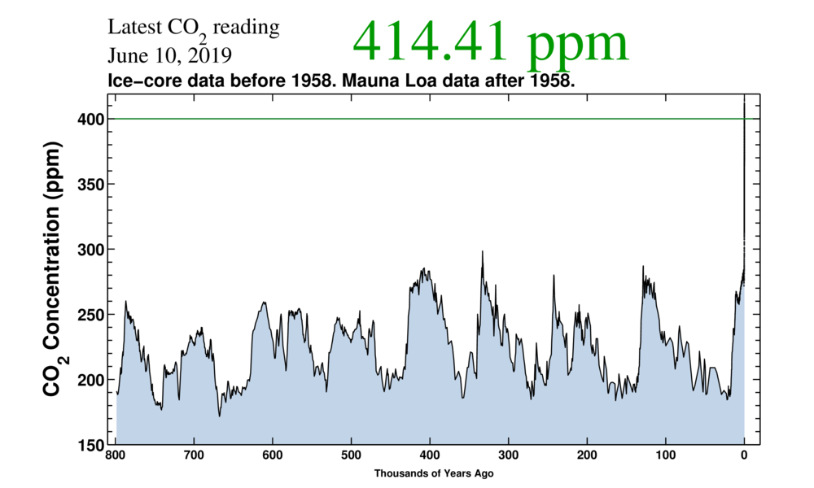
Last 800,000 years
Notes:
https://scripps.ucsd.edu/programs/keelingcurve/wp-content/plugins/sio-bluemoon/graphs/co2_800k.png
Climate deniers often say that Earth’s climate has cycles and we are in another cycle. How is this true and how is this false?

Slide 27
Observe and Explain
Notes:
Oceans absorb 90% of the heat from climate change

Slide 28
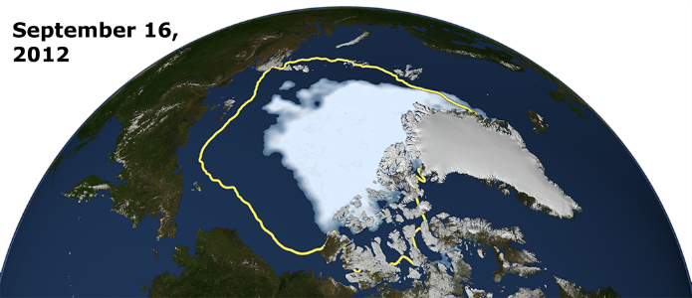
Apply:
Less sea ice accelerates climate change
Notes:
Less sea ice accelerates climate change

Slide 29
Notes:
One significant change in the Arctic region in recent years has been the rapid decline in perennial sea ice. Perennial sea ice, also known as multi-year ice, is the portion of the sea ice that survives the summer melt season. Perennial ice may have a life-span of nine years or more and represents the thickest component of the sea ice; perennial ice can grow up to four meters thick. By contrast, first year ice that grows during a single winter is generally at most two meters thick.
Below is an animation of the weekly sea ice age between 1984 and 2016. The animation shows the seasonal variability of the ice, growing in the Arctic winter and melting in the summer. In addition, this also shows the changes from year to year, depicting the age of the sea ice in different colors. Younger sea ice, or first-year ice, is shown in a dark shade of blue while the ice that is four years old or older is shown as white. A color scale identifies the age of the intermediary years.
A graph in the lower, right corner the quantifies the change over time by showing the area in millions of square kilometers covered by each age category of perennial sea ice. This graph also includes a memory bar - the green line that here represents the current maximum value seen thus far in the animation for the particular week displayed. For example, when showing the first week in September, the memory bar will show the maximum value seen for all prior years' first week of September since the beginning of the animation (January 1, 1984).
Correction: The original release on 10/28/2016 incorrectly labeled the oldest category on the graph as "5+". This was corrected to read "4+" on 10/30/2016.

Slide 30
Observe and Explain
water

Slide 31
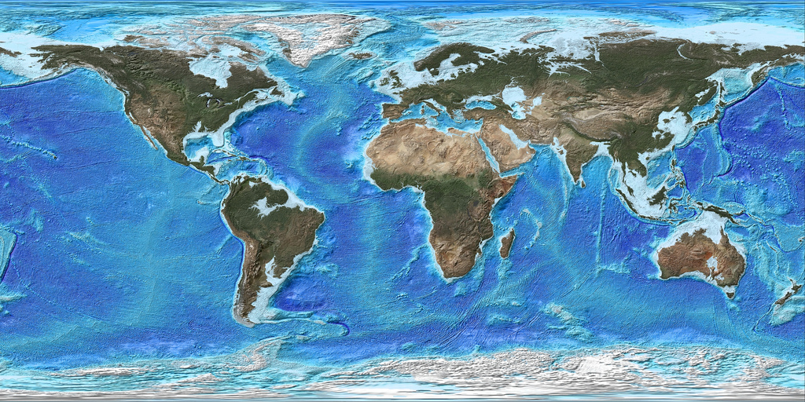
Apply: 70% of the Earth is covered by water
Notes:
70% of the Earth is covered by water

Slide 32
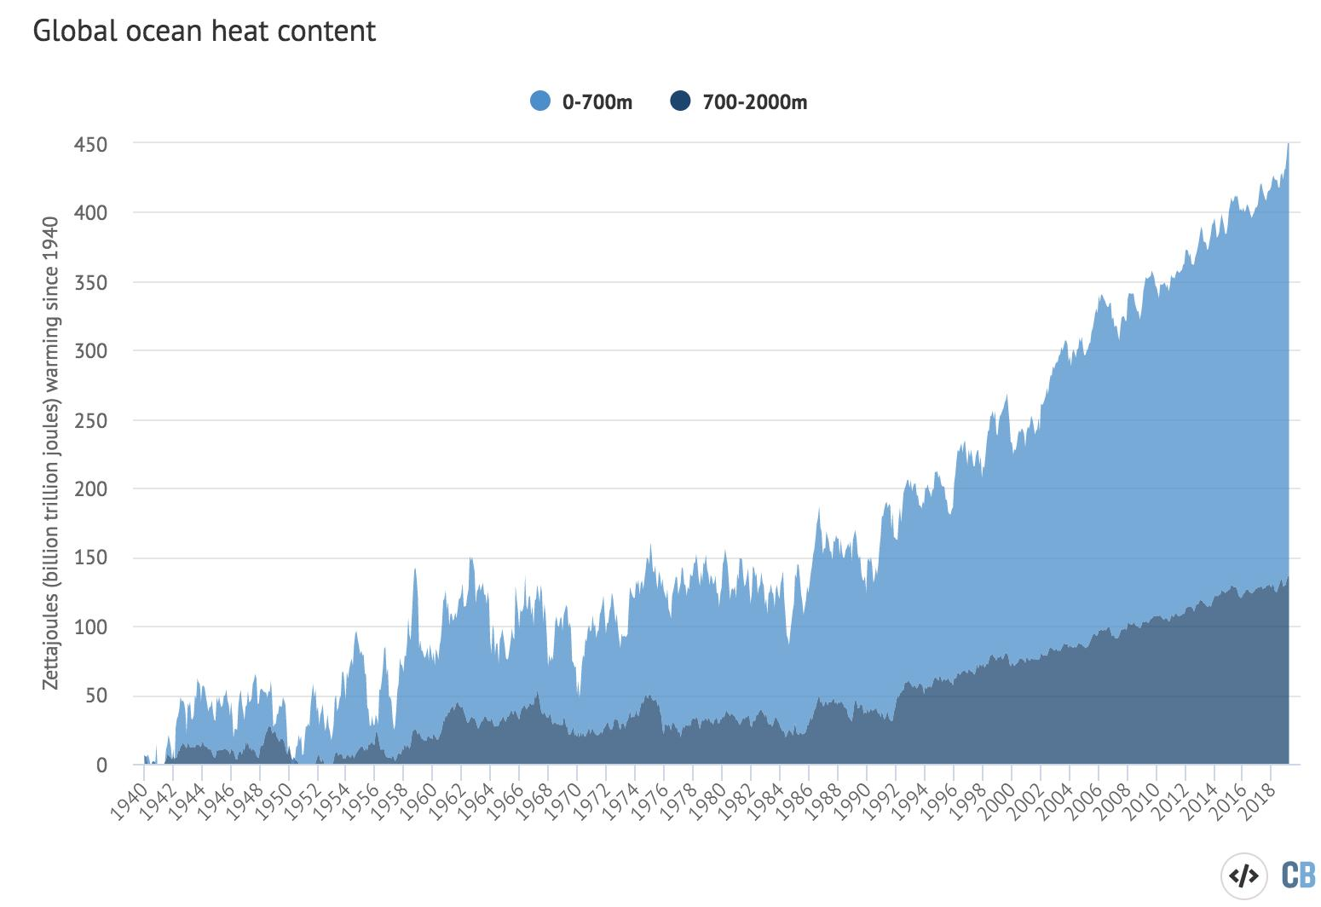
Oceans are hotter

Slide 33
Observe and Explain

Slide 34
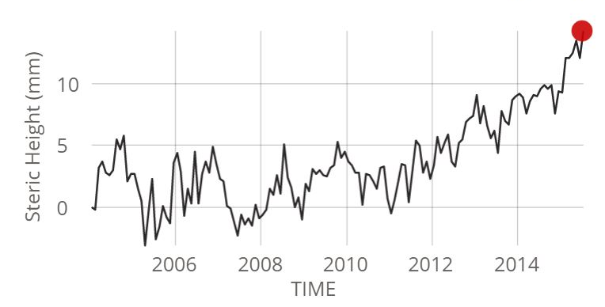
Apply: Measuring the Ocean’s Volume

Slide 35
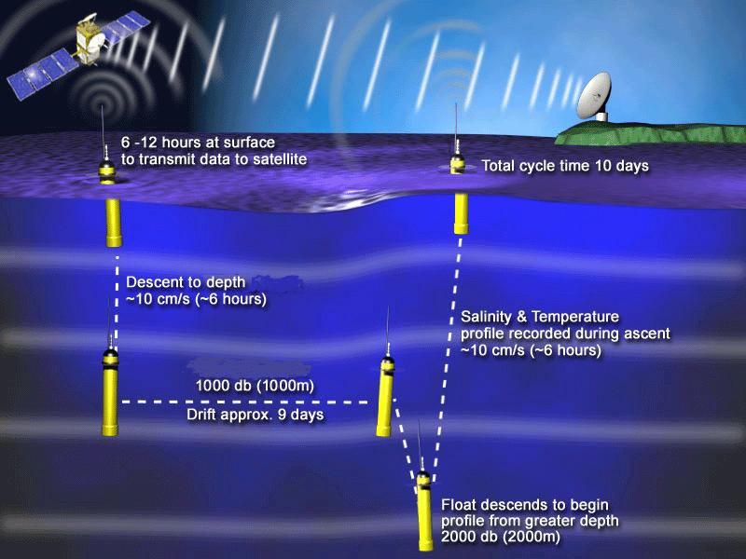
ARGO: Measuring the Ocean’s Volume
Notes:
ARGO measures salinity and temperature at two different depths

Slide 36
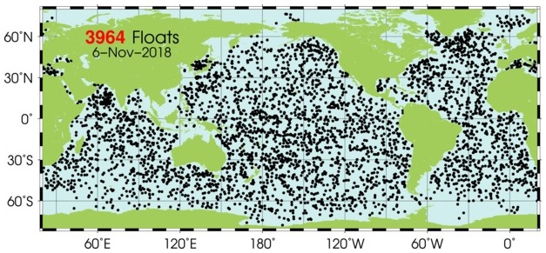
ARGO: Measuring the Ocean’s Volume
Notes:
Almost 4000 probes spread around the globe

Slide 37
Observe and Explain

Slide 38
Apply:
Land Ice vs Sea Ice
Notes:
Land ice vs Sea Ice

Slide 39
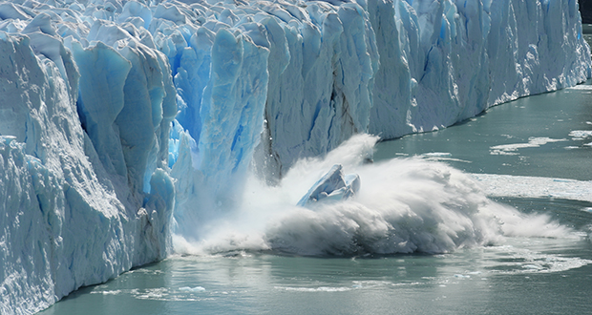
A melting ice berg does not cause a direct change in sea level
A melting glacier adds water to the ocean and causes a direct change in sea level
Notes:
A melting ice berg does not cause a direct change in sea level
A melting glacier adds water to the ocean and causes a direct change in sea level

Slide 40
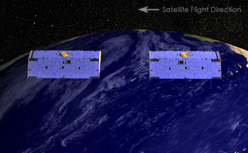
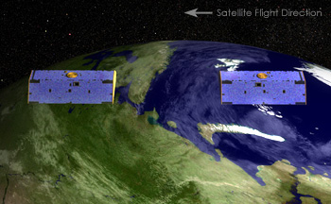
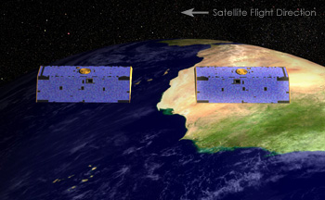
GRACE: Measuring Land Ice Mass
Notes:
Two satellites orbiting 220 km apart. Exact separation is measured using microwaves and GPS.
As lead satellite approaches more mass it accelerates slightly and moves away from trailing satellite.
GRACE can map out gravitational anomaly (and therefore mass) with great precision.

Slide 41
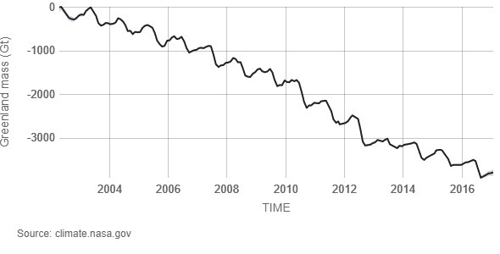
Antarctica ice mass is decreasing at 127 Gt per year
> 400 Gt per year!
Greenland ice mass is decreasing at 286 Gt per year
Notes:
Antarctica ice mass is decreasing at 127 Gigatonnes per year
Greenland ice mass is decreasing at 286 Gigatonnes per year

Slide 42
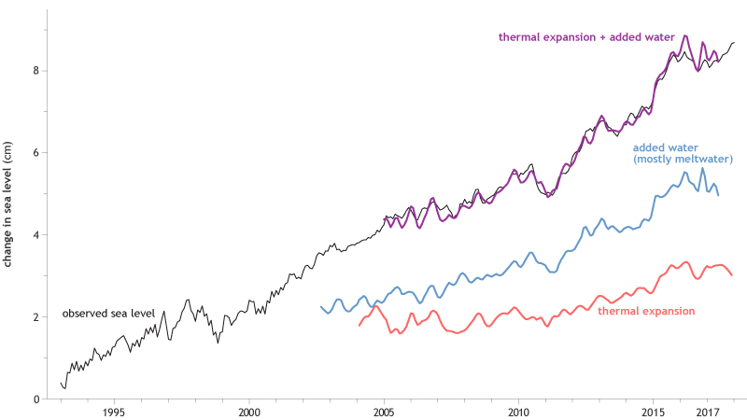
Sea Level Budget
Notes:
When we combine the sea level rise determined by ARGO (Thermal expansion) and GRACE (Added meltwater) we get the total observed sea level rise.

Slide 43
Examine all the data
Arrange the factors from largest to smallest contributor.
Which ones are positive forcings?
Which ones are anthropogenic?
Predict the overall temperature and share your prediction with the facilitator.
Notes:
JIGSAW groups of 6. (One from each forcing group)
Examine all the data
Put the factors in order from largest to smallest contributor.
Which ones are positive forcings?
Which ones are anthropogenic?
Predict the overall temperature & share your predict with the facilitator.

Slide 44
It’s not solar variation

Slide 45
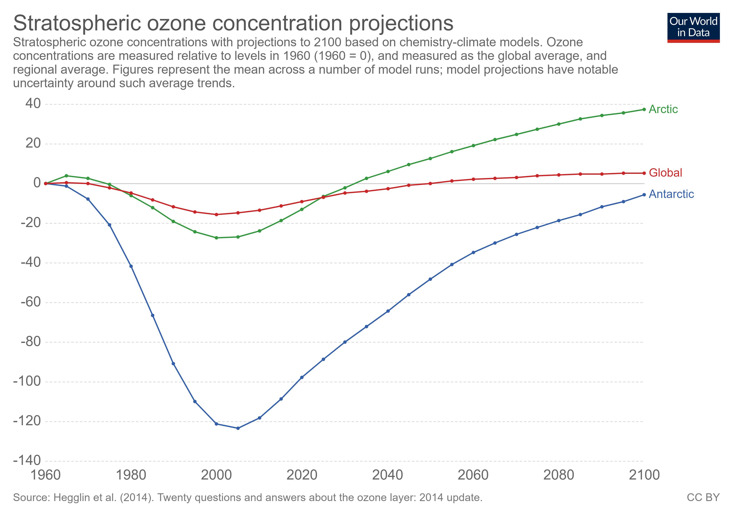
It’s not ozone depletion

Slide 46
It’s not volcanoes

Slide 47
And it’s not land use or …
Notes:
https://science2017.globalchange.gov/chapter/2/

Slide 48
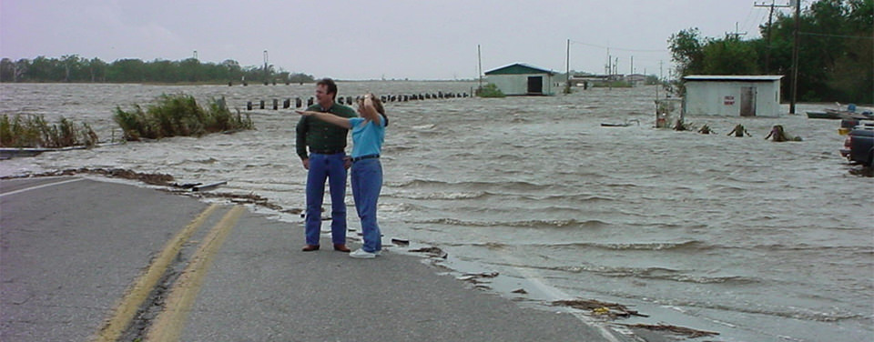
Effects of climate change
Increased flooding
Notes:
The Effects of Climate Change
Rising sea levels
86 mm since 1993
https://climate.nasa.gov/vital-signs/sea-level/

Slide 49
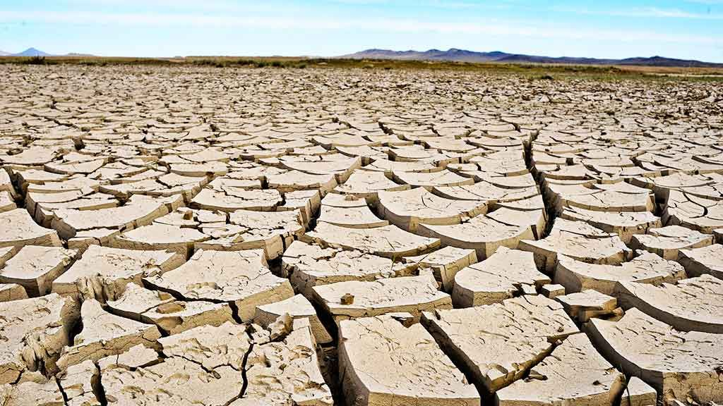
Effects of climate change
More extreme weather events
Notes:
The Effects of Climate Change
More extreme weather events
https://climate.nasa.gov/effects/

Slide 50
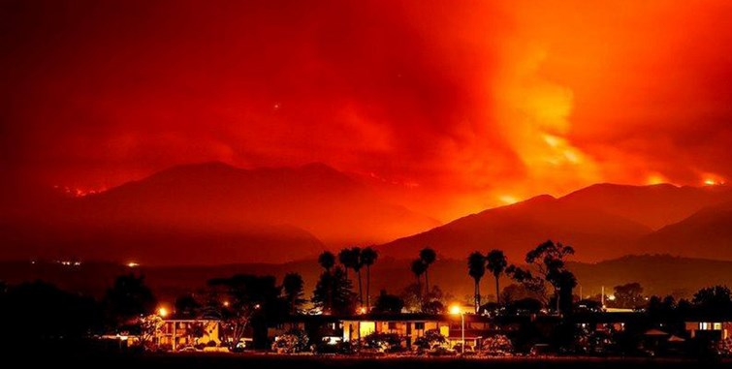
Effects of climate change
More intense wildfires
Notes:
The Effects of Climate Change
More extreme weather events
https://www.ucsusa.org/sites/default/files/legacy/assets/documents/global_warming/ucs-ca-wildfires-1.pdf

Slide 51
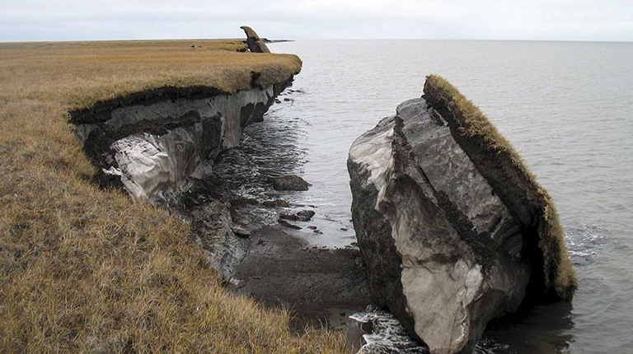
Effects of climate change
Thawing permafrost
Notes:
The Effects of Climate Change
Thawing permafrost
https://blogs.ei.columbia.edu/2018/01/11/thawing-permafrost-matters/

Slide 52
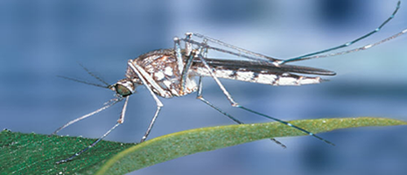
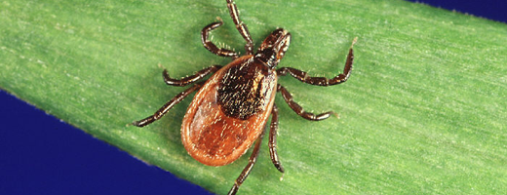
Effects of climate change
Spreading diseases
Notes:
The Effects of Climate Change
Mosquitoes and Ticks are examples of changing vector-borne diseases
https://www.canada.ca/en/health-canada/services/climate-change-health.html

Slide 53
Climate Change
It’s real…
It’s us…
It’s serious…
And the window of time to prevent dangerous impacts is closing fast.
Katharine Hayhoe, Texas Tech

Slide 54
Resources
Notes:
Kathrine Hayhoe is a Canadian climate scientist in Texas. Follow her on Twitter and YouTube.
SkepticalScience is a fantastic website/app with a huge amount of climate information. They had an app but it seems to have been removed from Google Play Store.
https://www.carbonbrief.org/ is an excellent environmental website with lots of good, current data and analysis.
https://climate.nasa.gov/ is the official NASA Climate site
https://www.climateprediction.net/ is a large citizen science project running climate models on individual computers.

Slide 55
Some positive actions being taken:
Ozone layer is recovering
World bank no longer funding fossil fuel exploration
Cost of batteries is falling rapidly
UK is no longer using coal to generate electricity
Students striking for climate action

Slide 56
Project Drawdown Top 10
Refrigerant Management ($3M Global Cooling Prize)
Wind Turbines
Reduced Food Waste
Plant-Rich Diet
Tropical Forests
Educating Girls
Family Planning
Solar Farms
Silvopasture
Rooftop Solar
Notes:
This table provides the detailed results of the Plausible Scenario, which models the growth solutions on the Drawdown list based on a reasonable, but vigorous rate from 2020-2050. Results depicted represent a comparison to a reference case that assumes 2014 levels of adoption continue in proportion to the growth in global markets.
https://www.drawdown.org/solutions-summary-by-rank

Slide 57
Simple actions you can take:
Talk about Climate Change
Reduce your own personal footprint
Transportation and energy choices
Carbon offsets
Dietary choices
Lobby for systemic change
Political, social, economic

Slide 58
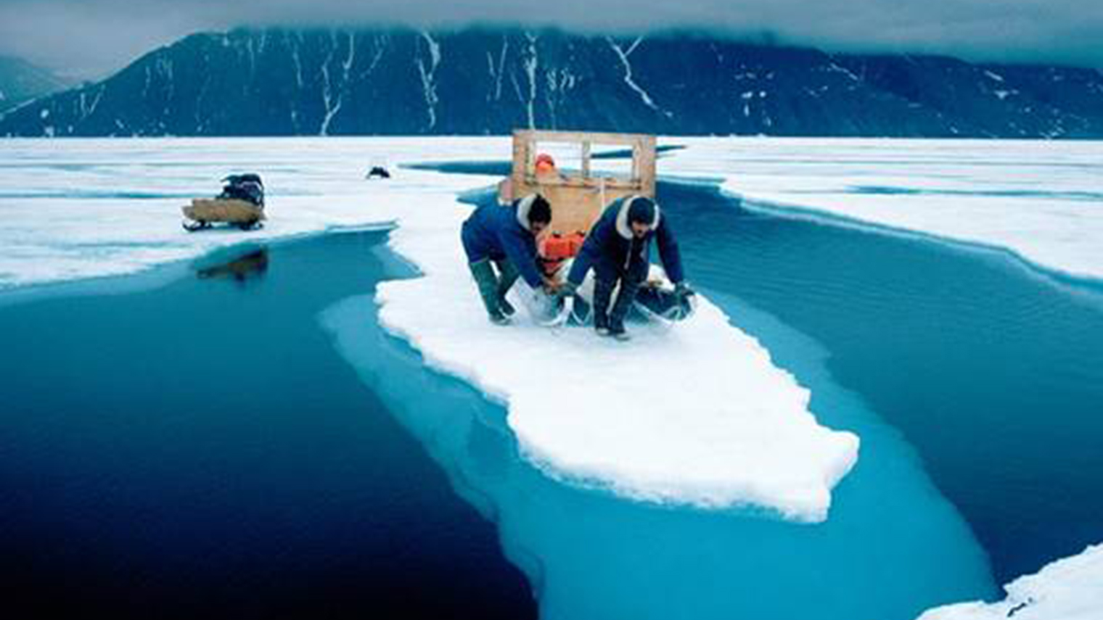
PI Resource Centre
Evidence for Climate Change
https://resources.perimeterinstitute.ca/
Notes:
Visit the website and show the teachers how to download the resources

Slide 59
Thank You! - Ευχαριστώ!!
Dave Fish
PI Teacher-in-Residence Emeritus
dfish@perimeterinstitute.ca
Olga Michalopoulos
PI Teacher Network Lead for Greece
omichalopoulos@gmail.com

