Slide 1

Black Holes

Slide 2
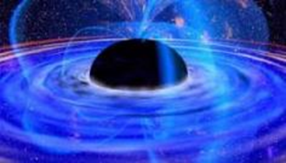
Why Teach Black Holes?
Student curiosity
Extreme parts of the universe – Push the laws of nature
Crucial to formation of galaxies
Notes:
Black holes are a natural hook for most students

Slide 3
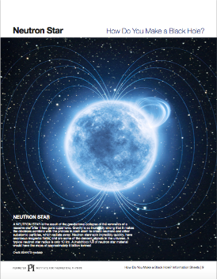
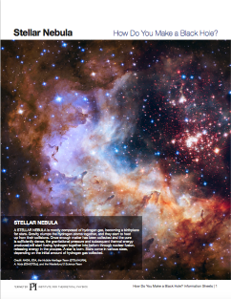
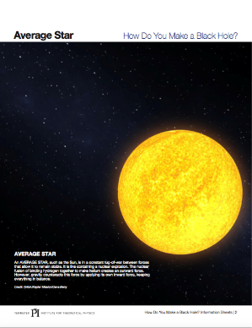
Formation of a Black Hole
Form groups of 4.
Arrange the information sheets into the correct order for a star life cycle.

Slide 4
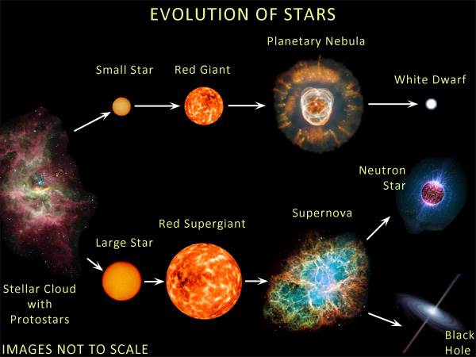

Slide 5
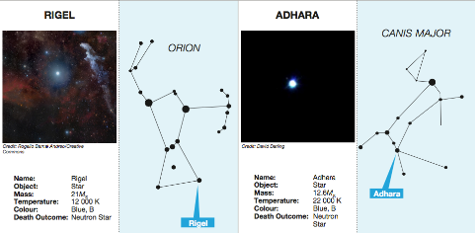
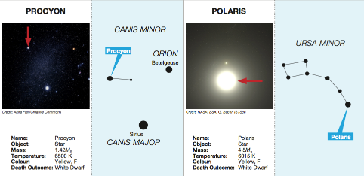
Formation of a Black Hole
Sort the cards to determine which stars will become white dwarfs, neutron stars, and black holes.

Slide 6
Formation of a Black Hole
Create a number line like the one below and mark the divisions between white dwarf, neutron star, and black hole
White Dwarf
Neutron Star
Black Hole
0 5 10 15 20 25 30 35…
Solar Mass Units

Slide 7
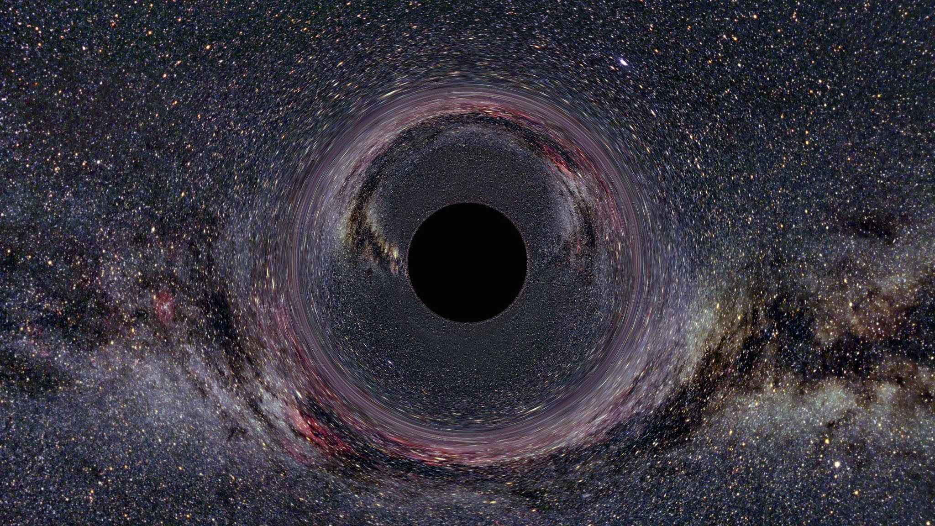
Black Holes
Notes:
There is perhaps no environment more extreme than that of a black hole. Black holes are some of the most mysterious and extreme objects in the Universe – things go in, but nothing can come out.
When we look out at the Universe, really our only way to get information about the objects we see is to collect light from them, but in the case of black holes, nothing, not even light can escape them
In this session we are going to examine the life cycle of stars to determine what type of star becomes a black hole, and we are going to explore the creative ways astrophysicists have used to observe these mysterious objects.

Slide 8
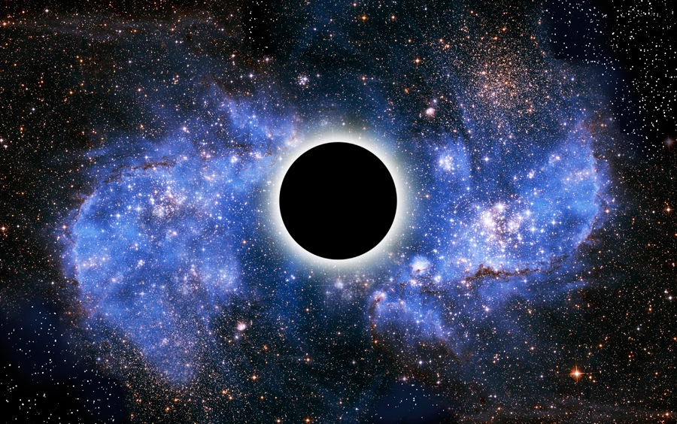
How do you make a black hole?
Notes:
But first, let’s ask ourselves what are black holes anyway and why can’t anything, not even light escape them

Slide 9
How do you make a black hole?
Download the video at: https://resources.perimeterinstitute.ca

Slide 10
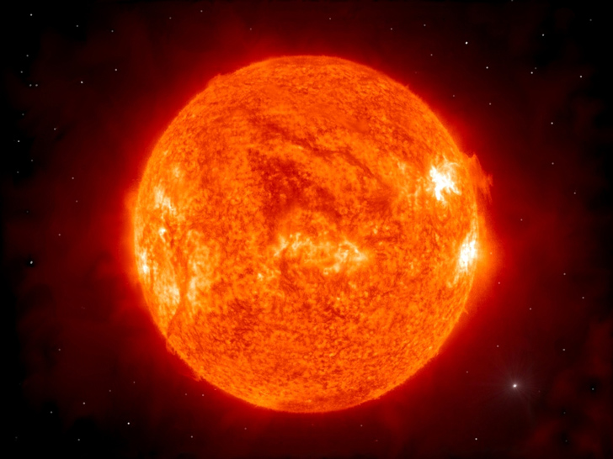
Gravity
Pressure
Notes:
In some systems, like stars, it is possible for a black hole to form once the star runs out of fuel
When it does run out of fuel, gravity will win over pressure and the star collapses

Slide 11
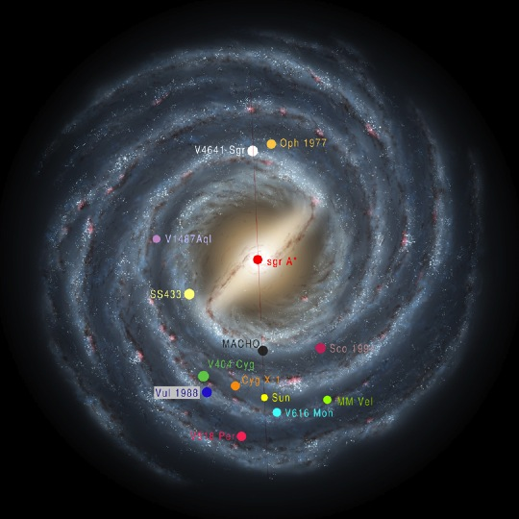

Slide 12
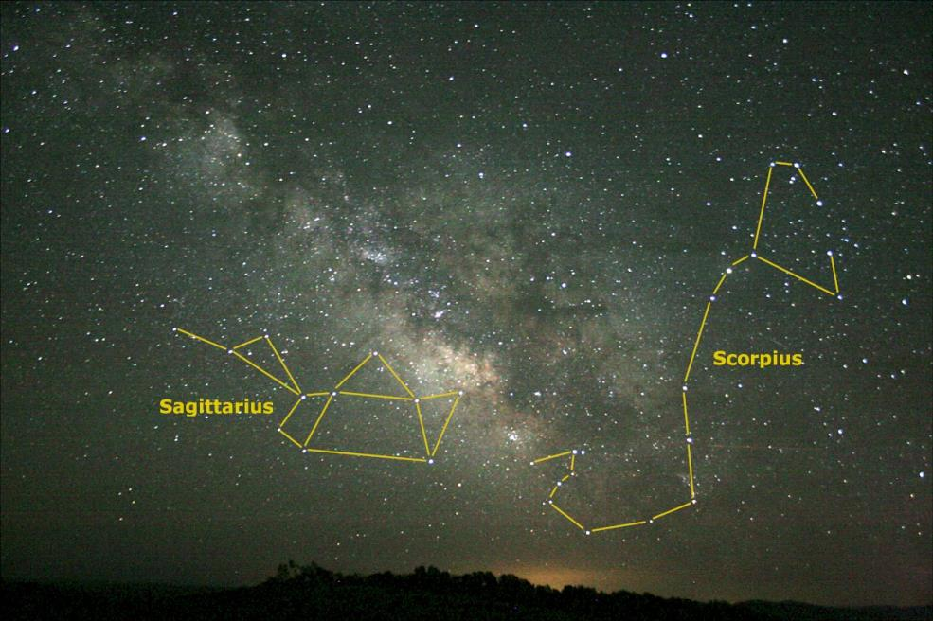

Slide 13
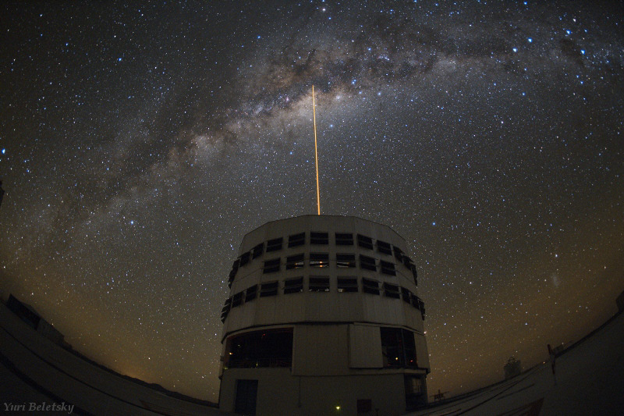

Slide 14
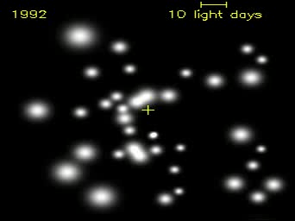
Black Hole at the Center of the Milky Way
Stars orbit about ‘something’ invisible
How can we find the mass of that ‘something’?
Sgr A*

Slide 15

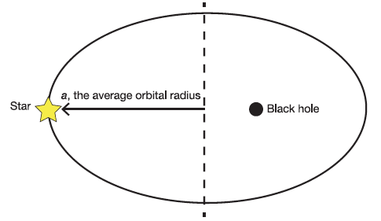
Kepler’s Third Law

Slide 16
Calculate…
Supermassive black hole, Sgr A*

Slide 17
Then graph…
a³ (x10⁹ AU³)
T² (x10³ years²)

Slide 18
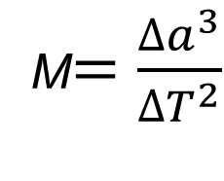
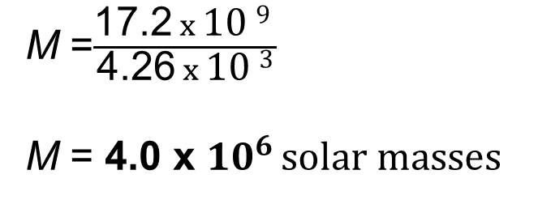
And calculate slope…
a³ (x10⁹ AU³)
16
14
12
10
M$=\frac{∆a^{3}}{∆T^{2}}$
8
6
4
M =$\frac{\text{17}\text{.2} x \text{10 }\text{9} }{\text{4.}\text{2}\text{6} x \text{10 }\text{3}}$
M = 4.0 x ${10}^{6 }solar masses$
2
1
2
3
4
T² (x10³ years²)

Slide 19
Mass of Sgr A* ?
About 4 million solar masses!

Slide 20
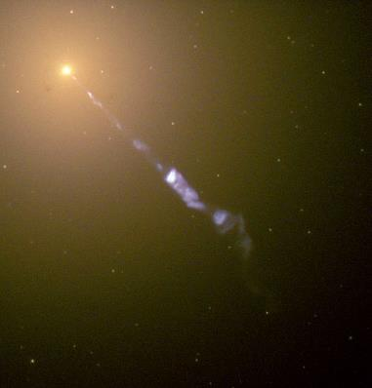
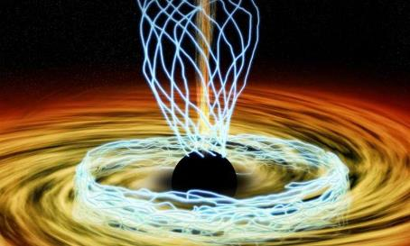
Galaxy M87
6 billion solar mass black hole
Powerful jets ejecting gas beyond the galaxy

Slide 21
Thank You! – Ευχαριστώ!!
Dave Fish
PI Teacher-in-Residence Emeritus
dfish@perimeterinstitute.ca
@DaveFishPI
Olga Michalopoulos
PI Teacher Network Lead for Greece
omichalopoulos@gmail.com

