Slide 1

Expanding Universe
Perimeter Explorations 04
Notes:
The main idea of this presentation is subversive physics. Many of these topics include connections to modern physics using classical activities.

Slide 2
Why is the Sky Dark?
Download the video at: https://resources.perimeterinstitute.ca
Notes:
Click to launch “Why is the sky dark?”
https://www.youtube.com/watch?v=iKTv-BDZ8Os&list=PL224464F48007F658&index=2

Slide 3
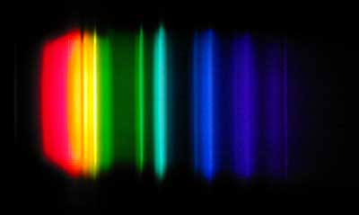
Signature of the Stars: Overview
Spectra in the Lab
Analyzing Stars
Hubble’s Law
Age of the Universe

Slide 4
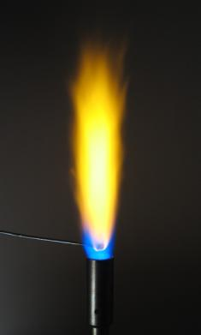
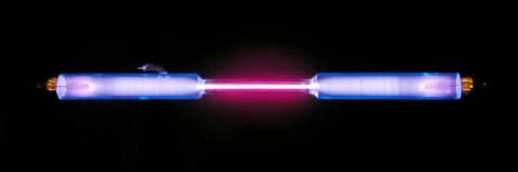
Spectra In the Lab
When elements get excited they release light…

Slide 5
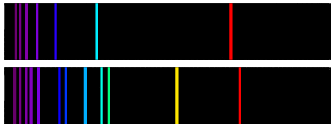
Spectra In the Lab
Every element has a unique spectral signature…
H
He

Slide 6

Spectra In the Lab
1a. Can you identify the elements in the unknown mixtures?
H
H
H
Na
H
H
Na

Slide 7

Spectra In the Lab
1b. Can you identify the elements in the unknown mixtures?
H
He
H
Li
He
H
H
He
He
Li
Li
He
He
H
He
Li

Slide 8
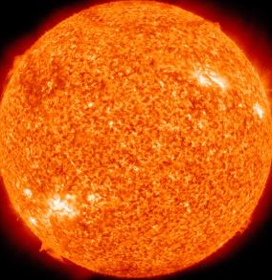

Analyzing Stars
Our sun is a big ball of hot gas…

Slide 9
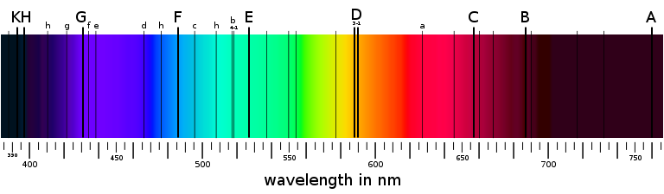
Analyzing Stars
If we look at the light from the sun, we observe the following spectrum:
…but why are the lines dark?

Slide 10
Analyzing Stars
Using the spectra of absorption lines from the Sun, we can infer which elements are present in its outer layers.
C&F - Hydrogen
H&K - Calcium
D - Sodium
G - Iron & Calcium
E - Iron

Slide 11
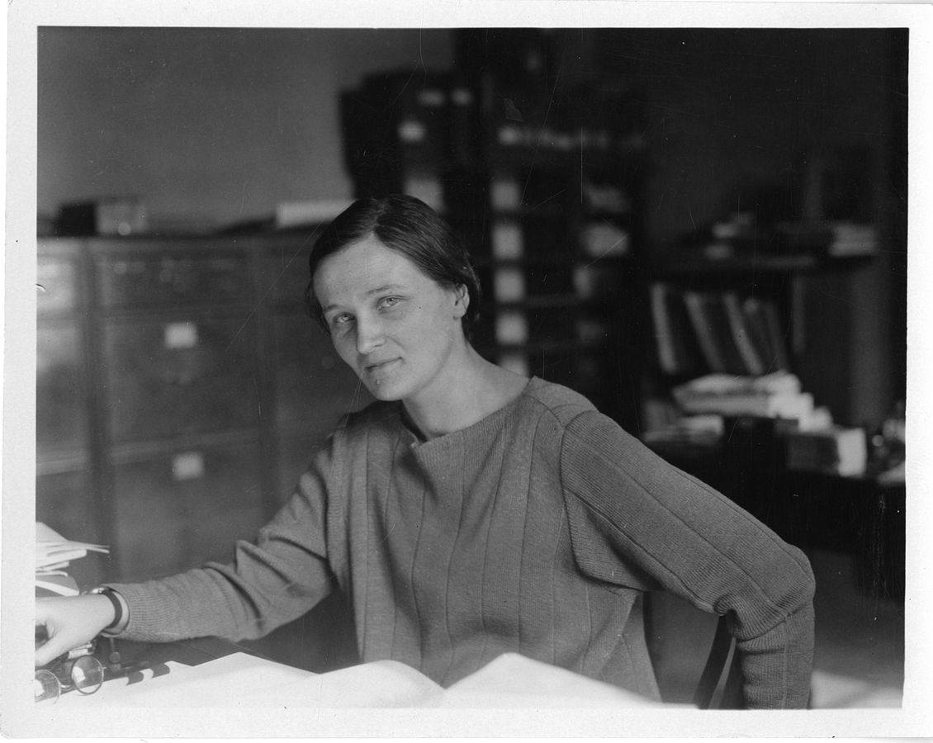
Cecilia Payne-Gaposchkin
From Smithsonian Institute
Notes:
OH WAIT LET ME TELL YOU ABOUT CECILIA PAYNE.
Cecilia Payne’s mother refused to spend money on her college education, so she won a scholarship to Cambridge.
Cecilia Payne completed her studies, but Cambridge wouldn’t give her a degree because she was a woman, so she said to heck with that and moved to the United States to work at Harvard.
Cecilia Payne was the first person ever to earn a Ph.D. in astronomy from Radcliffe College, with what Otto Strauve called “the most brilliant Ph.D. thesis ever written in astronomy.”
Not only did Cecilia Payne discover what the universe is made of, she also discovered what the sun is made of (Henry Norris Russell, a fellow astronomer, is usually given credit for discovering that the sun’s composition is different from the Earth’s, but he came to his conclusions four years later than Payne—after telling her not to publish).
Cecilia Payne is the reason we know basically anything about variable stars (stars whose brightness as seen from earth fluctuates). Literally every other study on variable stars is based on her work.
Cecilia Payne was the first woman to be promoted to full professor from within Harvard, and is often credited with breaking the glass ceiling for women in the Harvard science department and in astronomy, as well as inspiring entire generations of women to take up science.
Cecilia Payne is awesome and everyone should know her.

Slide 12
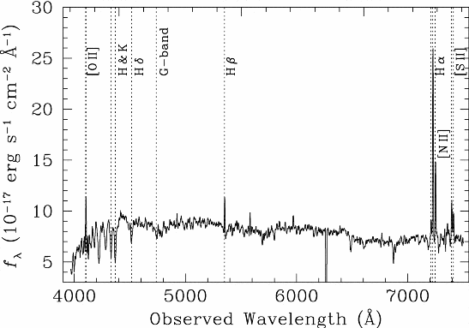
Galaxies have spectra too!

Slide 13
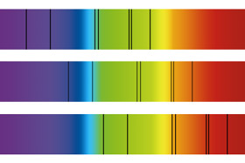
Hubble’s Law
If we look at galaxies at different distances, we notice something strange:
…why have the lines moved?

Slide 14
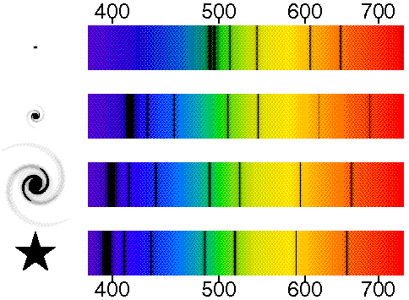
Hubble’s Law
As we look farther away, the lines shift toward the red end of the spectrum

Slide 15
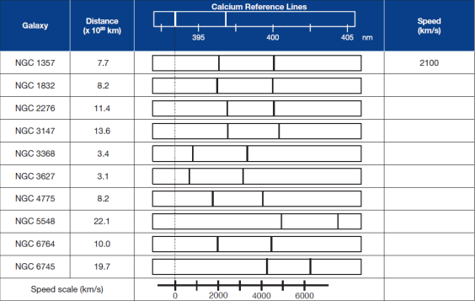
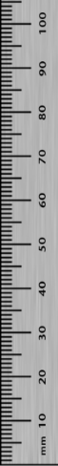
Hubble’s Law
Use a ruler to measure the red-shift and infer information about a galaxy’s relative velocity.

Slide 16
Hubble’s Law

Slide 17
Hubble’s Law
The farther a galaxy is from us, the faster it seems to be traveling.
This line can be described with the following equation:

Slide 18
Hubble’s Law (typical high school text)
FARTHER = FASTER
Thinking of the red-shift as a Doppler Effect introduces a misconception that the galaxies are “moving” through space.
Notes:
Current value:
H₀ = 67.15 km/s/Mpc (+/- 1.2)

Slide 19

Cosmological Red Shift
Doppler Effect is NOT the best explanation

Slide 20


Cosmological Red Shift
What happens to the wave as the medium stretches?

Slide 21
Hubble’s Law (deeper insight)
REDDER = OLDER
Greater red-shift is evidence that the light has been in transit for a longer period of time, so space has expanded more (stretching the light with it).
The red-shift is actually a measurement of TIME!
Notes:
Current value:
H₀ = 67.15 km/s/Mpc (+/- 1.2)

Slide 22
Hubble’s Law (deeper insight)
The Hubble parameter, H₀, is the rate of expansion.
If we run the expansion backwards, we can estimate the age of the universe…
Notes:
Current value:
H₀ = 67.15 km/s/Mpc (+/- 1.2)
Estimate of age based on Hubble ignores the effects other parameters like dark matter and acceleration.

Slide 23
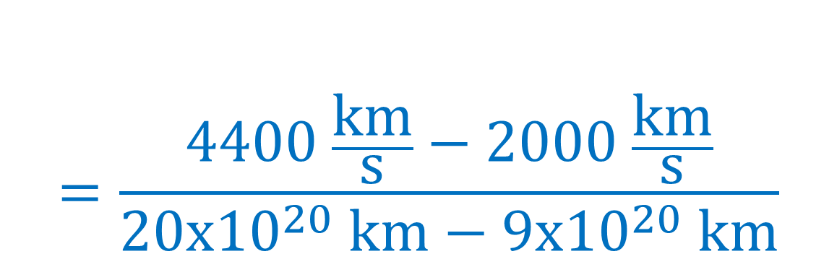


Hubble’s Law
$$H_{0}=\frac{∆v}{∆d}$$
$$=\frac{4400 \frac{\text{km}}{\text{s}}−2000 \frac{\text{km}}{\text{s}}}{20\text{x}{10}^{20} \text{km}−9\text{x}{10}^{20} \text{km}}$$
$$=2.2\text{x}{10}^{−18} \text{s}$$

Slide 24
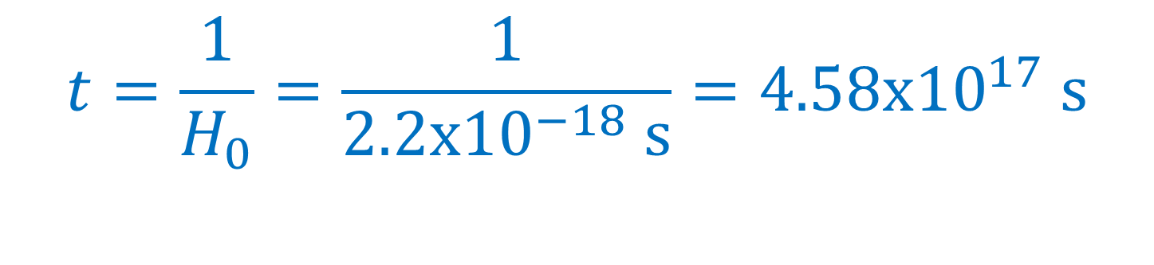

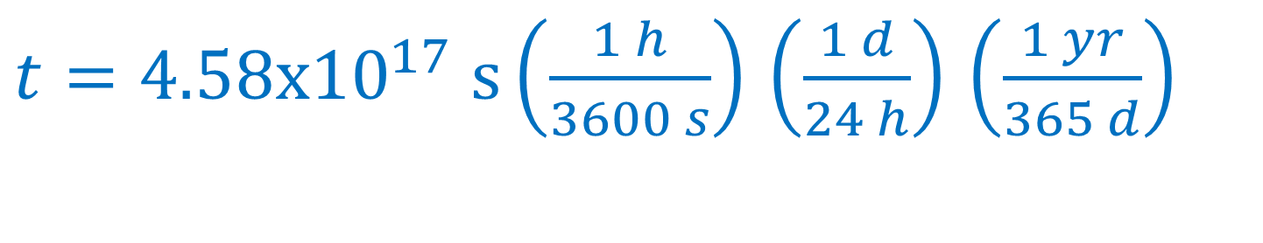
Hubble’s Law
$$t=\frac{1}{H_{0}}=\frac{1}{2.2\text{x}{10}^{−18} \text{s}}=4.58\text{x}{10}^{17} \text{s}$$
$t=4.58\text{x}{10}^{17} \text{s}\left(\frac{1 h}{3600 s}\right)$ $\left(\frac{1 d}{24 h}\right)$ $\left(\frac{1 yr}{365 d}\right)$
$$t=14.5\text{x}{10}^{9} yr$$
Not bad…current value is 13.82x10⁹
Notes:
The correction factor F is computed to be about 0.956 which would make our answer 13.86 billion years

Slide 25
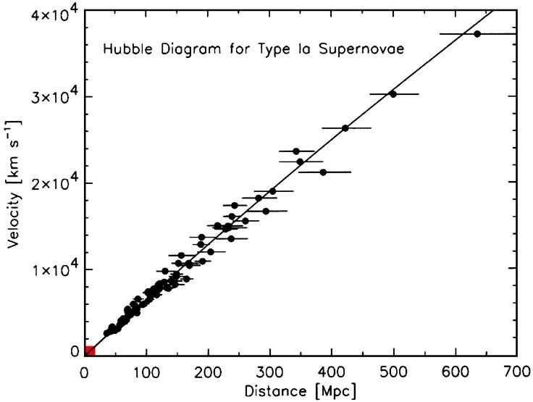
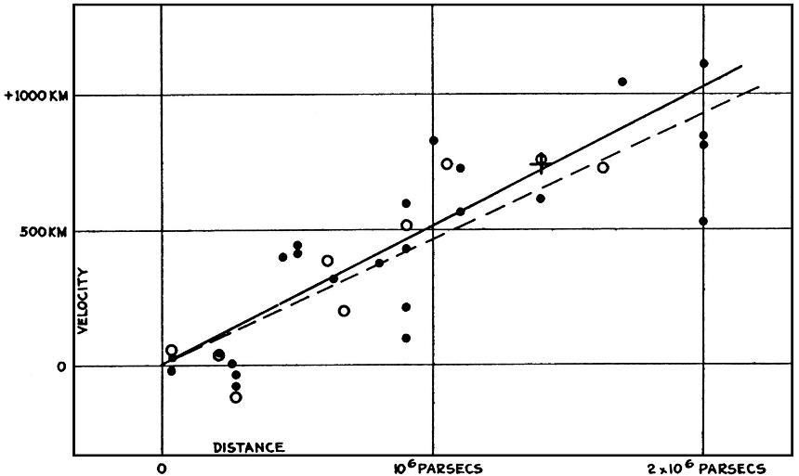
Notes:
Hubble’s original plot. Note two things: y-axis is mislabeled (wrong units) and nearby galaxies are actually blue-shifted.
https://www.pnas.org/content/101/1/8

Slide 26
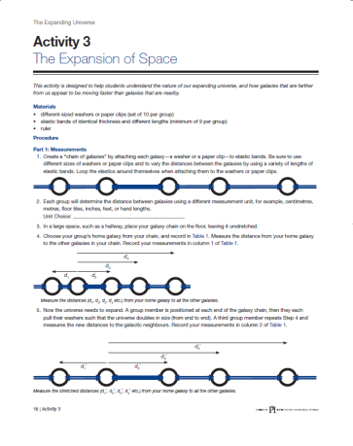
Activity 3: The Expansion of Space
Demonstrates the expansion of a one dimensional universe using a simple model of washers attached with elastics
Students confront misconceptions about the expansion of our actual universe

Slide 27
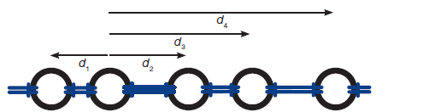
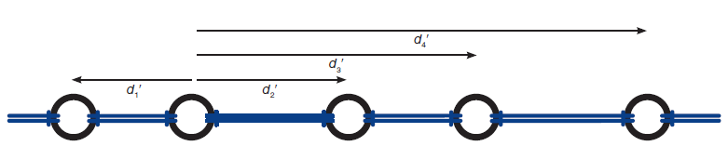
Activity 3: The Expansion of Space
Early Universe:
Later Universe (double the length):

Slide 28
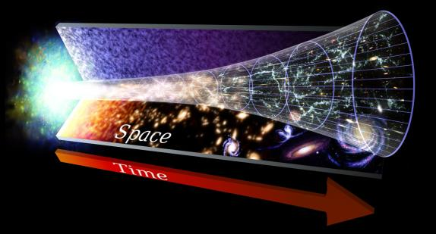
Activity 3: The Expansion of Space
Misconceptions
List three misconceptions that your students might have when thinking about the expansion of space.

Slide 29
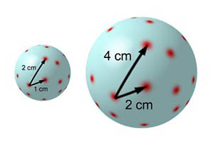
Models for Expansion
Balloon analogy can introduce misconceptions

Slide 30


POE: Where is the Centre?
The universe in the past…

Slide 31
POE: Where is the Centre?
The universe now…

Slide 32
POE: Where is the Centre?
Everything is moving away from us

Slide 33
POE: Where is the Centre?
Choose another viewpoint…

Slide 34
POE: Where is the Centre?
Or another viewpoint…

Slide 35
POE: Where is the Centre?
Or another…

Slide 36


POE: Where is the Centre?
It doesn’t matter where you are… everything else is moving away from you
There is NO CENTRE!!

Slide 37
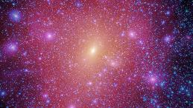
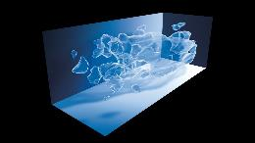

PI Resource Centre
The Expanding Universe
Mystery of Dark Matter
https://resources.perimeterinstitute.ca/
Notes:
Visit the website and show the teachers how to download the resources

Slide 38
Thank You! – Ευχαριστώ!!
Dave Fish
PI Teacher-in-Residence Emeritus
dfish@perimeterinstitute.ca
Olga Michalopoulos
PI Teacher Network Lead for Greece
omichalopoulos@gmail.com

