Slide 1

Hands-On Wave-Particle Duality
The Challenge of Quantum Reality
Notes:
DONE

Slide 2
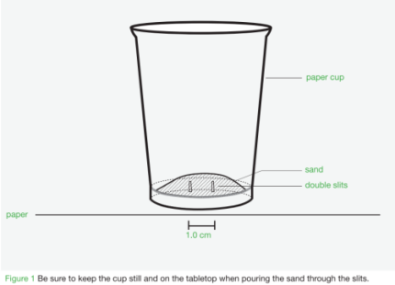
Double Slit with Classical Particles (POE)
Sketch your prediction and provide three (3) phrases describing why you think this will happen.
Notes:
(2-3min) BEFORE starting the activity, talk about the effectiveness of the whiteboards. They are safe, easy, and engaging for the students. They get the students thinking about the task at hand so their perceptions can be challenged or confirmed. The students, however, must be accountable for their work. It is important to develop some sort of “check” system to keep them focused and engaged.
Distribute the worksheets and advise the participants as to what will happen. Get them to make a prediction about how the sand will fall from the cup and encourage them to provide three words to describe the nature of a particle behaviour using their whiteboards.
Development of vocabulary is very important. When they have made their predictions, they can come to the front to verify they have made a prediction with the instructor, and then receive the equipment to complete the activity. Let them complete the first part of the activity.

Slide 3
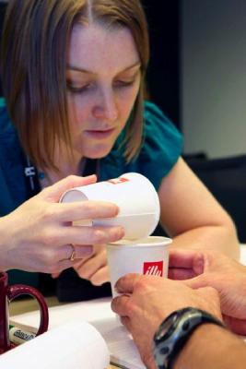
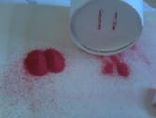
Double Slit with Classical Particles (POE)
Classical particles…
  collide
  localized
Notes:
(15min)
Encourage the participants to perform the experiment several times to obtain several data sets. Identify and trouble shot systematic errors. The cup should sit flat on the table and the participants just need to tap the sides. See how the volume of sand used makes a difference.
After about 10 min, summarize the activity as a group (especially question #4). Develop the vocabulary as a class using the words from their whiteboards from earlier.
Develop a Particle Behaviour Model including vocabulary (collide, localized) and illustrations
Briefly talk about the effectiveness of the POE teaching strategy.

Slide 4
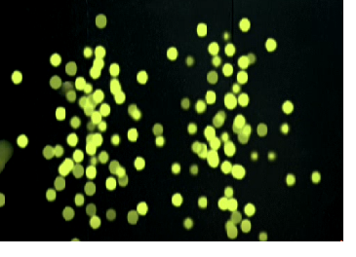
Particle Model of Nature
What is a particle?
Localized object
Only in one place at a time
Can bounce off other particles
Notes:
Here are the summaries of the built vocabulary.

Slide 5
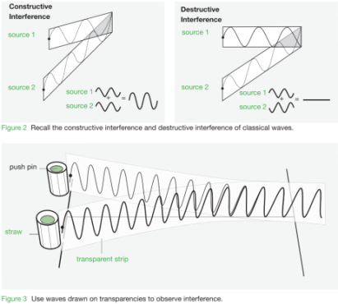
Double Slit with Classical Waves (POE)
Sketch your prediction and provide three (3) phrases describing why you think this will happen.
Notes:
(10-15min) Using the same procedure as before, ask the participants to make a prediction of how waves would look when passing through the double slits. Ask for three describing words again.
When participants have completed their predictions, they can be validated by the instructor and then obtain their equipment to verify their model and answer the questions on the sheet.

Slide 6
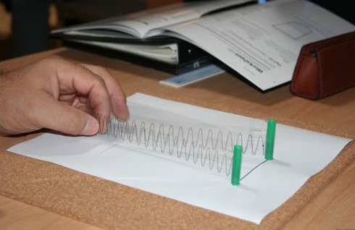
Double Slit with Classical Waves (POE)
Classical waves…
  interfere
  non-localized
Notes:
After 8-10min, summarize their findings (especially question #4). Develop vocabulary that described classical waves.

Slide 7
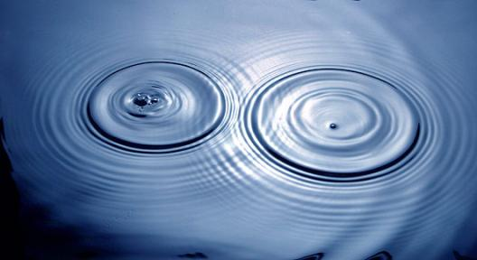
Wave Model of Nature
What is a wave?
Non-localized
Spread out
Add together to produce interference
Notes:
Explain the vocabulary above.

Slide 8
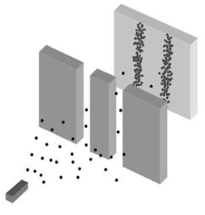
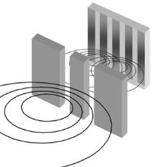
Summary
Particles Waves
Localized
One place at a time
Can bounce off other particles
Non-Localized
Spread out
Add together to produce interference
Notes:
Summarize the two concepts. Recap the vocabulary.

Slide 9
Electrons Through the Double Slits
What model do you think the electron will most closely follow?
What should happen if we pass electrons through the two slits?
Notes:
(5min) Using the whiteboards, ask the participants to predict which model the electrons should adhere to. Get them to predict which pattern will result on the screen.

Slide 10
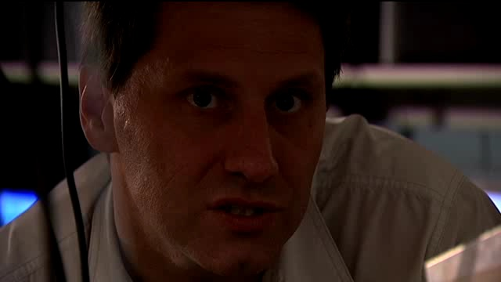
Double Slit with Electrons
Notes:
Challenge the students to explain what they saw. Which model is it behaving as? Begin to develop the concept of wave-particle duality and how the electrons can behave using both models.

Slide 11
Double Slit with Electrons
Download the video at: https://resources.perimeterinstitute.ca
Notes:
Video

Slide 12
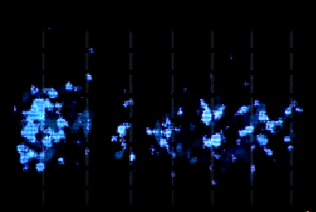
Double Slit with Electrons
Notes:
Video

Slide 13
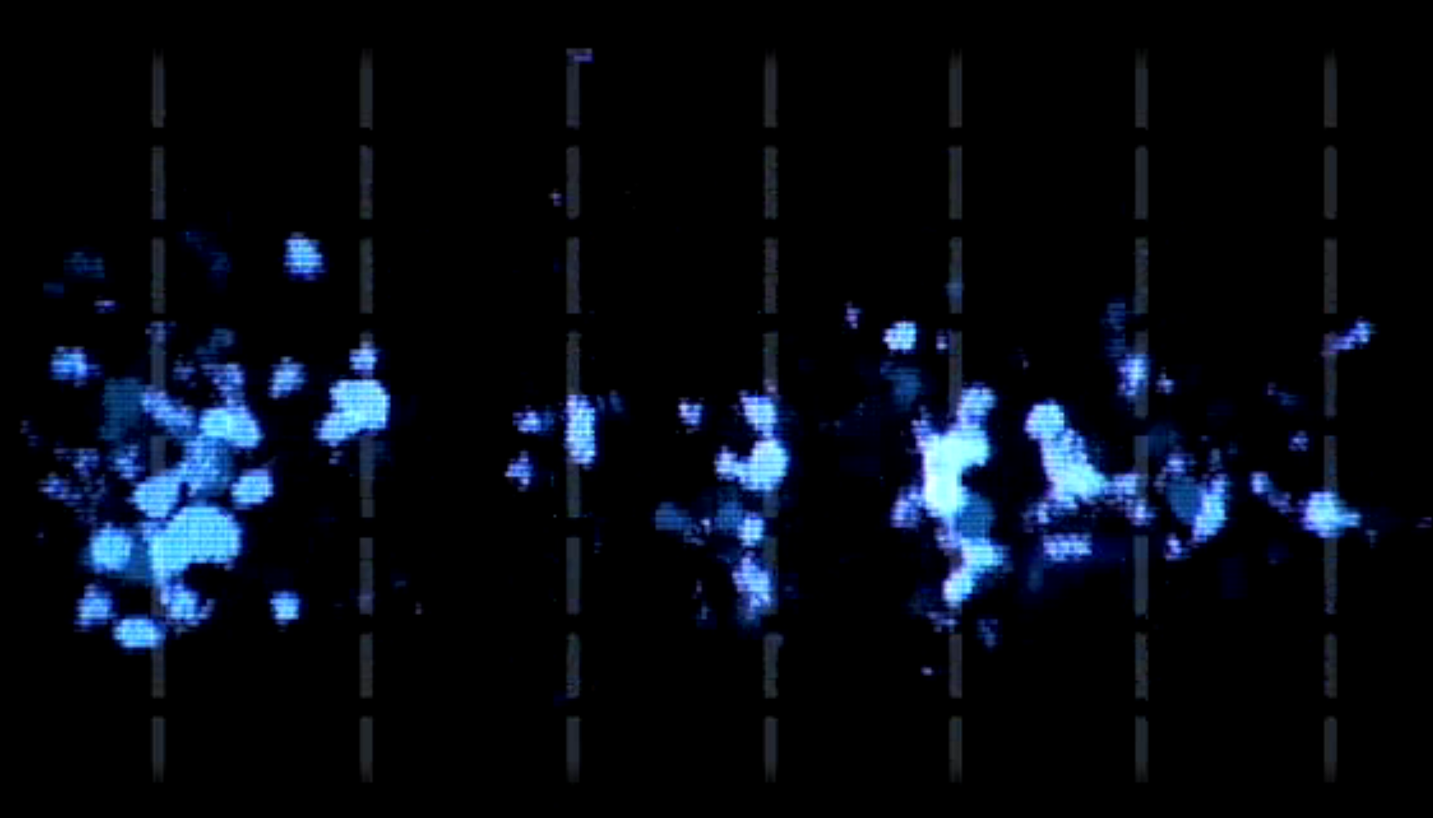

Slide 14
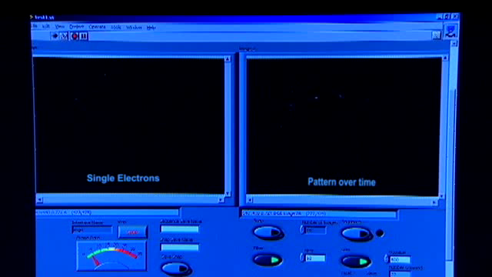
Double Slit with Electrons
Notes:
Is there any way to test the above models for the electrons? Be sure to relate the results to the vocabulary mentioned earlier. (Hopefully one student recommends passing the electrons through one at a time, to see if they are localized). After that recommendation, play the video on the following slide, where only one electron is sent through at a time.

Slide 15
Double Slit with Electrons
Download the video at: https://resources.perimeterinstitute.ca
Notes:
Video. The electrons still act as waves.

Slide 16
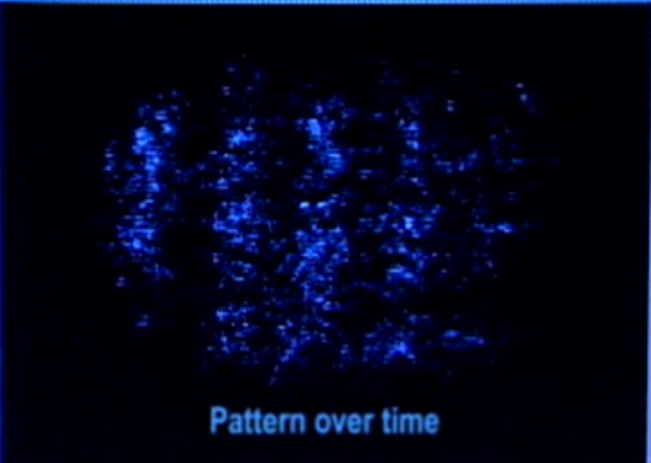

Slide 17
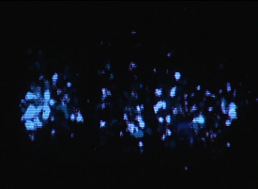
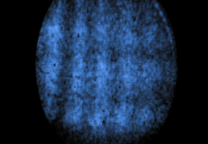
Wave-Particle Duality
Electrons …
leave and arrive individually
arrive at discrete, random locations
produce an interference pattern
Notes:
(5 min) Summary of wave-particle duality.

Slide 18
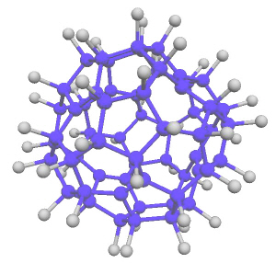
Wave-particle Duality is Universal
Protons
Neutrons
Light
Atoms
Molecules
Fluoro Fullerene: C₆₀F₄₈
Notes:
Since Louis de Broglie's hypothesis that all massive particles should also show wave behaviour, many exciting experiments have studied interference of electrons, neutrons, atoms and molecules. This macro nanomolecule is a fluorous porphyrin, which is composed of 810 atoms and has a molecular mass of 10123 amu.

Slide 19

What is the electron doing?
Notes:
POE for the students to make a model for what the electron is actually doing. Get them to write/draw what they think on the whiteboards.

Slide 20
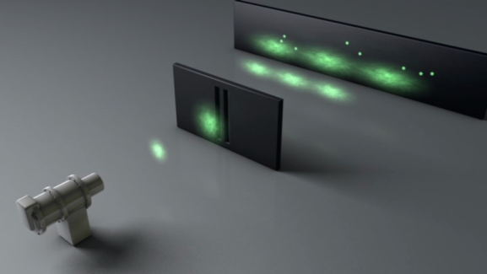
What is your interpretation?
?
?
?
Notes:
All interpretations are explained in the booklet.

Slide 21
Interpretations: Collapse
Notes:
Collapse wave function.

Slide 22
Interpretations: Collapse
Download the video at: https://resources.perimeterinstitute.ca
Notes:
Video

Slide 23
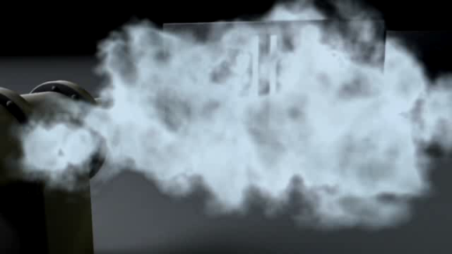
Interpretations: Copenhagen
Notes:
Copenhagen Interpretation

Slide 24
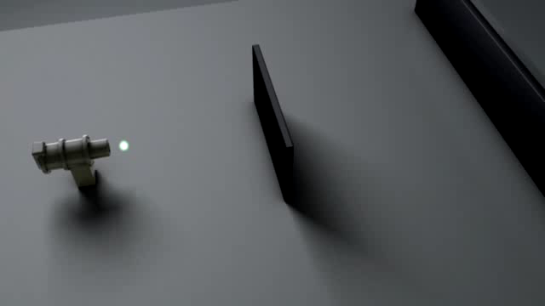
Interpretations: Many Worlds
Notes:
Many Worlds Interpretation

Slide 25
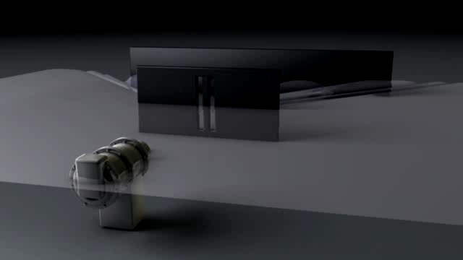
Interpretations: Pilot Wave
Notes:
Pilot Wave Interpretation

Slide 26
Quantum is abstract.
But it’s also the most established scientific model ever.

Slide 27
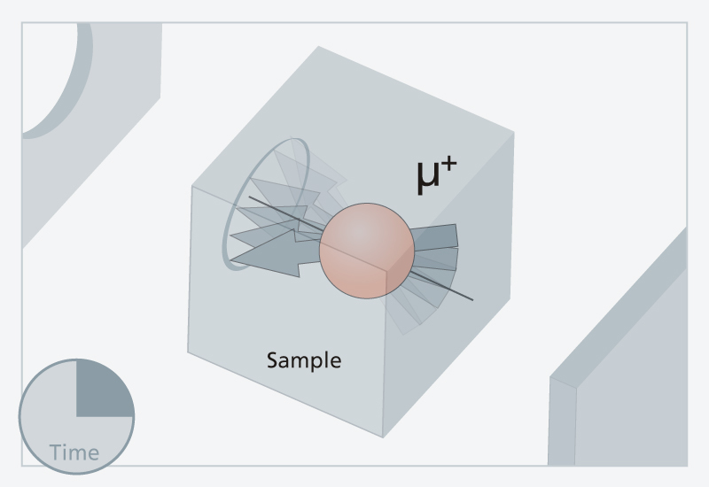

1. Most experimental verified model
e⁻
Magnetic Field Strength of Electron
Quantum Prediction: $0.001 159 652 181 643± 764 × {10}^{−15}$
Observation: $0.001 159 652 180 73 ±280 × {10}^{−15}$
Notes:
In agreement to 1 part in a billion.

Slide 28
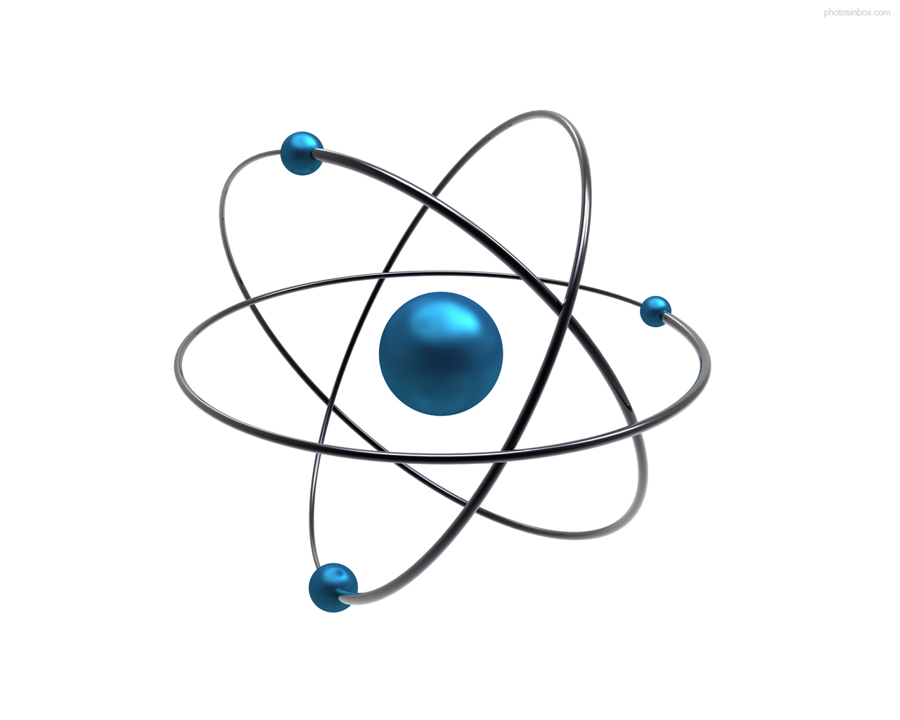
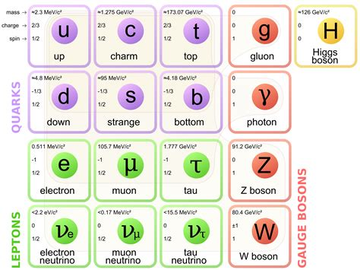
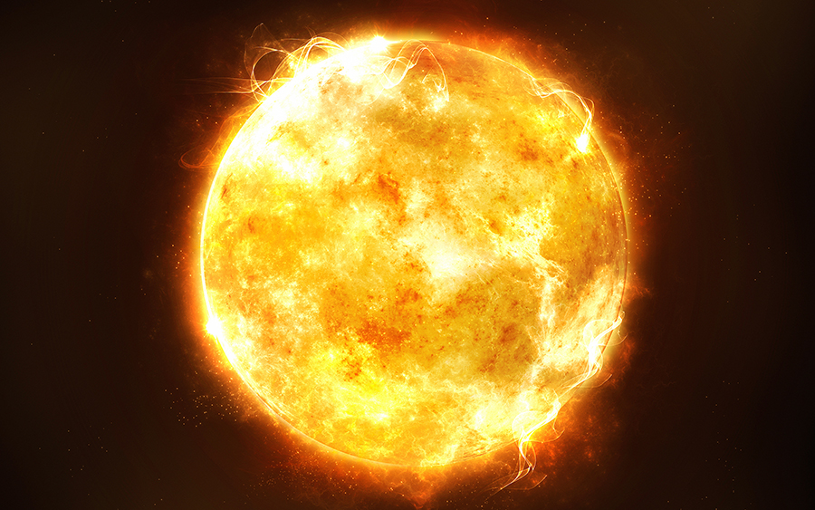
2. Explains more of the world than any other model

Slide 29
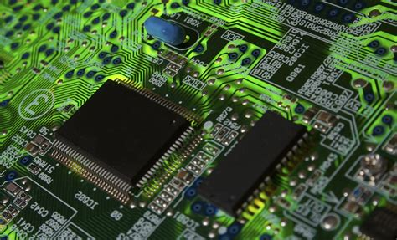
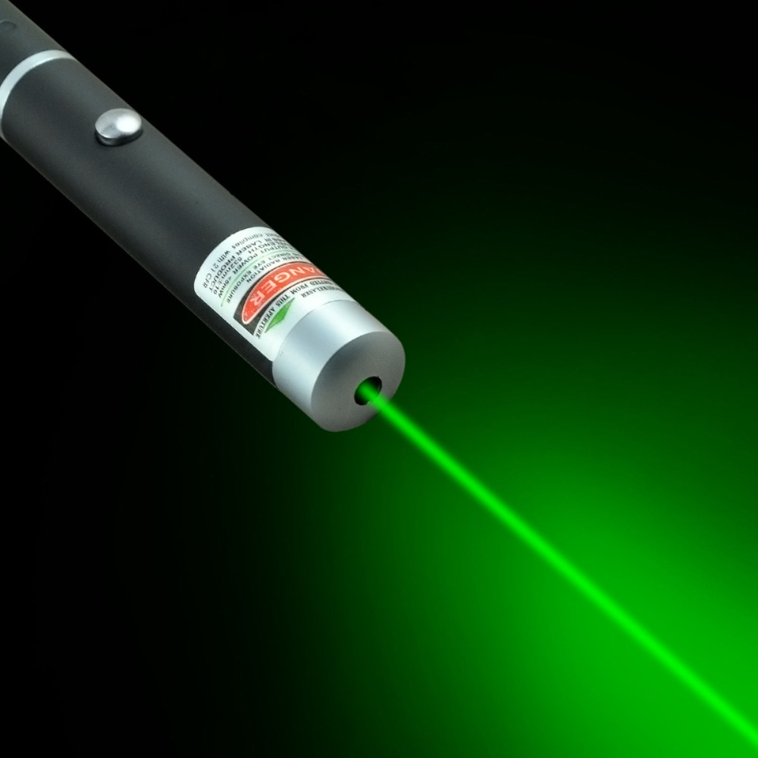
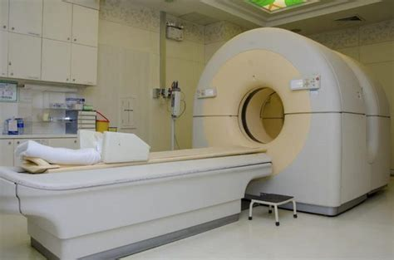
3. Many technological applications
Transistor – computers, cell phones
laser
MRI
garage-door openers
LEDs
smoke detectors
quantum-dot screen displays

Slide 30
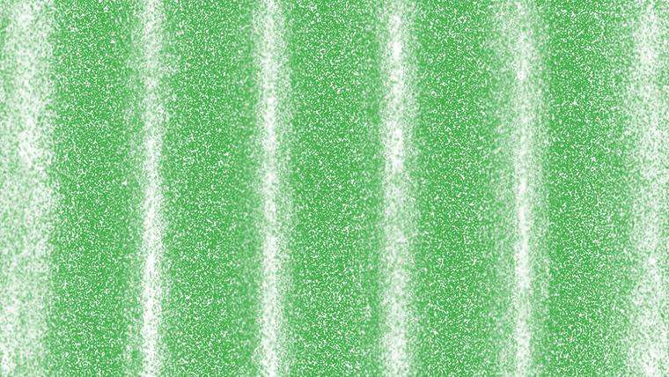
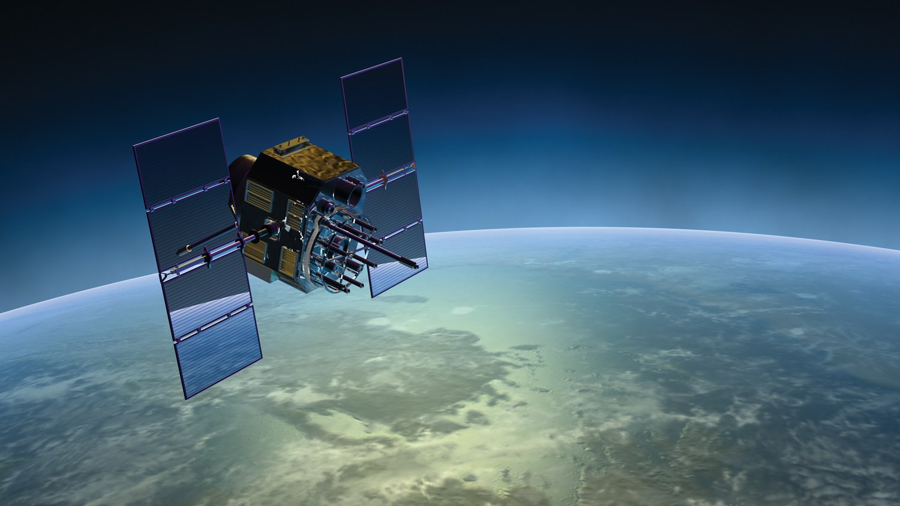

PI Resource Centre
The Challenge of Quantum Reality
Everyday Einstein: GPS & Relativity
https://resources.perimeterinstitute.ca/
Notes:
Visit the website and show the teachers how to download the resources

Slide 31
Thank You! – Ευχαριστώ!!
Dave Fish
PI Teacher-in-Residence Emeritus
dfish@perimeterinstitute.ca
Olga Michalopoulos
PI Teacher Network Lead for Greece
omichalopoulos@gmail.com

